Slide 1
Mining Historical Archives for
Near-Duplicate Figures
Thanawin (Art) Rakthanmanon,
Qiang Zhu,
Eamonn J. Keogh

Slide 2
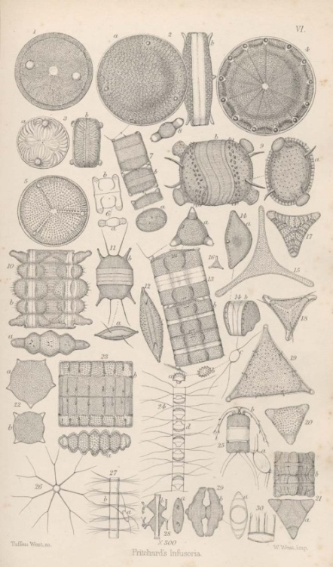
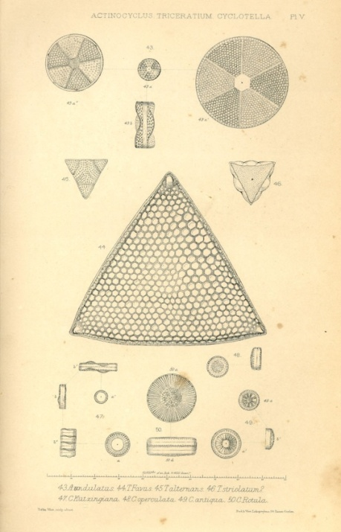
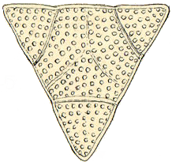
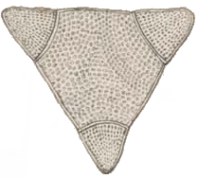
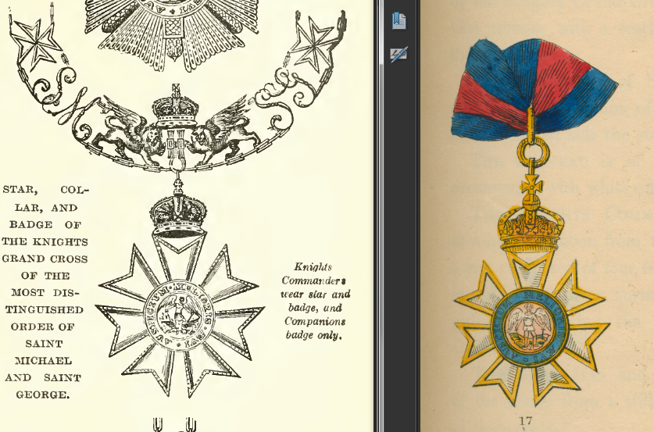
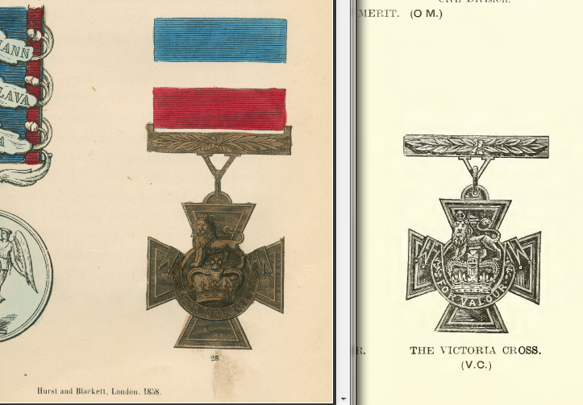
What is a near-duplicate pattern (motif)?
Biddulphia alternans
[15] A history of Infusoria, including Desmidiaceae and Diatomaceae, 1861.
[20] A synopsis of the British Diatomaceae, 1853
[3] Book of Orders of Knighthood and Decorations of Honour of all Nations, 1858.
[6]
[3]
[6] Dod’s Peerage, Baronetage and Knight age of Great Britain and Ireland,1915

Slide 3
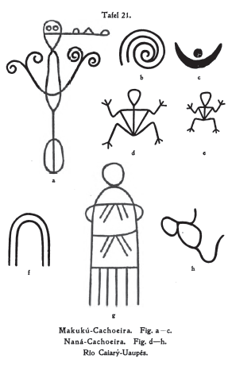
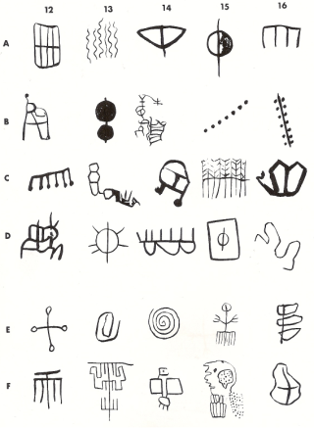
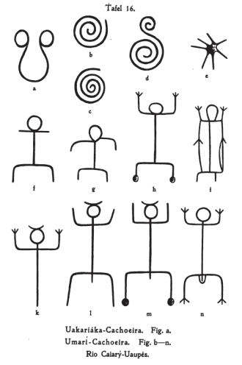
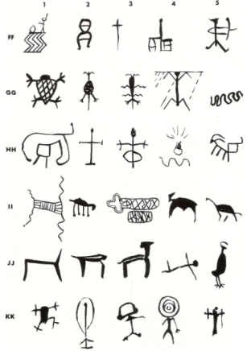
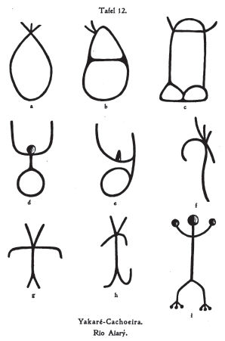
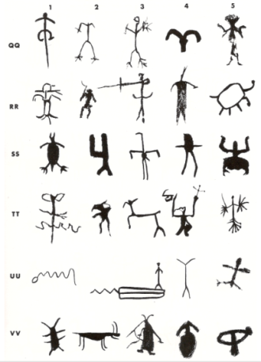












Problem Statement
Given 2 books and user defined parameters (i.e. size of motifs), find similar patterns/figures between these books in reasonable amount of time.
1st book
2nd book
Motifs
[21]
[13]
[21] Indian Rock Art of Southern California with Selected Petroglyph Catalog, 1975.
[13] Südamerikanische Felszeichnungen” (South American petroglyphs), Berlin, 1907.

Slide 4
Problem Statement
Given 2 books and user defined parameters (i.e. size of motifs), find similar pattern/figures between these books in reasonable amount of time.
What is a “reasonable amount of time”?
Given that it can take minutes to hours to scan the books. And, given that this could be done offline (a ‘screensaver’ could work on you personal library at night), we would like to be able to process two books in minutes or tens of minutes.

Slide 5
Related Work
Evolution of Pattern Discoveries
  Transactions: Frequent itemsets (Agrawal 1993)
  Sequences: Frequent sequences (Zaki 1998)
  Time series: Time series motifs (Keogh, Lonardi 2002)
  Documents: Approximate shape motifs
  Shape/Block detection (in Multimedia research area)
  High complexity
  Time consuming
  Cannot scale up to find motifs in books

Slide 6

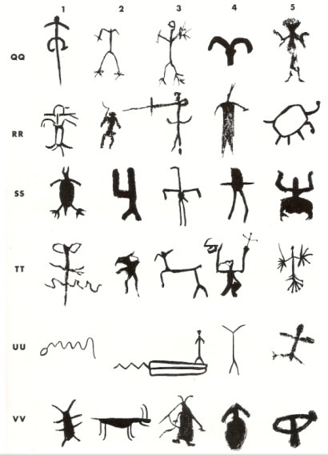
Is it possible to find the exact motif by Brute Force Algorithm?
n
Time series
  Brute Force: Sliding all windows.
  Complexity O(n²m), n=time series length, m=motif length.
  Best known algorithm still requires O(n²m) time in the worst case to find top-1 motif, and O(nmr) time in the best case.
m
Documents
  Brute Force: Sliding all rectangles.
  Complexity O(n⁴m²), n=size of page (width or height), m=size of rectangle.
  If there exists an algorithm to find an exact motif in O(n³) or O(n⁴), the running time is still very huge.
Approximate Motif Discovery
n

Slide 7

Motivation
There are about 130 million books in the world (according to Google 2010).
Many are now digitized.
Finding repeated patterns can ..
  allow us to trace the evolution of cultural ideas
  allow us to discover plagiarism
  allow us to combine information from two sources

Slide 8
Objectives
We propose an algorithm to discover similar patterns inside a manuscript or across 2 books.
Our scalable method consider only shape so input documents can be b/w or color documents.
Our method will return approximately repeated shape patterns in small amount of time.

Slide 9
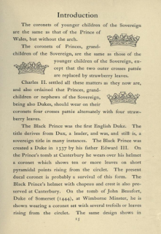
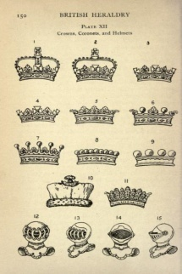
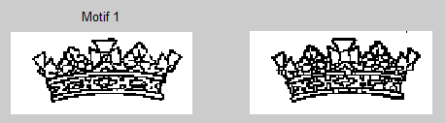
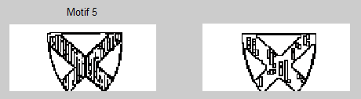
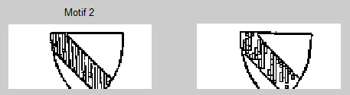
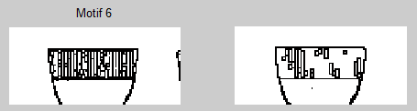
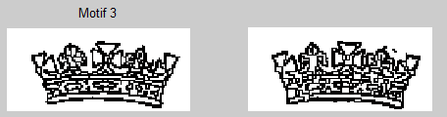
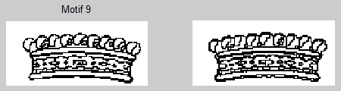
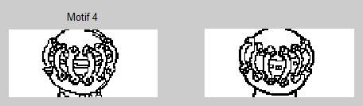

Example Results (1)
25 seconds to find motifs across 2 books of size 478 pages and 252 pages.

Slide 10
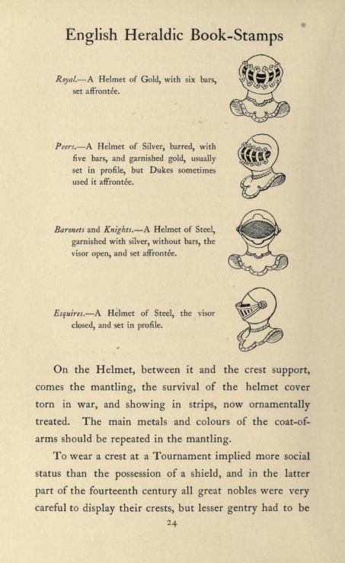
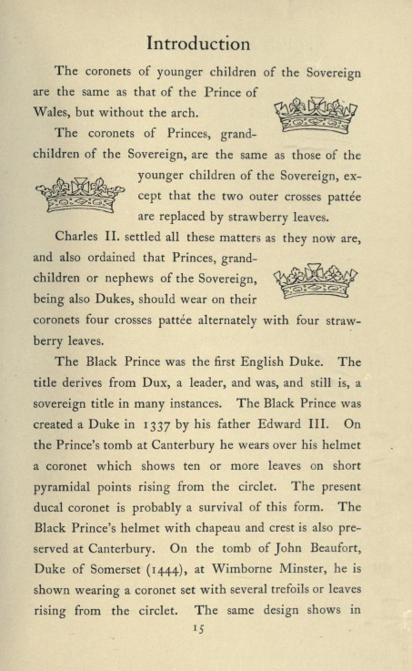

Example Results (2)
[5]
[4]

Slide 11













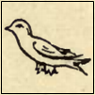










Example Results (4)
Similar figures from 4 different books are discovered.
Book1 [29]: Scottish Heraldry (243 pages)
Book2 [30]: Peeps at Heraldry (110 pages)
Book3 [4]: British Heraldry (252 pages)
Book4 [5]: English Heraldry (487page)
[4]: C. Davenport, British Heraldry, 1907.
[5]: C. Davenport, English heraldic book-stamps, figured and described, 1912.
[29]: G. H. Johnston, Scottish Heraldry made easy, 1912.
[30]: P. Allen Peeps at Heraldry, 1912.

Slide 12
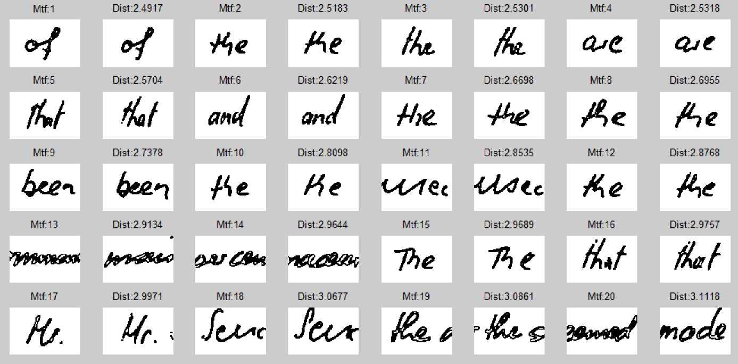
Example Results (5)
Although our algorithm is designed to discovery general shape motifs, it works well for handwritten documents.
[31] IAM dataset

Slide 13
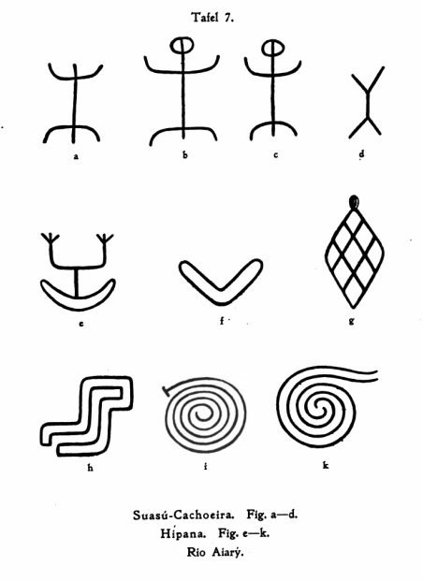
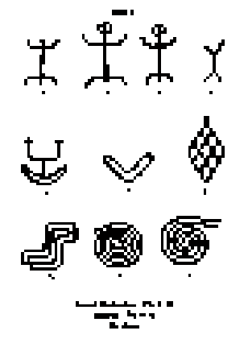
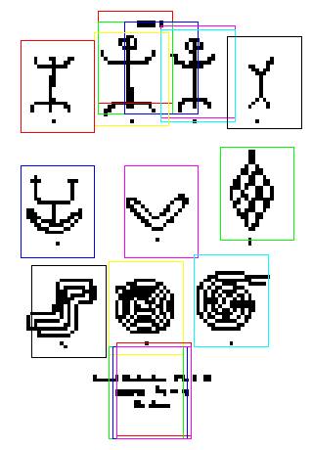




Overview of Proposed Algorithm
1000x1000 pixel²
250x250 pixel²
15 potential windows
Locate
Potential
Windows
Down
Sampling
Hash Signature
Hashing
Compute all pair distances
(GHT distance)

Slide 14
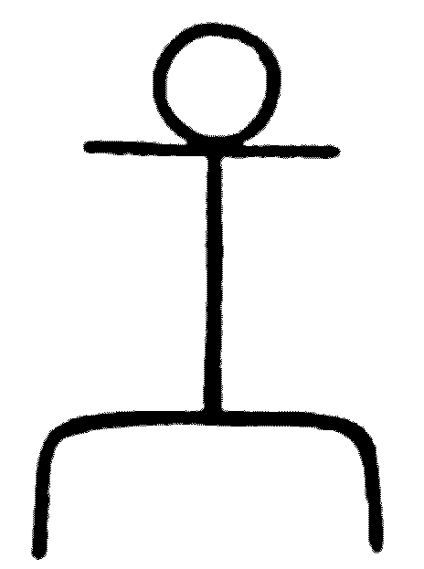
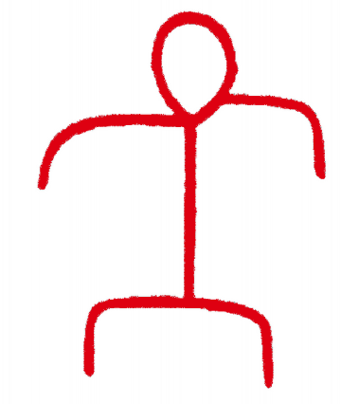

Key Idea 1: Downsampling
Overlap 16%
Overlap 82%
Reduce search space.
Increase the quality of matching.

Slide 15
Key Idea 2: Random Projection
Hashing is an efficient way to reduce the number of expensive real distance calculations.
Mask template
Remove
Enough
Same Signature
Mask template
Remove
Enough

Slide 16
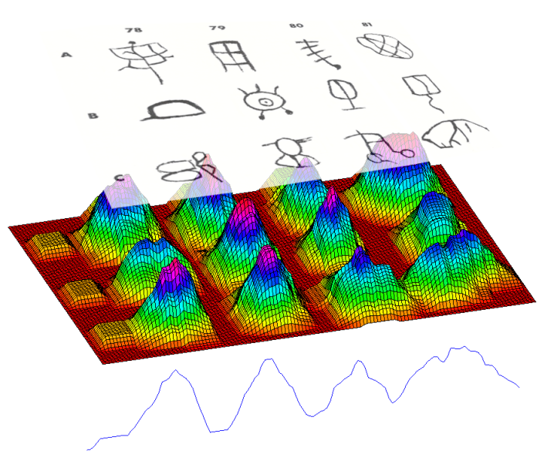
Key Idea 3: Locating Potential Windows
Humans easily locate the position of figures. How?
Our observation ...
Document contain black and white pixels.
Summation number of black pixels around a fix pixel.
Remove noise by threshold and adjust the position.
Search space is reduced from ~20,000 to ~20 potential windows.

Slide 17
Overview of Proposed Algorithm
Locate
Potential
Windows
Down
Sampling
Hash Signature
Hashing
Compute all pair distances
(GHT distance)

Slide 18
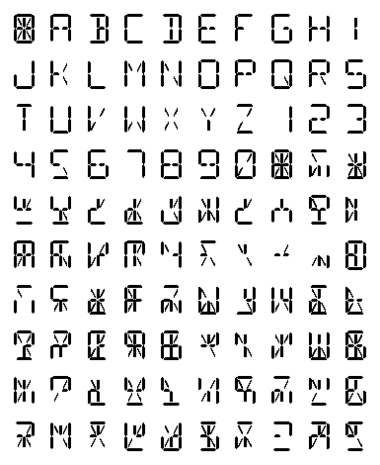
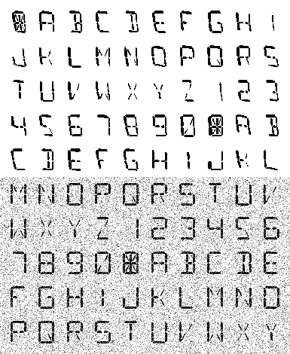


Experimental Results
The performance of our algorithm depends on dataset.
We created artificial “books” to test on.
Each page of book contains 100 random characters.
Each characters contains 14 segments.
Polynomial
Distortion
Gaussian
Noise

Slide 19


Scalability & Robustness
Motifs among 200,000 symbols (2,000 pages) can be found in half an hour.
Var = 0.10

Slide 20
Experimental Results
3.0
4
x 10
2.5
6.9 hours
2.0
Exact Motif (All Windows)
Execution Time (sec)
1.5
1.0
0.5
Exact Motif (Potential Windows)
Approx Motif
5.5 minutes
0
1
2
4
8
16
32
64
128
256
512
Number of Pages
The running time of 3 algorithms:
  The best known exact motif discovery algorithm, MK algorithm (Mueen and Keogh 2006), on all sliding windows.
  The exact motif discovery algorithm on potential windows.
  The proposed algorithm, ApproxMotif.

Slide 21
Parameter Effects: Accuracy
The average distances from top 20 motifs are not much different among different parameter choices.
30
Masking Ratio
25
Mask 50%
20
Mask 40%
Average Distance
Mask 30%
15
Mask 20%
10
A
BruteForce
5
0
2
4
8
16
32
64
128
256
512
30
Hash Downsampling
25
20
HDS=2 (4:1)
Average Distance
HDS=3 (9:1)
15
BruteForce
10
B
5
0
2
4
8
16
32
64
128
256
512
30
Number of Iterations
25
iteration=5
20
iteration=9
Average Distance
iteration=10
15
iteration=11
10
iteration=20
C
BruteForce
5
0
2
4
8
16
32
64
128
256
512
Number of pages

Slide 22
Parameter Effects: Running Time
700
600
Masking Ratio
400
Number of Iterations
500
50%
300
C
Execution Time (sec)
A
11 iterations
400
40%
Execution Time (sec)
300
200
10 iterations
30%
200
20%
100
100
0
0
9 iterations
1
2
4
8
16
32
64
128
256
512
1
2
4
8
16
32
64
128
256
512
Number of Pages
Number of Pages
400
Hash Downsampling
300
B
HDS=3 (9:1)
Execution Time (sec)
HDS=2 (4:1)
200
100
HDS=1 (1:1)
0
1
2
4
8
16
32
64
128
256
512
Number of Pages

Slide 23
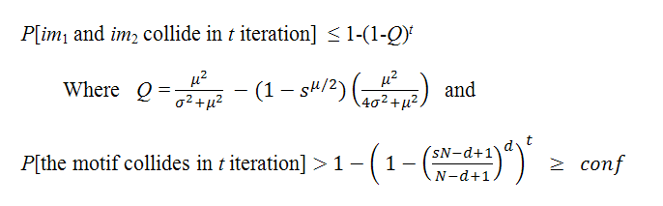
Theoretical Analysis (1)
Assumptions
  Know mean and std of the distance between each pair of windows.
  No assumption on type of distribution, e.g., Gaussian.
Objective
  We guarantee that if the motif will be discovered with probability at least conf (user defined confidence),
  we can bound the maximum probability of false positive (or false collision) occurred in hashing process by:
s – masking ratio
t – number of iterations
d – motif distance
N –windows size

Slide 24
Theoretical Analysis (2)
It is possible to allow the algorithm to set parameters automatically
and guarantee that the motif can be found with 99% confidence.
Probability of Collision
1
Time taken
equivalent to
brute force search
0.8
0.6
Probability of Collision
0.4
d=4
good parameter
Time taken
equivalent to
linear search
Sample motif with d = 4
0.2
0
10
20
30
40
50
60
70
80
90
100
Masking Ratio (%)
Probability of Collision
Time taken
equivalent to
brute force search
0.5
0.4
Probability of Collision
0.3
0.2
d=4
good parameter
Time taken
equivalent to
linear search
0.1
0
1
2
4
6
8
10
12
14
16
18
20
Number of Iterations
Other Parameters: N=400, u=100, sig=10, conf=99%

Slide 25
Limitation
Limited scale invariance (downsampling gives us this).
No rotation invariance.
GHT distance is used as a distance measure.
Require several parameters from user.
  Parameters can be learned if user can provide some annotation.

Slide 26
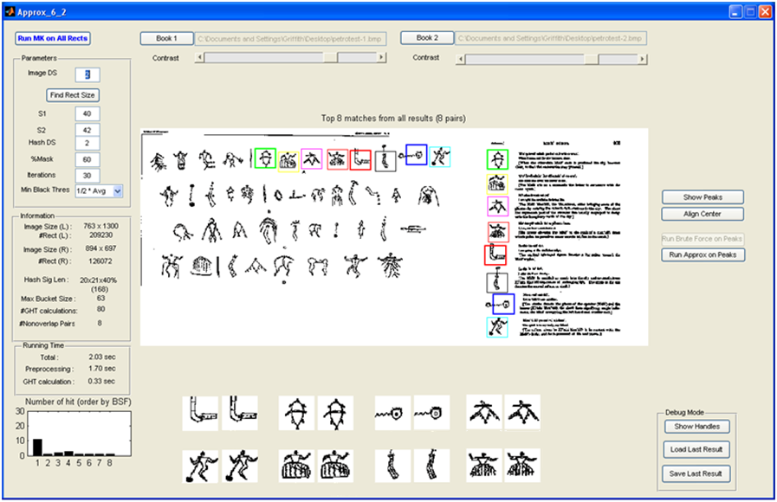
User Interface for our algorithm
Watch vdo demo for 30 sec.

Slide 27
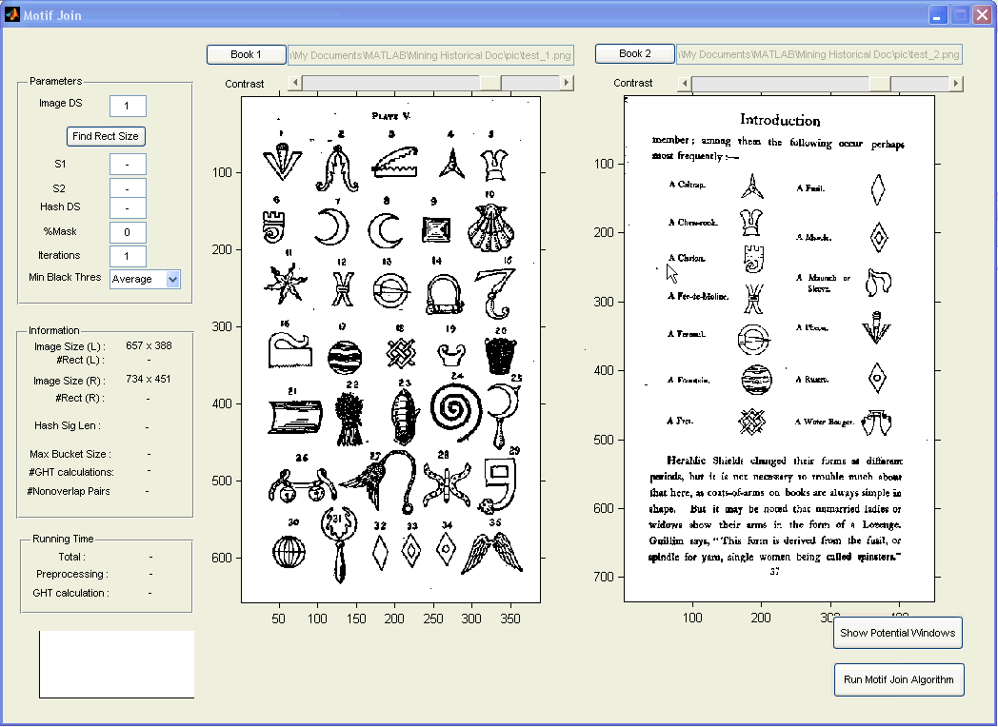

Slide 28
Extended Motifs

Slide 29





Extended Motifs
In previous work, all motifs are in the same size defined by user.
Many times we can find the small repeated pattern in book. If we grow them, we may find the bigger and more interesting motifs.
Watch vdo demo for 30 sec.

Slide 30
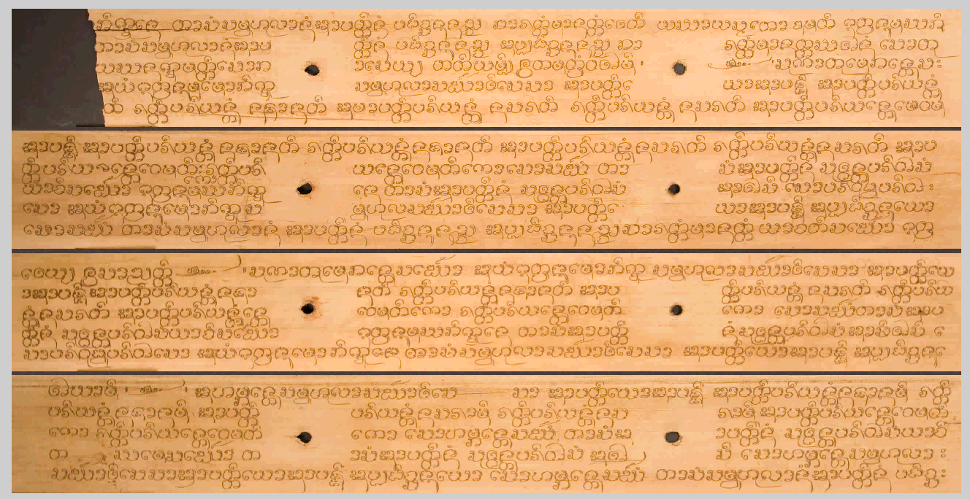
Extended Motifs

Slide 31
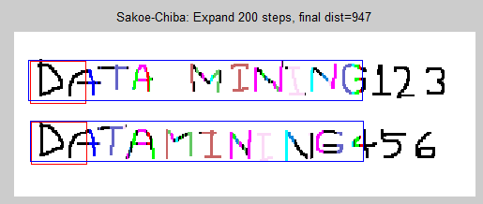
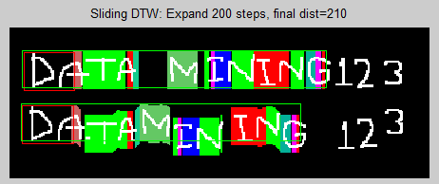
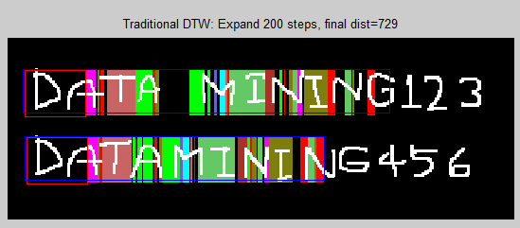
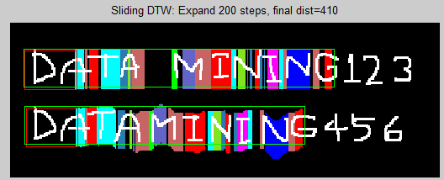
Extended Motifs: Warping
Each window of a seed can grow to different size.
Seed also can slide a bit out of the line.
seed
Another example

Slide 32


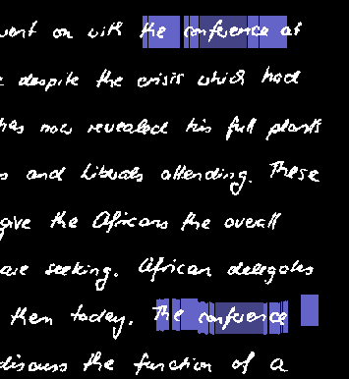
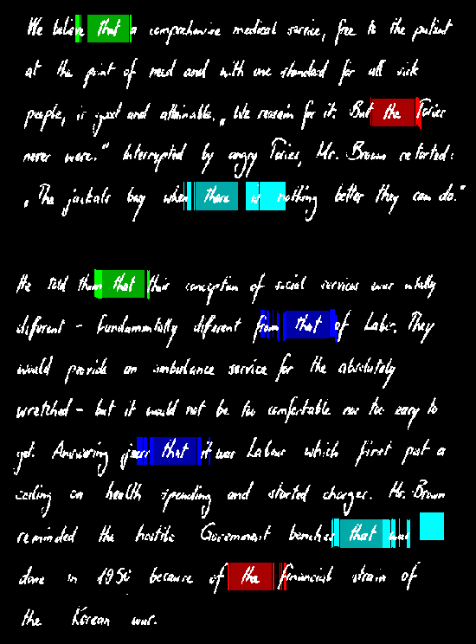

Example Extended Motifs
[31] IAM dataset

Slide 33
References
G. Ramponi, F. Stanco, W. D. Russo, S. Pelusi, and P. Mauro, “Digital automated restoration of manuscripts and antique printed books,” EVA - Electronic Imaging and the Visual Arts, 2005.
J. V. Richardson Jr., “Bookworms: The Most Common Insect Pests of Paper in Archives, Libraries, and Museums.”
A. Pritchard, “A history of Infusoria, including Desmidiaceae and Diatomaceae,” British and foreign. Ed. IV. 968. London, 1861.
W. Smith, “A synopsis of the British Diatomaceae; with remarks on their structure, function and distribution; and instructions for collecting and preserving specimens,” vol. 1 pp. [V]-XXXIII, pp. 1-89, 31 pls. London: John van Voorst, 1853.
W. West, G S.. West, “A Monograph of the British Desmidiaceae,” Vols. I–V. Ray Society, London, 1904–1922.
C. R. Dod, R. P. Dod, “Dod’s Peerage, Baronetage and Knightage of Great Britain and Ireland for 1915,” London: Simpkin, Marshall, Hamilton, Kent and co. ltd, 1915.
J. B. Burke, “Book of Orders of Knighthood and Decorations of Honour of all Nations,” London: Hurst and Blackett, pp. 46-47, 1858.
B. Gatos, I. Pratikakis, and S. J. Perantonis, “An adaptive binarisation technique for low quality historical documents,” Proc. of Int. Work. on Document Analysis Sys., pp. 102–13.
E. Kavallieratou and E. Stamatatos, “Adaptive binarization of historical document images,” Proc. 18th International Conf. of Pattern Recognition, pp. 742–745.
H. J. Wolfson and I. Rigoutsos, “Geometric Hashing: An Overview,” IEEE Comp’ Science and Engineering, 4(4), pp. 10-21, 1997.
X. Bai, X. Yang, L. J. Latecki, W. Liu, and Z. Tu, “Learning context sensitive shape similarity by graph transduction,” IEEE TPAMI, 2009.
E. J. Keogh, L. Wei, X. Xi, M. Vlachos, S. Lee, and P. Protopapas, “Supporting exact indexing of arbitrarily rotated shapes and periodic time series under Euclidean and warping distance measures,” VLDB J. 18(3), 611-630, 2009.
P. V. C. Hough, “Method and mean for recognizing complex pattern,” USA patent 3069654, 1966.

Slide 34
Reference
Q. Zhu, X. Wang, E. Keogh, and S. H. Lee, “Augmenting the Generalized Hough Transform to Enable the Mining of Petroglyphs,” SIGKDD, 2009.
R. O. Duda and P. E. Hart, “Use of the Hough transform to detect lines and curves in pictures,” Comm. ACM 15(1), pp.11-15, 1972.
D. H. Ballard, “Generalizing the Hough transform to detect arbitrary shapes,” Pattern Recognition 13, 1981, pp. 111-122.
M. Tompa and J. Buhler, “Finding motifs using random projections,” In proceedings of the 5th Int. Conference on Computational Molecular Biology. pp 67-74, 2001.
T. Koch-Grunberg, “Südamerikanische Felszeichnungen” (South American petroglyphs), Berlin, E. Wasmuth A.-G, 1907.
A. Fornés, J. Lladós, and G. Sanchez, “Old Handwritten Musical Symbol Classification by a Dynamic Time Warping Based Method. in Graphics Recognition: Recent Advances and New Opportunities,” Lecture Notes in Computer Science, vol. 5046, pp. 51-60, 2008.
G. Sanchez, E. Valveny, J. Llados, J. M. Romeu, and N. Lozano, “A platform to extract knowledge from graphic documents. application to an architectural sketch understanding scenario,” Document Analysis Systems VI, Vol. 3163, pp. 389 -400, 2004.
J. Mas, G. Sanchez, and J. Llados, “An Incremental Parser to Recognize Diagram Symbols and Gestures represented by Adjacency Grammars,” Graphics Recognition: Ten Year Review. Lecture Notes in Computer Science, vol. 3926, pp. 252-263, 2006.
K. B. Schroeder et al., “Haplotypic Background of a Private Allele at High Frequency,” the Americas, Molecular Biology and Evolution, 26 (5), pp. 995-1016, 2009.
G. A. Smith, and W. G. Turner, “Indian Rock Art of Southern California with Selected Petroglyph Catalog,” San Bernardino County, Museum Association, 1975.
C. Davenport, “British Heraldry,” London Methuen, 1912.
C. Davenport, “English heraldic book-stamps, figured and described,” London : Archibald Constable and co. ltd, 1909.
X. Xi, E. J. Keogh, L. Wei, and A. Mafra-Neto, “Finding Motifs in a Database of Shapes,” Prof. of Siam Conf. Data Mining, 2007.

Slide 35

Thank you!

Slide 36
Supplementary

Slide 37
Other Project
w
m
Online Motif Discovery
Complexity: Time Space
Brute Force O(w²m) O(w)
Mueen and Keogh 2006 O(wm) O(w^{3/2})
Lam, Pham,and Calders 2010 O(wm) O(w)
Our algorithm O(w) O(w)
Key Idea:
  Using dynamic programming to save both time and space.

Slide 38
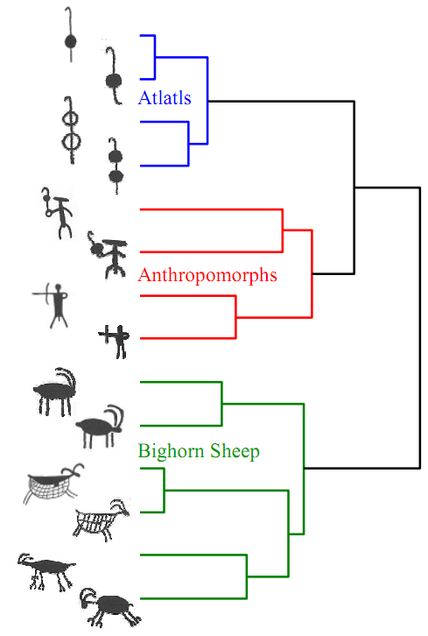
GHT Distance on Petroglyph Dataset
Figure from [14]

Slide 39
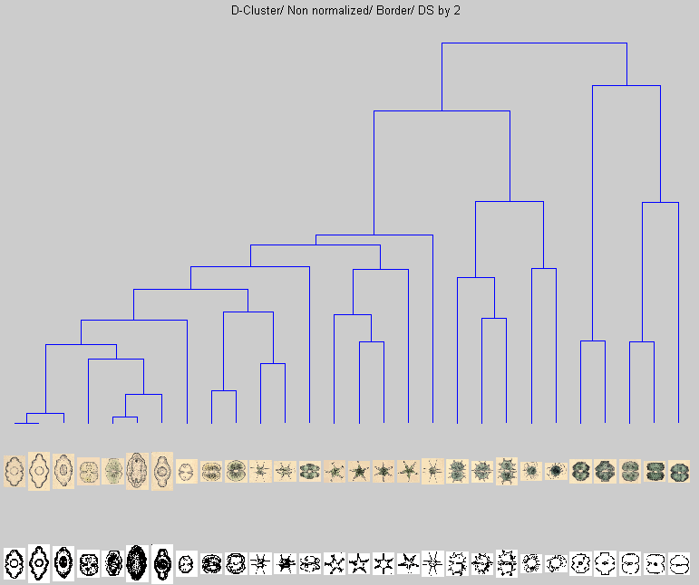
GHT Distance on Diatom dataset

Slide 40
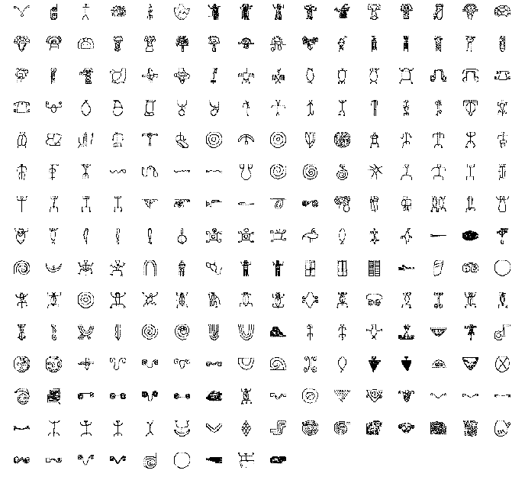

Dataset
1st Book: Selected Petroglyph Catalog
by Wilson G. Turner
(233 images)
2nd Book: Petroglyphs
by Koch-Gruจnberg, Theodor, 1872-1924
(2852 images)

Slide 41
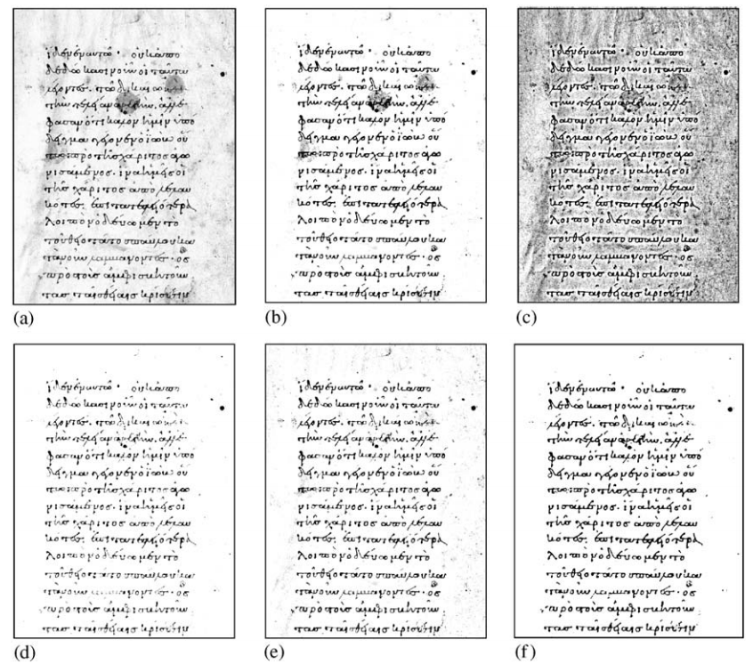
How to binarize documents?
Adaptive degraded document image binarization,
by B. Gatos, I. Pratikakis, and S.J. Perantonis in Pattern Recognition, 2005.

Slide 42
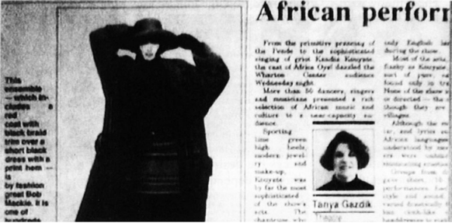
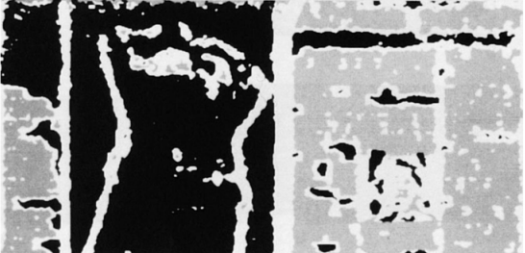


How to remove text? (1)
Jain and Bhattacharjee apply Gabor filter to segment text from a document.
A. K. Jain and S. Bhattacharjee,
Text Segmentatioin Using Gabor Filtor
For Automatic Document Processing,
Machine Vision and Applications, 1992.
Gabor Filter
Figures from Wikipedia

Slide 43

How to remove text? (2)
There is a lot of techniques to do text segmentation from image.
Z. Liu and S. Sarkar, 2008.
Robust Outdoor Text Dection Using
Text Intensity and Shape Features

Slide 44



How to remove text? (3)
N. Nikolaou, M. Makridis, B. Gatos, N. Stamatopoulos, and N. Papamarkos, Segmentation of historical machine-printed documents using Adaptive Run Length Smoothing and skeleton segmentationi paths, Image and Vision Computing, 2009.

Slide 45


More Literatures (1)
Nearest Neighbor based Collection OCR
by K. P. Sankar, C. V. Jawahar, and R. Manmatha in DAS 2010.

Slide 46



More Literatures (2)
M. Cho, Y. M. Shin and K. M. Lee, Unsupervised Detection and Segmentation of Identical Objects, CPVR 2010.
In single image
Across 2 images

