Slide 1
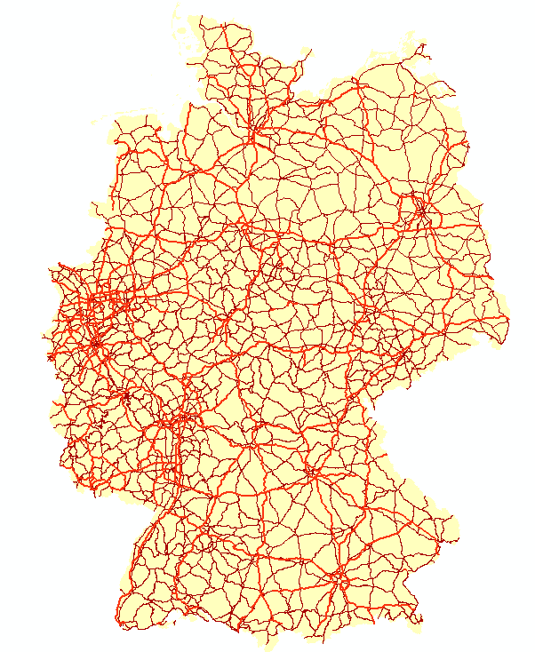
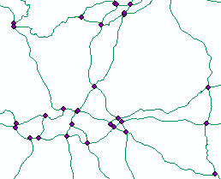
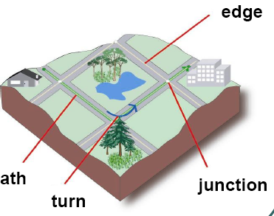
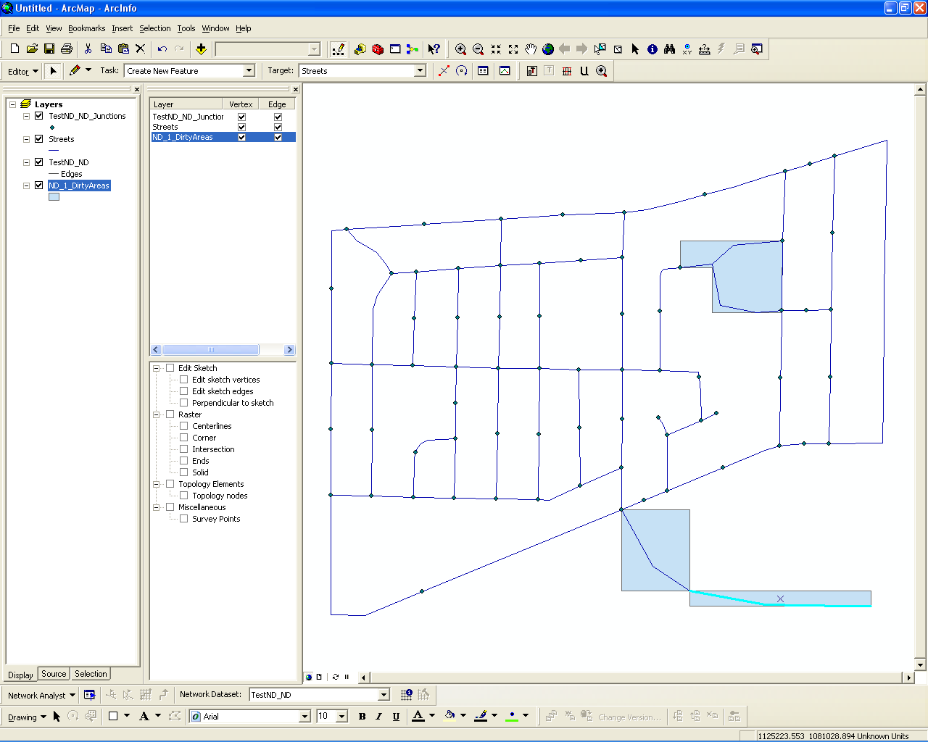
Editing and Versioning Dynamic Network Models
Petko Bakalov*, Erik Hoel*, Wee-Liang Heng* , Vassilis J. Tsotras #
* Environmental Systems Research Institute (ESRI)
# University of California, Riverside
1 Definition
3 Re-establishing connectivity
5 Network Model Versioning
Network Model: A mechanism for defining and managing the connectivity information of spatial features, objects and their relationships.
Re-Building – the process of re-establishing connectivity in the spatial regions where the logical network is stale.
Use the dirty area management concept provided by topology.
When a feature is modified a dirty area is created.
The approach: Detect conflicts between multiple versions and create dirty areas during the reconciliation process.
This process is governed by 4 rules:
Uses an associated logical network (graph) to store connectivity information.
j7
j8
Rule 1
Rule 2
I1
P1
S2
j6
e4
e6
Parent
Parent
S1
j1
e1
j2
e2
j3=P1
e3
j4
I2
e5
Child
Parent
Child
Parent
j5
P1
j7
j8
There are three types of
logical elements
in this graph:
Junctions
Edges
Turns
Problem: As edits are made to the spatial features in a network dataset, the logical network becomes stale.
I1
S2
j6
e4
e6
Reconcile
Rule 3
Rule 4
Reconcile
S1
j1
e1
j2
e2
j3=P1
e3
j4
I2
S3
e5
j5
Parent
Parent
Complete correctness is only guaranteed when the network has been rebuilt over all the dirty areas
Child
Parent
Child
Parent
In the general case, the rebuilding region is only part of the dirty region
2 Mapping between spatial features and logical elements
Reconcile
Reconcile
Rebuilding these regions and objects guarantees that the logical network is correct.
line
edge
edge
6 Implementation
feature
1
1..*
element
1
1
object
The proposed versioning scheme for network models has been prototyped and will be shipped with upcoming ESRI ArcGIS products.
1
2..*
0..*
0..*
4 Versioning
turn
1
1
turn
Versioning: Mechanism for maintaining multiple states in the geodatabase.
Versions can be represented
as a tree rooted at the
Default Version.
Operations:
Create Version
Reconcile
Post
feature
element
1
1..*
2
2
point
0..1
1
junction
1
1
junction
Post
feature
element
object
feature space
logical network space
storage
Reconcile
DEFAULT
Reconcile
Create
version
Create
version
Urban Planning
version
Enviromental
Planing version

