Slide 1
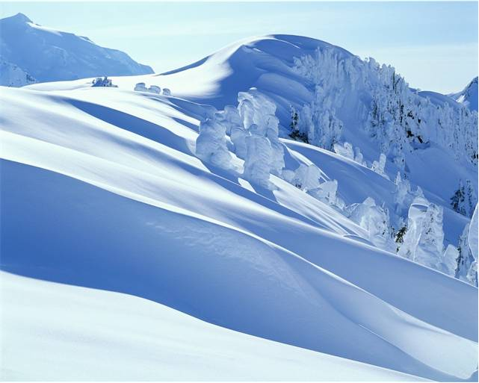
Montagna Del Pattino
Visit Us Today!

Slide 2
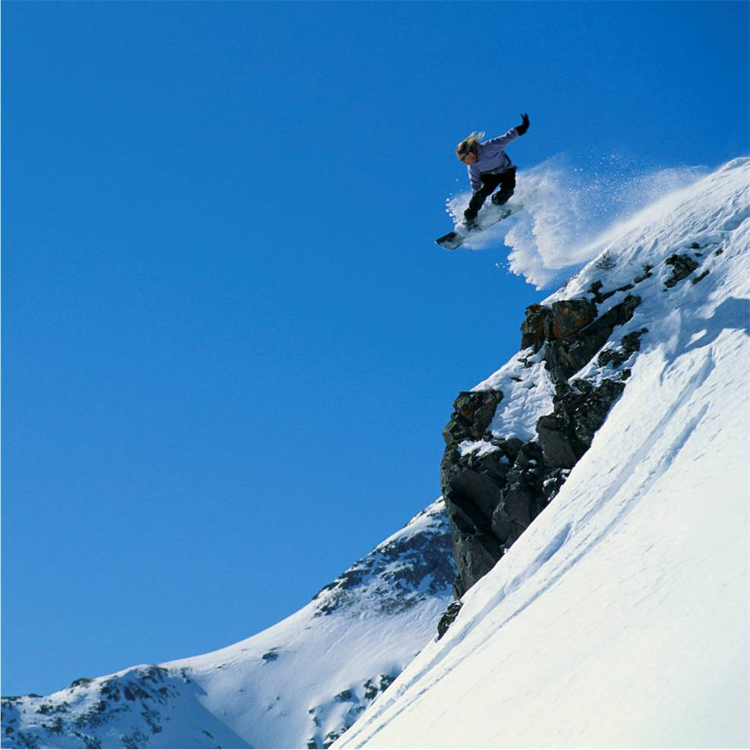
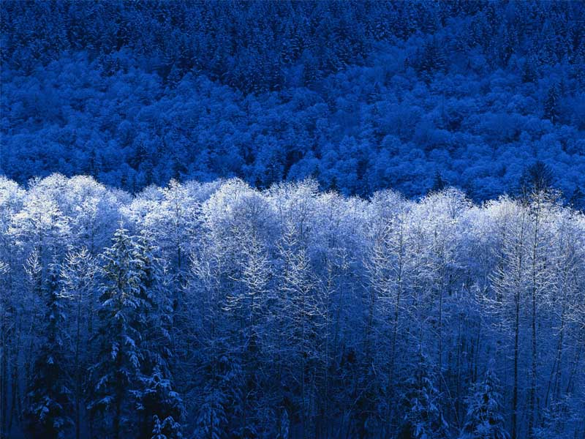
Plan Your Stay
High Energy
Relaxation
Whatever Your Style

Slide 3
Need Some Down Time?
Friday Evening
  Dinner at the Montagna Vista Club
Saturday morning
  Breakfast and gondola ride
Saturday afternoon
  Facial at Pattino Day Spa
  Tour of the Village Gallery and shopping
Saturday evening
  Dinner show at Montagna Vista Club

Slide 4
Come to the Mountain

