Slide 1
Human computation
Gesture CAPTCHA
Jaehoon Kim
Committees : Eamonn Keogh, Stefano Lonardi.

Slide 2
Motivation
There exists a spectrum of resources.
People may be willing to spend from a few seconds up to hours to obtain it.
The resources that need to be physically checked by the user having to go somewhere (Expensive)

Slide 3
Human computation on a common network

Slide 4
Example1: Car tinting violation
Assume, your car windows are too dark, a Police officer warn you.
  The officer said
“At least, I want to recognize people’s faces
inside of your car.”
Now, you need to remove tinting and visit police station on a certain day.
Visiting police station may take several hours.

Slide 5
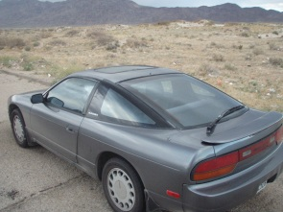
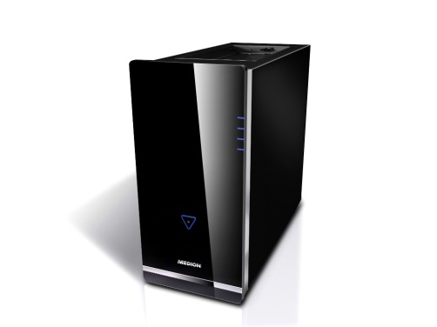
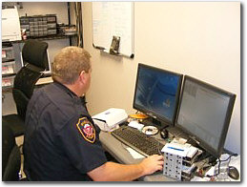
Simple Photo System for
Car tinting violation.
Take your tinting removed car pictures and send it to the police photo system.
This is a very simple example of Human computation.
A officer has to judge photos. It is difficult job as image processing.
It is simple, but highly confidence system.
You need few minutes.
What if violators(users) are 1,000 or 10,000…

Slide 6
Example2: Network voting System
Assume, there are a lot of users.
Each user gets a choice and selects one answer on the voting system.
Finally, the system shows the statistic result of the total vote.

Slide 7
A Typical Network System
The System does not need human computation because a server
automatically counts each user’s choice.
A lot of voters
The sever counts yours selection.

Slide 8
Existence of Black Sheep
Often, network Systems have Black Sheep
users.
A naive server.
It cannot recognize who are
the White or Black sheep.
Black sheep

Slide 9
Who are Black sheep?
People who do not want to follow the Network system rules.
  First, commercial hackers. If they penetrate The Network system, they are able to get enough benefit.
    e.g.) Password hackers and Advertisement e-mail broadcasters.
  Second, fabricators who want to archive a certain voting result.
    e.g.) Assume there is a TV show voting network system. Someone may be capable of fabricating voting results by multiple voting. They may vote 1,000 or 10,000 times for a certain candidate.

Slide 10
How do Black sheep attack
They commonly use Robot programs.
  Robots
    Robots are not special Artificial intelligence programs.
    They are extremely diligent and capable of attacking multiple times within a short period endlessly.
    For each attack, robots can cost money or time. The costs are relatively cheaper than a resource on online.

Slide 11
Why do Back sheep use Robots?
Because the cost for one system penetration is cheaper than the wealth of resource on the system.
Even if a Robot has to try a million times to successfully penetrate the system just once, if the resource is worth persisting, then it will continue to attack.
A Robot need 1$ for a attack
The Robot penetrate once after 10 attacks.
Cost of one penetration is 10$
Cost of one penetration
Too expensive for Back Sheep
Profit horizon
Good Cost for Black Sheep
each
penetration
Value of a resource
Value of one penetration.

Slide 12
How to make penetrations expensive
Make robots spend more time or money on attacks penetrations.
  Servers have to successfully judge whether user is a human or a Robot.
    An ideal server would judge correctly 100% of the time, thus a Robot could never penetrate the system.
Cost of one penetration
Too expensive for Back Sheep
Too expensive for Back Sheep
Good Cost for Black Sheep
Profit horizon
Value of a resource

Slide 13
Cost of one penetration
Too expensive for Back Sheep
Good Cost for Black Sheep
Value of a resource
    If A server judge correctly 50% of the time.
Cost of one penetration
Good Cost for Black Sheep
Value of a resource
    If A server does not have a judgment function.

Slide 14
Our Aim
Cost of one penetration
Too expensive for Back Sheep
Good Cost for Black Sheep
Value of a resource
    A Practically possible judgment server.
    The more a robot attacks, the more money is lost.

Slide 15
Completely
Automated
Public
Turing test to tell Computers and
Humans
Apart
CAPTCHA

Slide 16
CAPTCHA Example1
Simple Question CAPTCHA.
  “What is the biggest country in the world.”
  “What is the first month of the year.”
  “When do you go to church?”
  ………..
  This system expects that robots do not have general knowledge but people do, and that robots cannot understand English grammar.

Slide 17
Positive
  Very simple.
Negative
  Updated Robots collect every question from the system and respond with correct answers.
  Whenever the system updates new questions, the robot collects them all.
  * A problem is the limited number of question sources.

Slide 18



CAPTCHA Example2
The system anticipates that robots cannot understand the warped words
but humans do.

Slide 19
Positive
  Endless questions can be created.
Negative
  Updated Robots have image analysis function.
  Current Robots are capable of recognizing twisted words quiet well.
  * Questions become easier for robots.

Slide 20
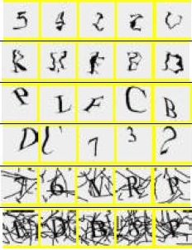
Recently suggested upgraded Word CAPTCHA.
Twists more
* Even humans cannot understand.

Slide 21
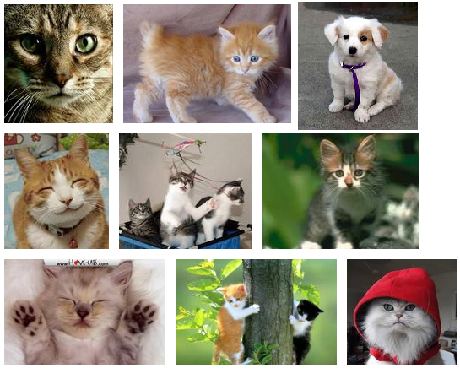
CAPTCHA Example3
Find a dog(s). (Object Recognition)

Slide 22
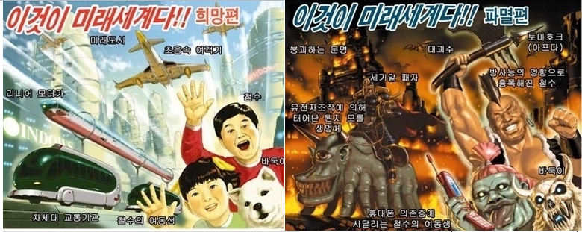
CAPTCHA Example4
Subject : “Futures”
Which picture is positive? (Emotional question)

Slide 23
Positive
  Object and Emotion analyses are nearly impossible questions for modern robots.
Negative
  There might be enough image sources
  but someone has to mine image data.
  Additional labor costs are required.
  * It can not be a completely automated system.

Slide 24
What is an Ideal CAPTCHA?
It has endless sources.
The source should be collected automatically with almost zero labor costs.
Created questions must be difficult enough for modern robots but easy for humans.
Most importantly, Ideal CAPTCHA must provide high rate correction.
  It is…
  Having automatically collectable cheap cost questions and providing highly correct results.

Slide 25
Gesture CAPTCHA System
Project

Slide 26
Why did we think the Simple Photo System is highly confidential?
The Network System never lost photos
Most importantly, we assumed
the officer is not a poor judger.

Slide 27
IDEA OF GESTURE CAPTCHA
The System does not judge.
However, users who want to pass this system have to judge each other.
Users take their photos and check each other.
  Each user creates one CAPTCHA question.
  There is a tiny cost for each user but zero cost for the system
  * Automatically collectable zero cost
  questions

Slide 28
Assumptions for the prototype gesture CAPTCHA
The valuable resource is on Mobile networks.
  We cannot expect most computers have a camera.
  We can expect most Mobile phones have a camera.
Users use Android Smart phone clients.
All android Smart phones at least have a camera
Most humans are correct judgers.

Slide 29


Common CAPTCHA process
I want to register
What is the word
It is ‘following’
Pass
It can be other CAPTCHA questions

Slide 30
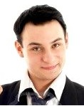
Gesture CAPTCHA process
I want to register

Slide 31
Gesture CAPTCHA process
I want to register
Follow this gesture and take picture
Make OK Sign

Slide 32
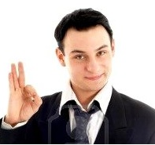
Gesture CAPTCHA process
I want to register
Follow this gesture and take picture
Click
Make OK Sign

Slide 33
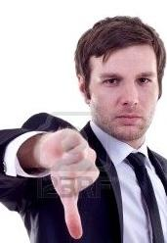
Gesture CAPTCHA process
I want to register
Follow this gesture and take picture
Answer what
is he doing in this Photo
Click
Make OK Sign

Slide 34
Gesture CAPTCHA process
I want to register
Follow this gesture and take picture
Answer what is he doing in this Photo
Making thumb down
Click
Make OK Sign

Slide 35
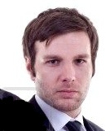
Gesture CAPTCHA process
I want to register
Follow this gesture and take picture
Answer what is he doing in this Photo
Making thumb down
Click
Make OK Sign
I want to register
Follow this gesture and take picture
. . .
Make V sign
Click

Slide 36
Gesture CAPTCHA process
I want to register
Follow this gesture and take picture
Answer what is he doing in this Photo
Making thumb down
Click
Make OK Sign
I want to register
Follow this gesture and take picture
Make V Sign
≠
Make thumb Down
. . .
Make V sign
Click

Slide 37
Gesture CAPTCHA process
I want to register
Follow this gesture and take picture
Answer what is he doing in this Photo
Making thumb down
Click
Make OK Sign
I want to register
Follow this gesture and take picture
Make V Sign
≠
Make thumb Down
. . .
Make V sign
Fail
Click

Slide 38
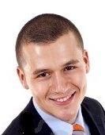
Gesture CAPTCHA process
I want to register
Follow this gesture and take picture
Answer what is he doing in this Photo
Making thumb down
Click
Make OK Sign
. . . . . . . .
Make V sign

Slide 39
Gesture CAPTCHA process
I want to register
Follow this gesture and take picture
Answer what is he doing in this Photo
Making thumb down
Click
Make OK Sign
. . . . . . . .
Make V sign
Making OK sign

Slide 40
Gesture CAPTCHA process
I want to register
Follow this gesture and take picture
Answer what is he doing in this Photo
Making thumb down
Click
Make OK Sign
Make OK Sign
=
Make OK Sign
. . . . . . . .
Make V sign
Making OK sign

Slide 41
Gesture CAPTCHA process
I want to register
Follow this gesture and take picture
Answer what is he doing in this Photo
Making thumb down
Click
Make OK Sign
Pass
Make OK Sign
=
Make OK Sign
. . . . . . . .
Make V sign
Making OK sign

Slide 42
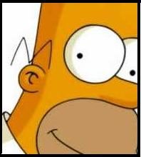

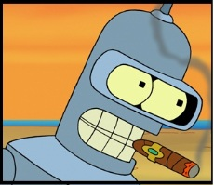
A Sever and Clients model of Gesture CAPTCHA
Click
. . . . . . . .
Make OK Sign
Touch your forehead
What dose the server do ?
Send Gesture messages
Collect User Photos
Send User photos to judgers
Compare actual Gesture messages
and Judger’s answer.
5. Decide ‘Pass’ or ‘Non-pass’
CAPTCHA Server daemon

Slide 43
FLOW CHART
For The Multi Thread Server
For The Client
I want to register
Waiting Daemon..
Check the CAPTCHA that server asked
A user wants to register
Request other CAPTCHA
Send a Gesture Description.
Understand The CAPTCHA and want to take Picture?
N
The user wants other Gesture?
Y
Y
N

Slide 44
Take picture.
Waiting for users Photo sending…
Want to send this picture?
N
Y
If photo is received,
reply back message
Send picture.
N
Sent well?
Save the photo
and user info
Y

Slide 45
Got a Question
Take a Photo from DB And
make question and sends
N time
iteration.
send answer
Waiting Users’ answers….
Waiting other’s evaluation…..
Y
Send evaluation result.
N
Got a pass?
Save a passed user data.
Y
Passed!
One CAPTCH Process is done

Slide 46
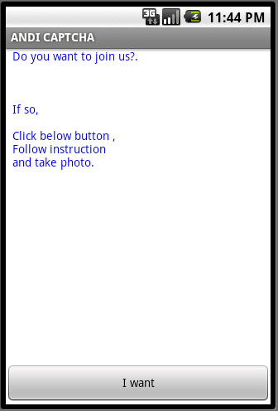
Start

Slide 47
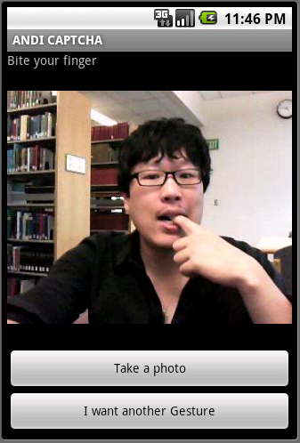
Taking a photo

Slide 48
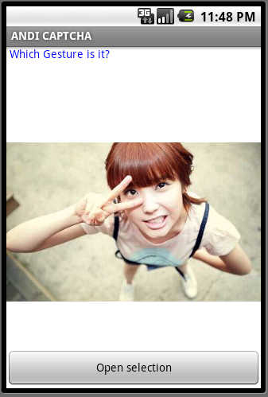
A question

Slide 49
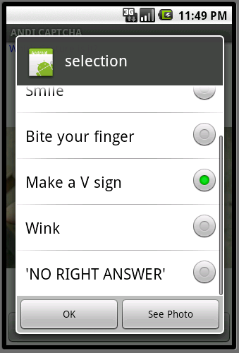
Select one

Slide 50
Problems
Project Gesture CAPTCHA System

Slide 51
A problem of HUMAN COMPUTATION
What if the officer is a bad judger.
Actually, he is a corrupt Cop!!

Slide 52
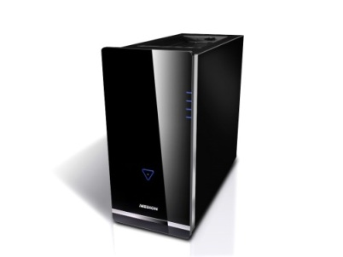
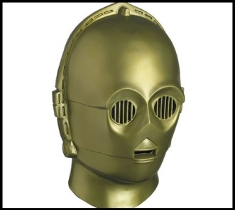
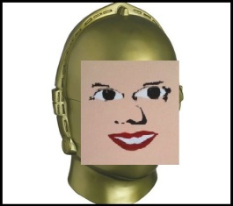
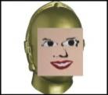
Counter Example. New Robot
There is new robot
which have collected all gesture questions.
And prepared all right photos for questions.
Make a V sign
Smile
Touch your forehead
Pinch your nose
Show your palm
…..
…
...
Smile
Smiling

Slide 53
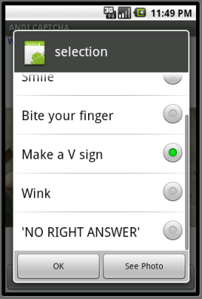
Counter Example. New Robot
New robot is also a bad judger
The robot selects any answer.
Make Ok sign
Biting a finger
?

Slide 54
Counter Example. New Robot
New robot is also a bad judger
The robot selects any answer.
Make Ok sign
Biting a finger
?
Fail
An innocent user gets a fail

Slide 55
Counter Example. New Robot
New robot is also a bad judger
The robot selects any answer.
Make Ok sign
Biting a finger
?
Pass
Fail
No mater what the judgment was,
new robot gets a pass
An innocent user gets a fail

Slide 56
multi questions System
Upgraded Gesture CAPTCHA
This idea from below paper :
von Ahn, L., Maurer, B., McMillen, C., Abraham, D., and Blum, M.
reCAPTCHA: Human-Based Character Recognition via Web Security Measures.
Science. pp. 1465-1468. (2008)

Slide 57
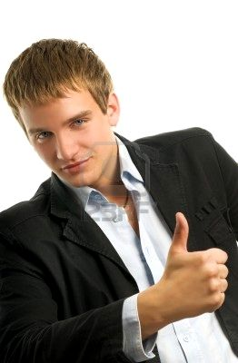

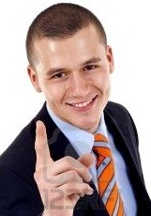
Upgraded Gesture CAPTCHA
Now, each user has to answer 3 questions.
First question is USER CHECKER.
A User needs to answer other’s gestures (same as before).
Second question is JUDGE CHECKER.
Server knows what the answer is. If a judge selects the
wrong answer, then the system would consider the user
as a ‘BAD JUDGER’.
Failure’s USER CHECKER answer is not considered as judgment.
Third question is STATISTICAL COLLECTOR.
Users’ answers of the photo are counted.
Eventually, if the system gets ‘Enough’ same answer, then
it becomes, a photo for JUDGE CHECKER.

Slide 58
Process of Questions
USER CHECKER POOL
JUDGE CHECKER POOL
STATISTICAL COLLECTOR
POOL
A User takes his gesture picture.

Slide 59
Process of Questions
USER CHECKER POOL
JUDGE CHECKER POOL
STATISTICAL COLLECTOR
POOL
Another user’s photo comes from the
USER CHECKER POOL.
The user answers ,“He is Making a thumb up”

Slide 60
Process of Questions
USER CHECKER POOL
JUDGE CHECKER POOL
STATISTICAL COLLECTOR
POOL
This Picture statistic
- 0 : Make thumb down
- 1 : Make thumb up
- 0 : show your palm
- 0 : make ok sign.
- 0 : make One sign
……
sum : 1

Slide 61
Process of Questions
USER CHECKER POOL
JUDGE CHECKER POOL
STATISTICAL COLLECTOR
POOL
This Picture’s answer is
- Make a thumb down
This User is a good judger
Make a thumb down
=
Make a thumb down
Next question comes from JUDGE CHECKER POOL
but the user does not know which question is.
The user answers ,“He is Making a thumb down”

Slide 62
Process of Questions
USER CHECKER POOL
JUDGE CHECKER POOL
STATISTICAL COLLECTOR
POOL
This Picture statistic
- 3 : Make thumb down
- 2 : Make thumb up
- 0 : show your palm
- 5 : make ok sign.
- 89 : make One sign
……
sum : 99
Last question is from
STATISTIC COLLECTION POOL

Slide 63
Process of Questions
USER CHECKER POOL
JUDGE CHECKER POOL
STATISTICAL COLLECTOR
POOL
This Picture statistic
- 3 : Make thumb down
- 2 : Make thumb up
- 0 : show your palm
- 5 : make ok sign.
- 89 : make One sign
……
sum : 99
Last question is from
STATISTIC COLLECTION POOL
The user answers ,“He is Making One sign”

Slide 64
Process of Questions
USER CHECKER POOL
JUDGE CHECKER POOL
STATISTICAL COLLECTOR
POOL
This Picture’s answer is
- Make One Sign
This Picture statistic
- 3 : Make thumb down
- 2 : Make thumb up
- 0 : show your palm
- 5 : make ok sign.
- 90 : make One sign
……
sum : 100

Slide 65

Process of Questions
USER CHECKER POOL
JUDGE CHECKER POOL
STATISTICAL COLLECTOR
POOL
This is a Completely Automated endless Questions Collecting System

Slide 66
If a Judger Checker proves insufficient
Example
  A Robot needs 1$ for an attack.
  A Judger Checker has 5 selections.
Statistically, the robot can
penetrate this system after
attacking 5 times.
1$ X 5 times = 5$
5$ is needed for one penetration
probabilistically.

Slide 67
If there are two Judger Checkers
Example
  A Robot needs 1$ for an attack.
  A Judger Checker has 5 selections.
Number of attacks to achieve one penetration is,
5 times X 5 times = 25 times
5$ X 5$ = 25$
25$ is needed for one penetration
probabilistically.

Slide 68
If there are three Judger Checkers
Example
  A Robot needs 1$ for an attack.
  A Judger Checker has 5 selections.
Number of attacks to achieve one penetration is,
5 X 5 X 5 = 125 times
5$ X 5$ 5$ = 125$
125$ is needed for one penetration
probabilistically.

Slide 69
Exponential graph:
How many JUDGE CHEKER are needed
Cost for one penetration.
Profit horizon
0%
Number of JUDGE CHECKERS.

Slide 70
What is an Ideal CAPTCHA?
It has endless sources.
The source should be collected automatically with almost zero labor costs.
Created questions must be difficult enough for modern robots but easy for humans.
Most importantly, Ideal CAPTCHA must provide high rate correction.
  It is…
  Having automatically collectable cheap cost questions and providing highly correct results.

Slide 71
Conclusion
It has endless sources.
The source are collected automatically with almost zero labor costs.
Created questions can be difficult enough for modern robots but easy for humans.
Most importantly, This CAPTCHA can provide high rate correction.

Slide 72
Q & A

