Slide 1
FRAppE: Detecting Malicious Facebook Applications
Md Sazzadur Rahman, Ting-Kai Huang, Harsha Madhyastha, Michalis Faloutsos
University of California, Riverside
Notes:
In this presentation, we show malicious facebook apps are rampant and
Some machine learning technique with appropriate features are very effective identifying malicious apps

Slide 2

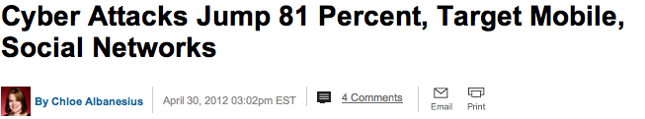

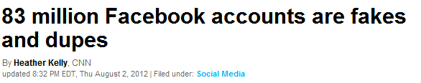

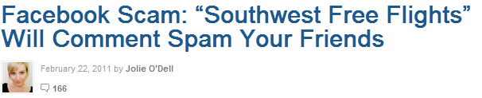
Problem Statement
Social malware is rampant on Facebook
Notes:
The motivation of our work stem from the fact that social malware is rampant

Slide 3


Problem Statement
MyPageKeeper can detect social malware*
  Facebook app, launched June, 2011
  20,000 user installed, monitors 3M wall
  Crawls user’s wall post and news feed continuously
  Identify malicious posts and notify infected user
Major enabling factor – malicious Facebook app
*Appeared in USENIX Security, 2012

Slide 4
Problem Statement
Malicious
Post
MyPageKeeper
Benign
Malicious
App ID
?
Benign
How to identify malicious Facebook apps given an app ID?
No commercial service or tool available to identify malicious apps

Slide 5
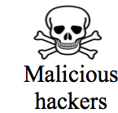


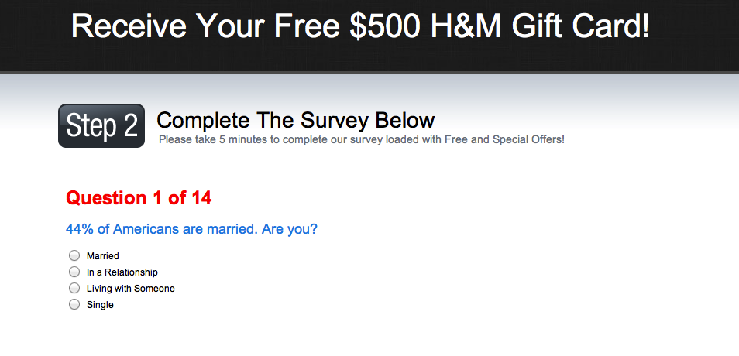
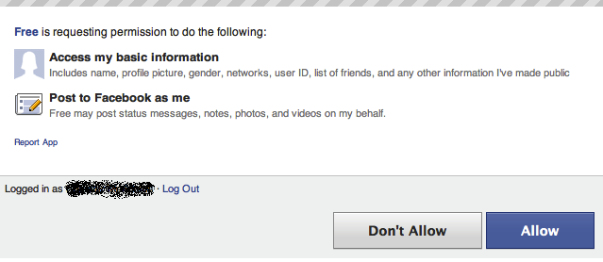
How malicious Facebook apps operate
Notes:
Malicious hackers make posts into compromised user’s wall.
Their friends see the post, click the link which leads to the malicious app installation page
Once installed, they redirect users to different pages for collecting victims personal information and
Make her complete surveys so that they can earn money
Once the app is installed, hackers get permission to post any time on the victims wall.
So, they make the same post and appears victims friends news feed and thus the cycle repeats and the app spreads in facebook

Slide 6
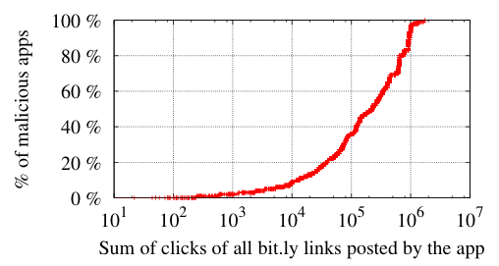
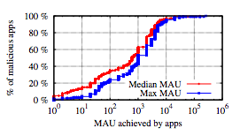
Motivation
  Malicious Facebook apps affect a large no of users
40% of malicious apps have a median of at least 1K MAU!
60% malicious apps get at least 100K clicks on the posted URLs!
Notes:
3,800 malicious apps posted 5700 bit.ly URLs
Using We query bit.ly using API for click through of these URLs

Slide 7
Contributions
Malicious Facebook apps are prevalent
  13% of the observed apps are malicious
Highlight differences between malicious & benign apps
  Malicious apps require fewer permissions than benign
Developed FRAppE to detect malicious apps
  Achieves 99% accuracy with low FP and FN rates
Identify the emergence of AppNets
  Malicious apps collude at massive scale

Slide 8
Roadmap
Profiling malicious and benign apps
FRAppE: Detecting malicious apps
Emergence of AppNets
Conclusion

Slide 9
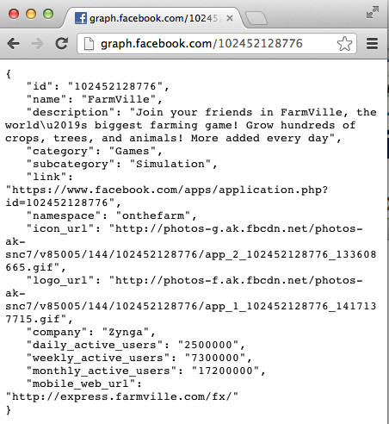
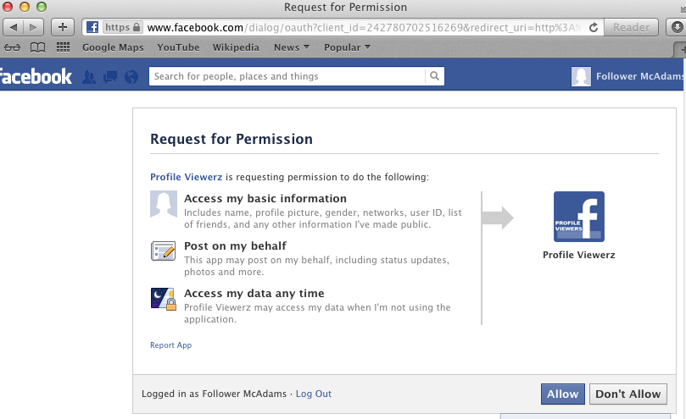
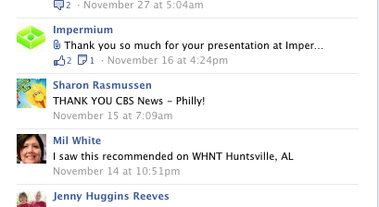
Data Collection
Data collected from MyPageKeeper
  From June 2011 to March 2012
Apps with known ground truth
  6,273 malicious apps
  6,273 benign apps
Collected different stats
  App summary
  App permissions
  Posts in app profile
Notes:
We collect data from MyPageKeeper, a security app in Facebook we developed and deployed 2011.
MyPageKeeper primarily detects malicious posts in Facebook and notify victims.
Our dataset contains 111K Facebook apps.
D-Sample dataset contains apps for which we know the ground truth, either they are malicious or not.
For collecting sample malicious apps, we use a hurestic: if a post is flagged by MyPageKeeper as malicious which is posted by an app, they app is malicious.
For collect same amount of benign apps to make the comparison fair. Benign apps are those apps who are not part of malicious apps and also vetted by socialbaker.com, a website collects app statictics.
D-Summary dataset contains the summary of apps which we collect using graph api. Summary includes app description, company name, category etc.
D-Inst dataset contains the permission set required by an app.
D-ProfiledFeed dataset contains the number of posts in apps timeline in facebook

Slide 10
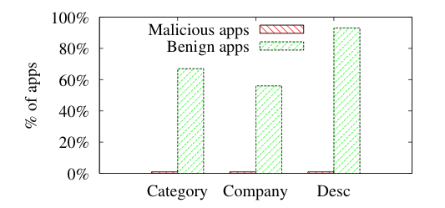
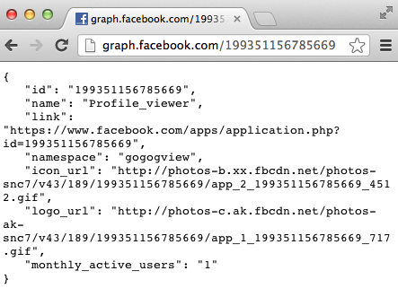
Malicious apps have incomplete summary
Notes:
A popular app, FarmVille contains different information such as category, description, company etc.
A malicious app “Profile_viewer” contains no such information

Slide 11
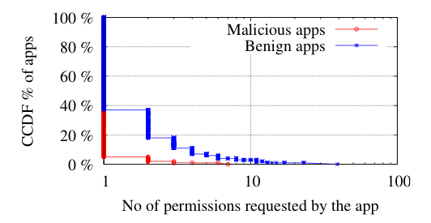
Malicious apps require fewer permissions
  97% of malicious apps require only one permission from users
https://www.facebook.com/dialog/oauth?client_id=242780702516269&
redirect_uri=http://apps.facebook.com/gfhyfte/&
scope=publish_stream,offline_access
Notes:
App installation URL contains the list of permission it requires.
For example, “Profile viewez” malicious apps two permissions, “publish stream” which is the ability to post any time in users wall
And “offline access” which gives the ability to access users data any time.

Slide 12
Malicious apps often share app names
6,273 malicious apps have 1,019 unique names
  627 app IDs have ‘The App’ name
  470 app IDs have ‘Pr0file Watcher’ name
6,273 benign apps have 6,019 unique names
Notes:
We computed similarity threshold by using normalized Damerau-Levenshtein edit distance

Slide 13
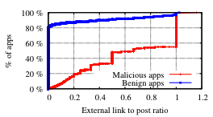
  Malicious apps post external links often
80% benign apps do not post any external link
40% malicious apps have one external link per post
Notes:
Some post may contain multiple URLs, that why the ration is > 1 for some case

Slide 14
Roadmap
Profiling malicious and benign apps
FRAppE: Detecting malicious apps
Emergence of AppNets
Conclusion

Slide 15
FRAppE – Facebook’s Rigorous App Evaluator
FRAppE Lite
  Based on Support Vector Machine
  Use features crawled on-demand
    No. of permissions required by an app
    Domain reputation of redirect URI
  Can be used user side
FRAppE
  Addition of two aggregation based features:
    Similarity of app names
    Whether posted links are external
    Can be used only OSN side
App ID
FRAppE Lite
Malicious
Benign
App ID
FRAppE
Malicious
Benign
Notes:
Features are obtained either opengraph API or instrumented browser

Slide 16
FRAppE Lite and FRAppE are accurate
  Used cross-validation on known ground truth dataset
 | Accuracy | False Positives | False Negatives
FRAppE Lite | 99% | 0.1% | 4.4%
FRAppE | 99.5% | 0% | 4.1%

Slide 17
Detecting more malicious apps with FRAppE
  100K more apps for which we lack of ground truth
Train FRAppE with 12K apps and test on 100K apps
  8,144 apps flagged by FRAppE
  98.5% validated using complementary techniques
Criteria | # of apps validated | Cumulative
Deleted from Facebook graph | 81% | 81%
App name similarity | 74% | 97%
Post similarity | 20% | 97%
Typo squatting of popular apps | 0.1% | 97%
Manual validation | 1.8% | 98.5%
Notes:
We applied FRAppE on 100K apps for which we don’t know the ground truth.

Slide 18
FRAppE is Robust
Some features are not robust
  App summary (description, category, company etc)
  No. of posts in profile
Robust features
  No. of permissions required by app
  Reputation of domain app redirects
  FRAppE is accurate even with only robust features
    98.2% accuracy with 0.4% FP and 3.2% FN

Slide 19
Roadmap
Profiling malicious and benign apps
FRAppE: Detecting malicious apps
Emergence of AppNets
Conclusion

Slide 20
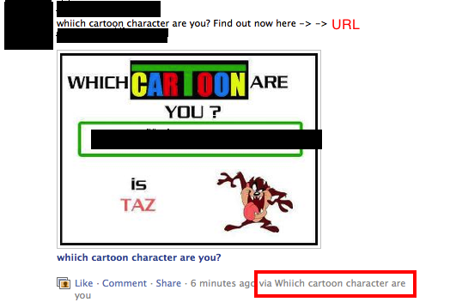
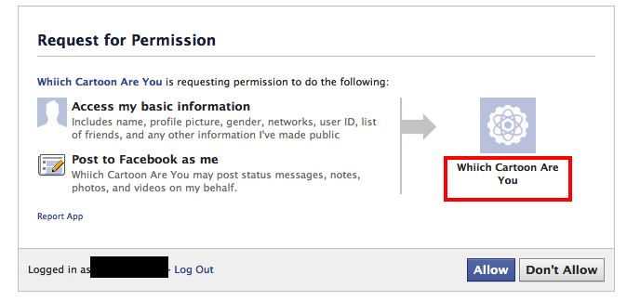
Cross promotion is rampant for malicious apps
    Direct cross promotion
Notes:
App cross-promotion is forbidden according to Facebook platform policy; however, it is rampant malicious apps
“Which cartoon character are you” malicious app post links in victims wall;
When the link is clicked it redirects to the installation page of another malicious app

Slide 21
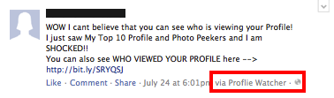
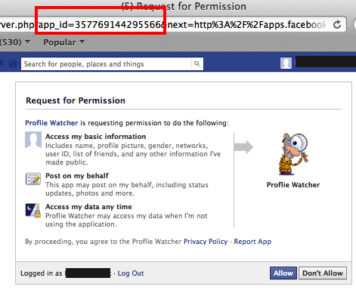
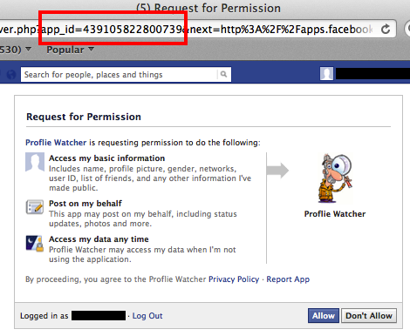
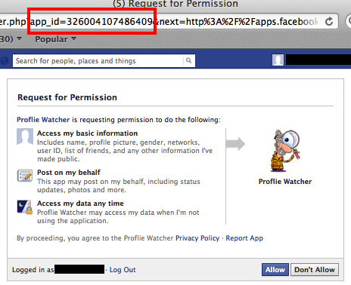
Highly sophisticated fast-flux like cross promotion
External website with redirector Javascript
We identified 103 URLs
pointing to such redirectors
Notes:
When the malicious URL is clicked in the post, it redirects user to an javascript redirector controlled by the malicious hacker
Which randomly takes users to different malicious app installation pages

Slide 22
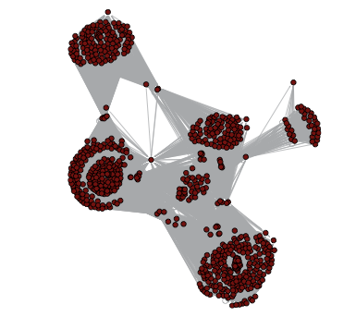
AppNets form large and dense groups
Collaborative graph
  High connectivity
    70% of apps collude with more than 10 other apps
  High density
    25% of apps have local clustering coefficient more than 0.74
  44 connected components
    Size of the largest connected component 3,484
Promoter
Promotee
Real snapshot of 770 highly collaborating apps
Notes:
We call the colaborative graph as AppNet.
It shows high collusion:
And high density

Slide 23
App Piggybacking
Popular apps abused for spreading malicious posts
Popular App | Malicious post by the app | Malicious link in the post
Farm Ville | WOW I just got 5000 Facebook Credits for Free | http://offers5000credit.blogspot.com
Facebook for iPhone | NFL Playoffs Are Coming! Show Your Team Support! | http://SportsJerseyFever.com/NFL
Mobile | WOW! I Just Got a Recharge of Rs 500. | http://ffreerechargeindia.blogspot.com/
Notes:
In our dataset, we found popular apps have posted malicious links..
How?

Slide 24
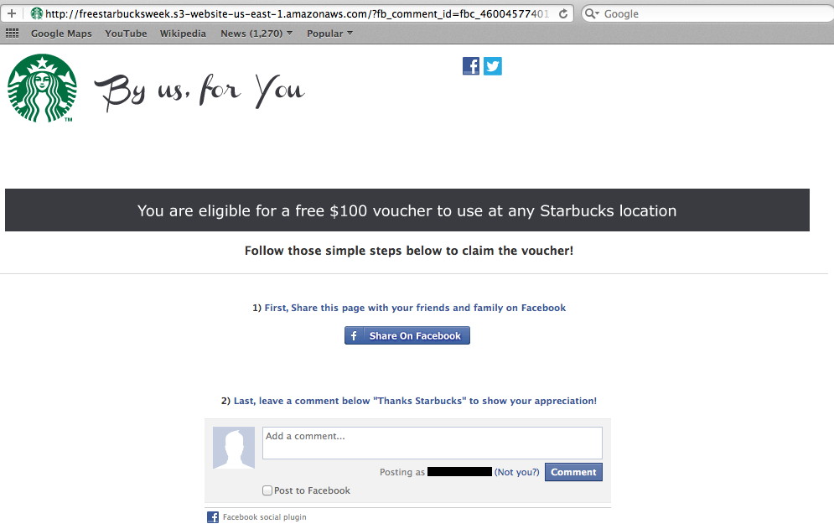
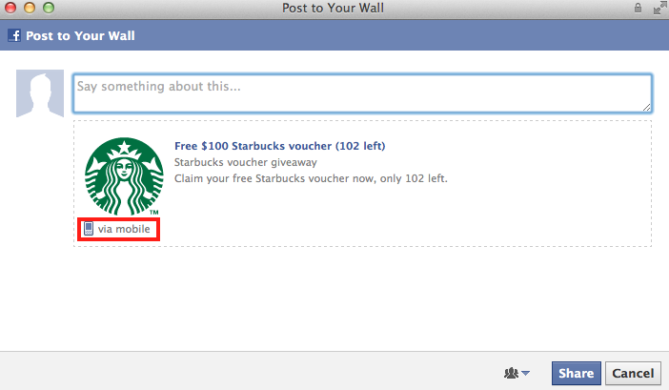
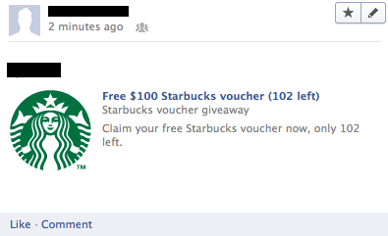
Facebook API Exploitation
Facebook Dialog API being exploited:
https://www.facebook.com/dialog/feed?app_id=175473612514557&
link=https://developers.facebook.com/docs/reference/dialogs/&picture=http://fbrell.com/f8.jpg&name=Facebook%20Dialogs&caption=Reference%20Documentation& description=Using%20Dialogs%20to%20interact%20with%20users.&redirect_uri=http://www.example.com/response
Notes:
When user click share, the post appears as if it is posted by the app “Mobile”.
So, if Facebook maintains a whitelist of app (any post made by these apps are beingn), this malicious post will evade their system

Slide 25
Conclusion
Malicious Facebook apps are rampant
  40% of malicious apps have at least median 1000 MAU
Highlight differences between malicious and benign apps
  Malicious apps require fewer permissions than benign
FRAppE can detect malicious apps accurately
  99% accuracy with low FP and FN
AppNets form large and densely connected groups
  70% apps collude with more than 10 other apps

Slide 26
Thank you!
Questions?
http://mypagekeeper.org

