Slide 1
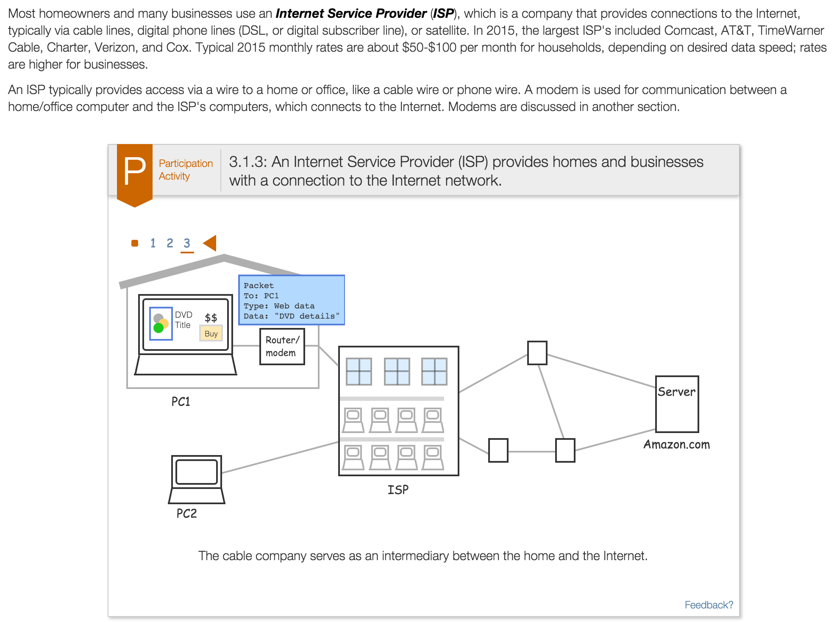
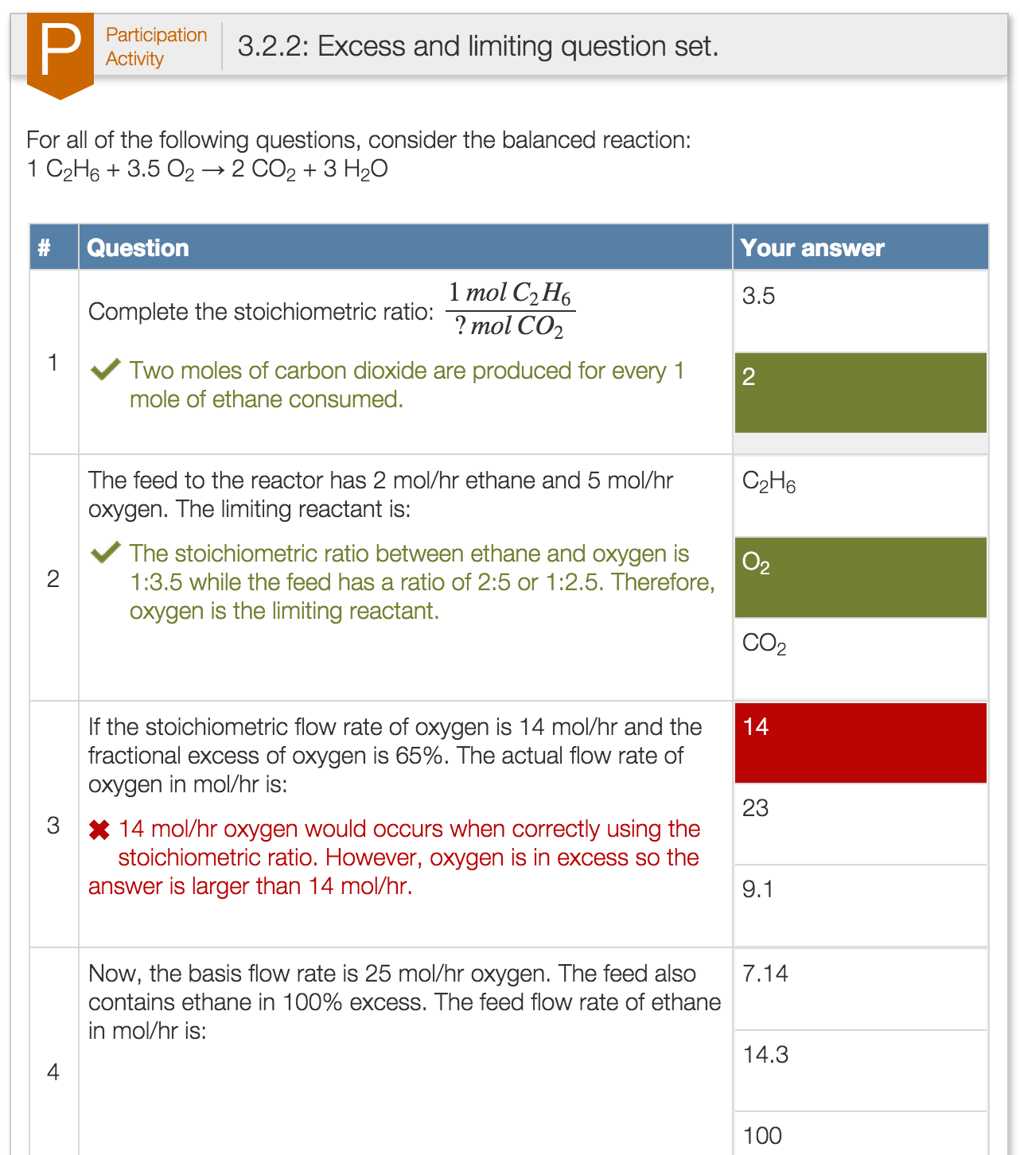
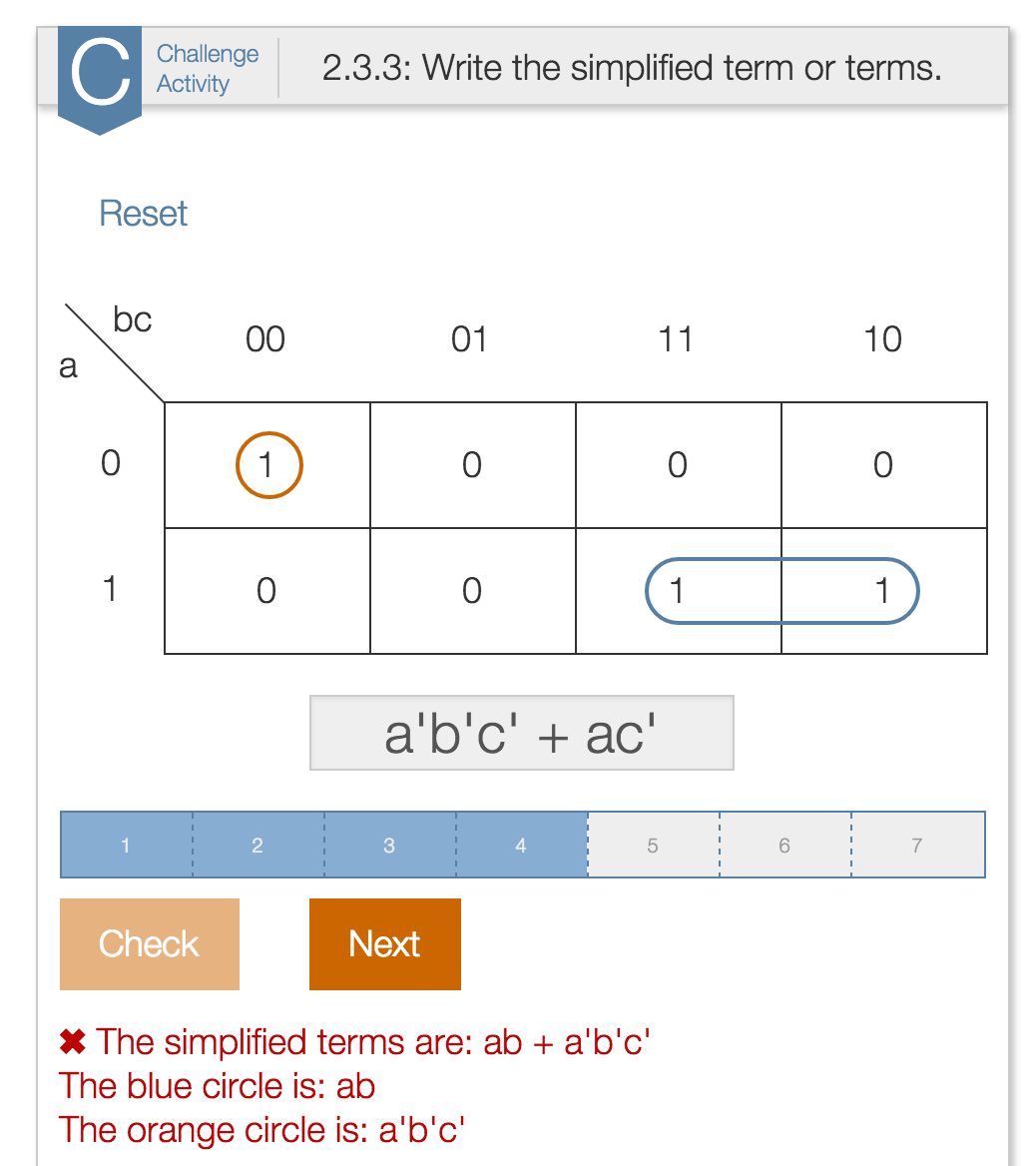
How Many Points Should Be Awarded for Interactive Textbook Reading Assignments?
Frank Vahid and Alex Edgcomb
Dept. of Computer Science and Engineering
University of California, Riverside
Also with zyBooks.com

Slide 2
Interactive textbook
Copyright © 2015 Frank Vahid and Alex Edgcomb, UC Riverside.

Slide 3
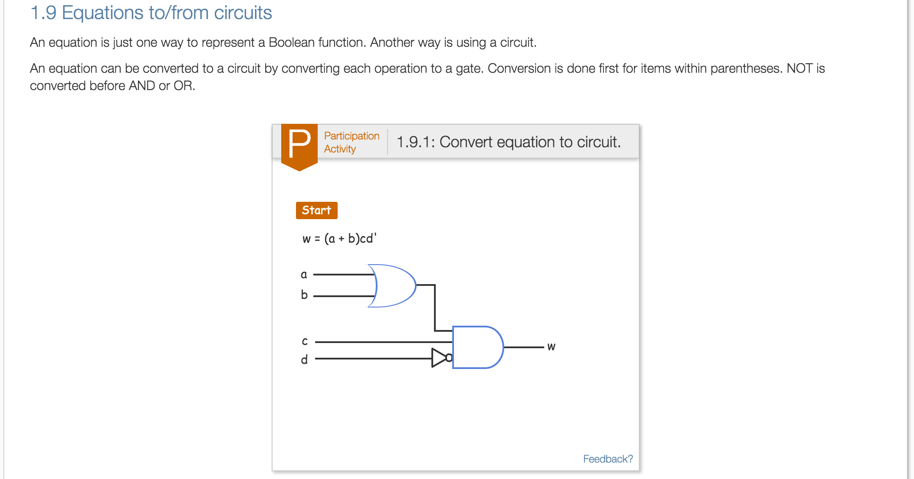
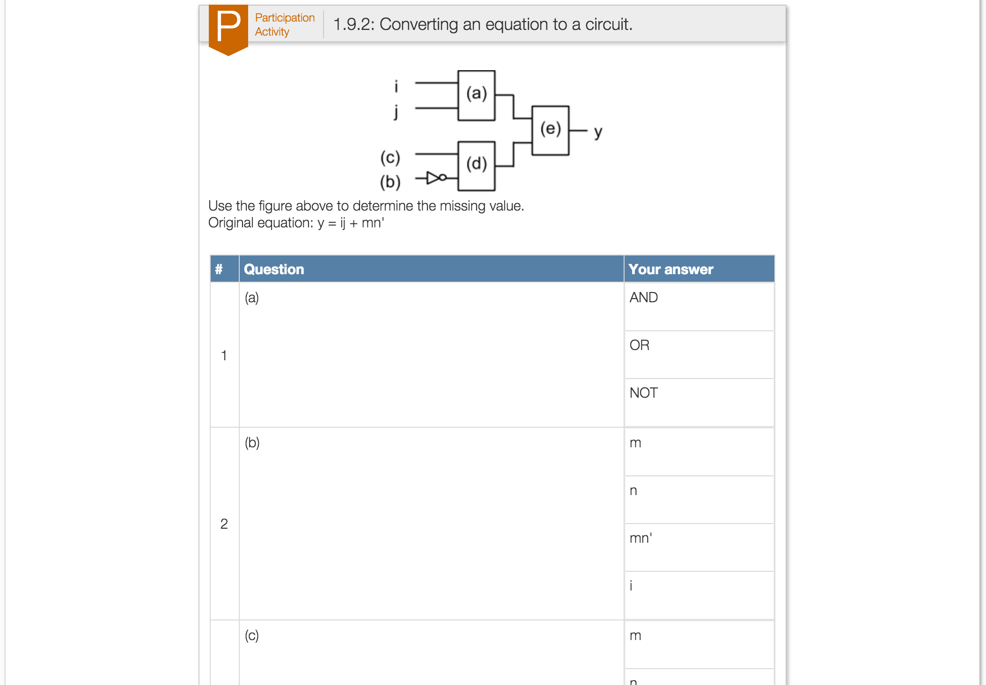
Interactive textbook – Less text
Copyright © 2015 Frank Vahid and Alex Edgcomb, UC Riverside.

Slide 4
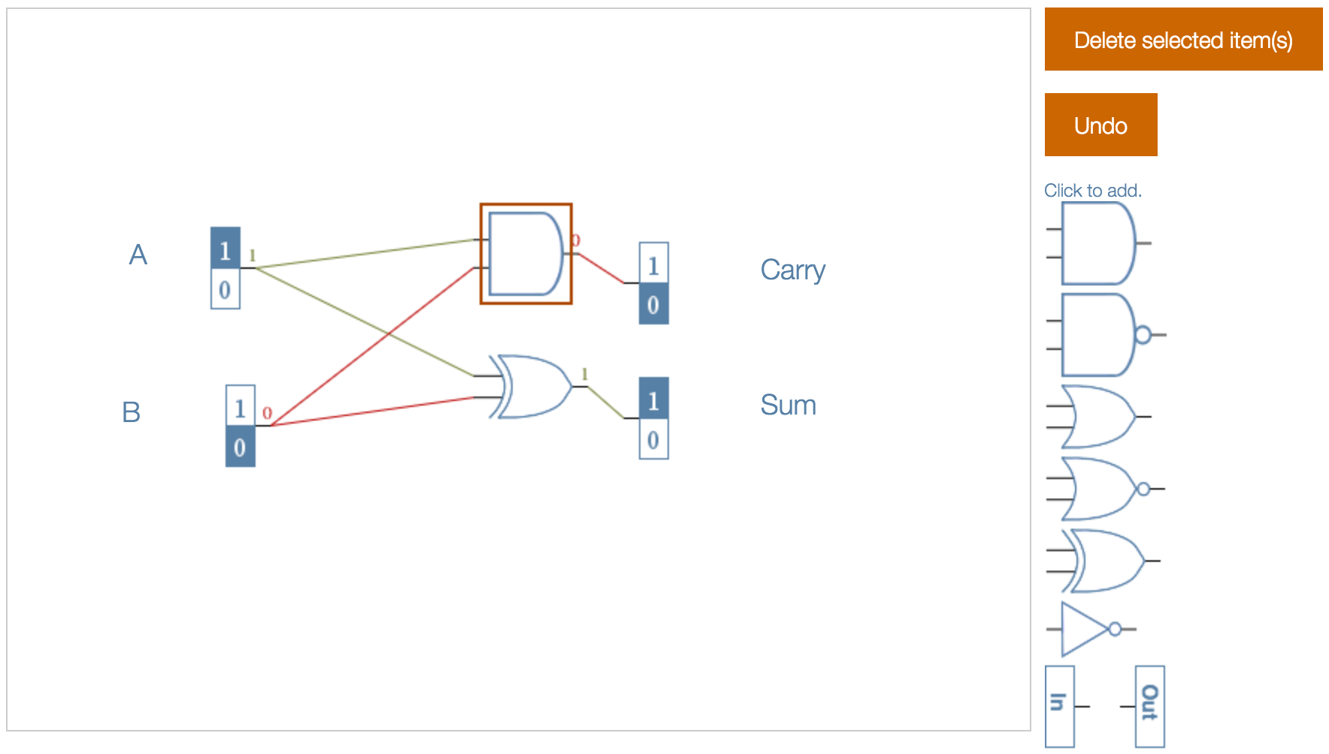
Interactive textbook – Simulators
Copyright © 2015 Frank Vahid and Alex Edgcomb, UC Riverside.

Slide 5
Interactive textbook – Animations
Copyright © 2015 Frank Vahid and Alex Edgcomb, UC Riverside.

Slide 6
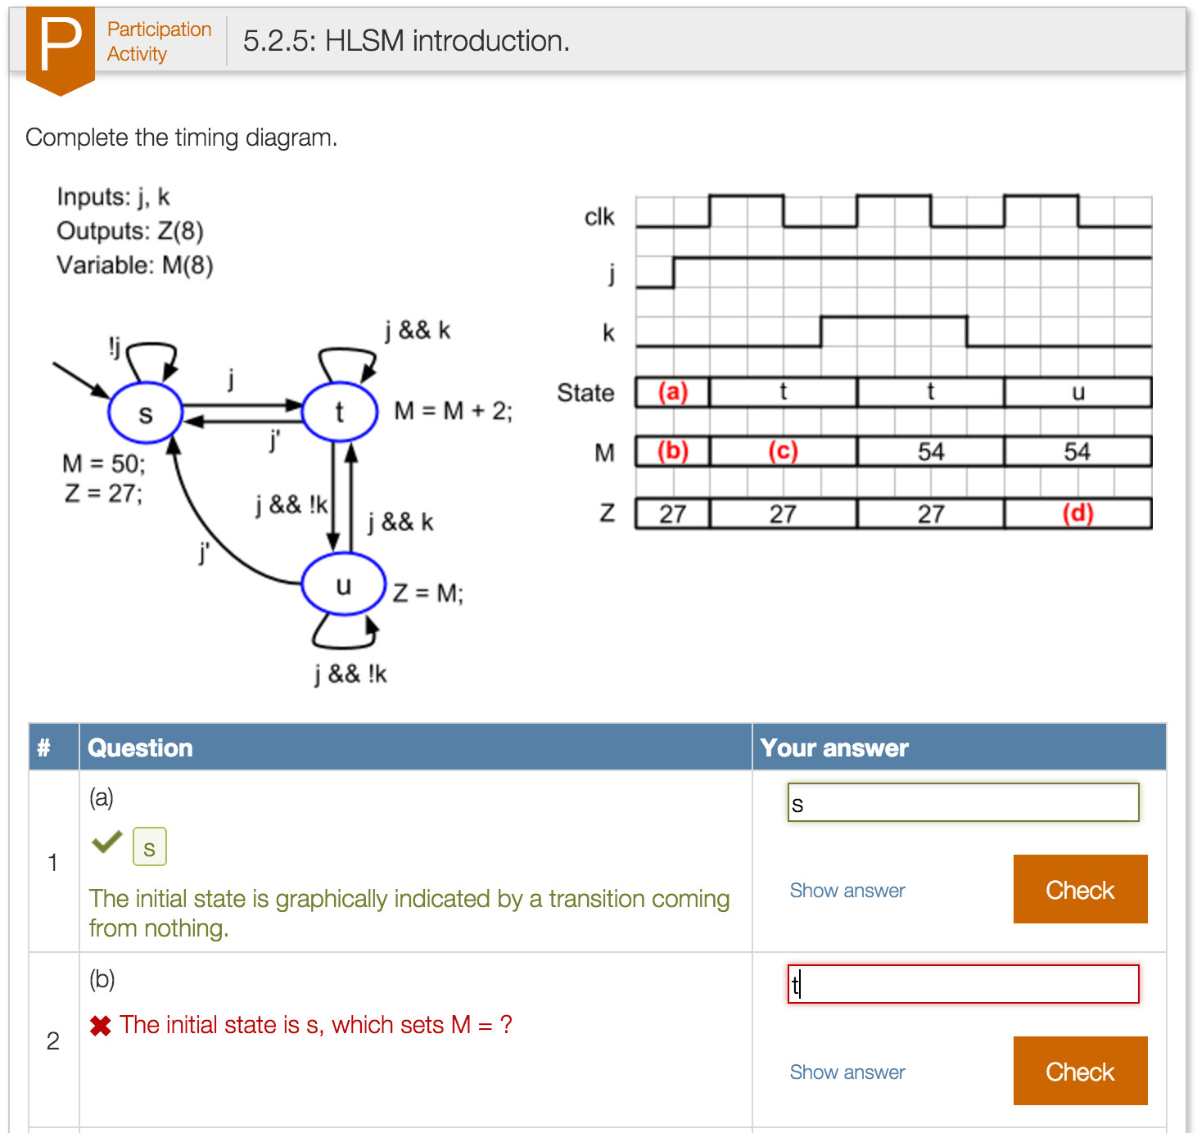
Interactive textbook – Learning questions
Copyright © 2015 Frank Vahid and Alex Edgcomb, UC Riverside.

Slide 7
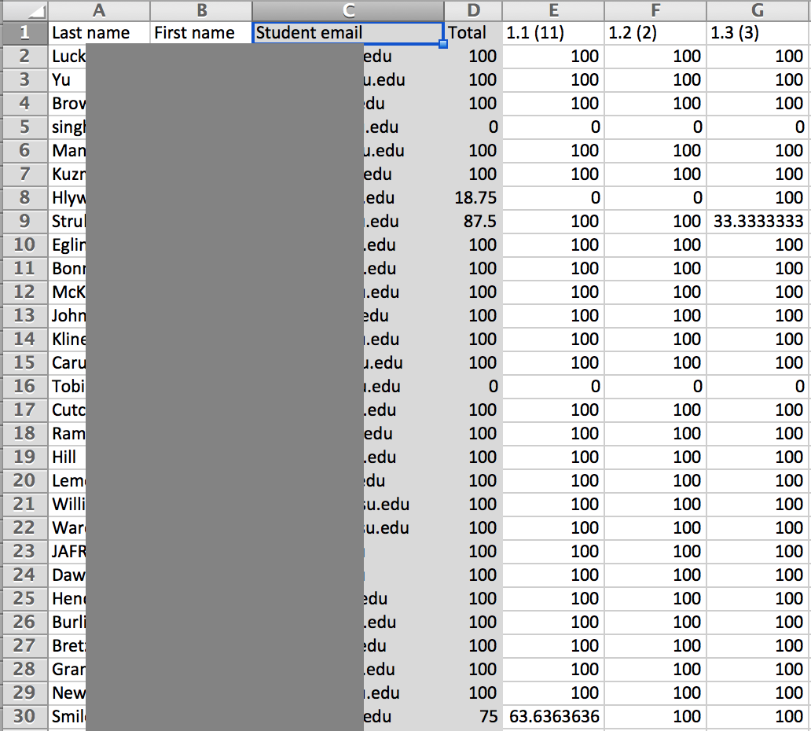
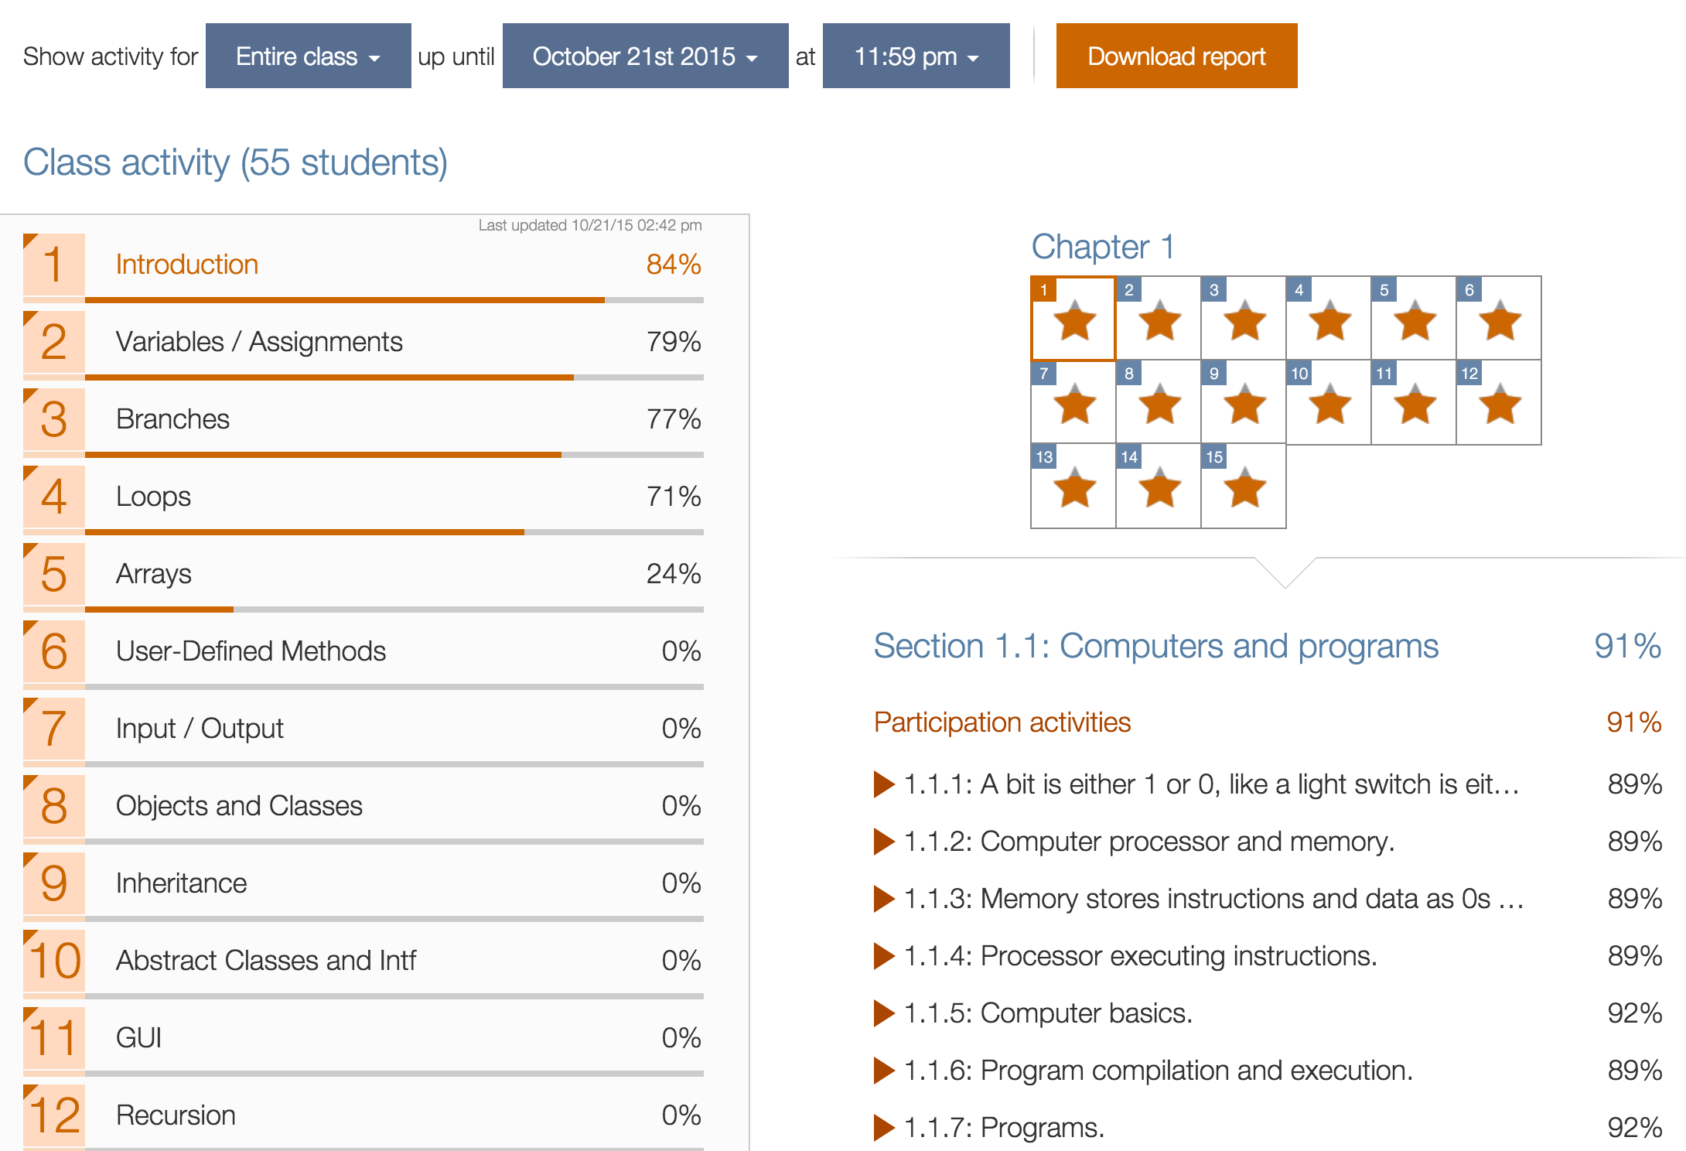
Interactive textbook – Instructor can assign points for participation activities (reading)
Copyright © 2015 Frank Vahid and Alex Edgcomb, UC Riverside.

Slide 8
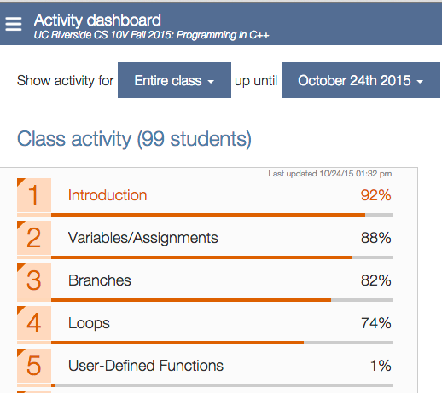

Slide 9
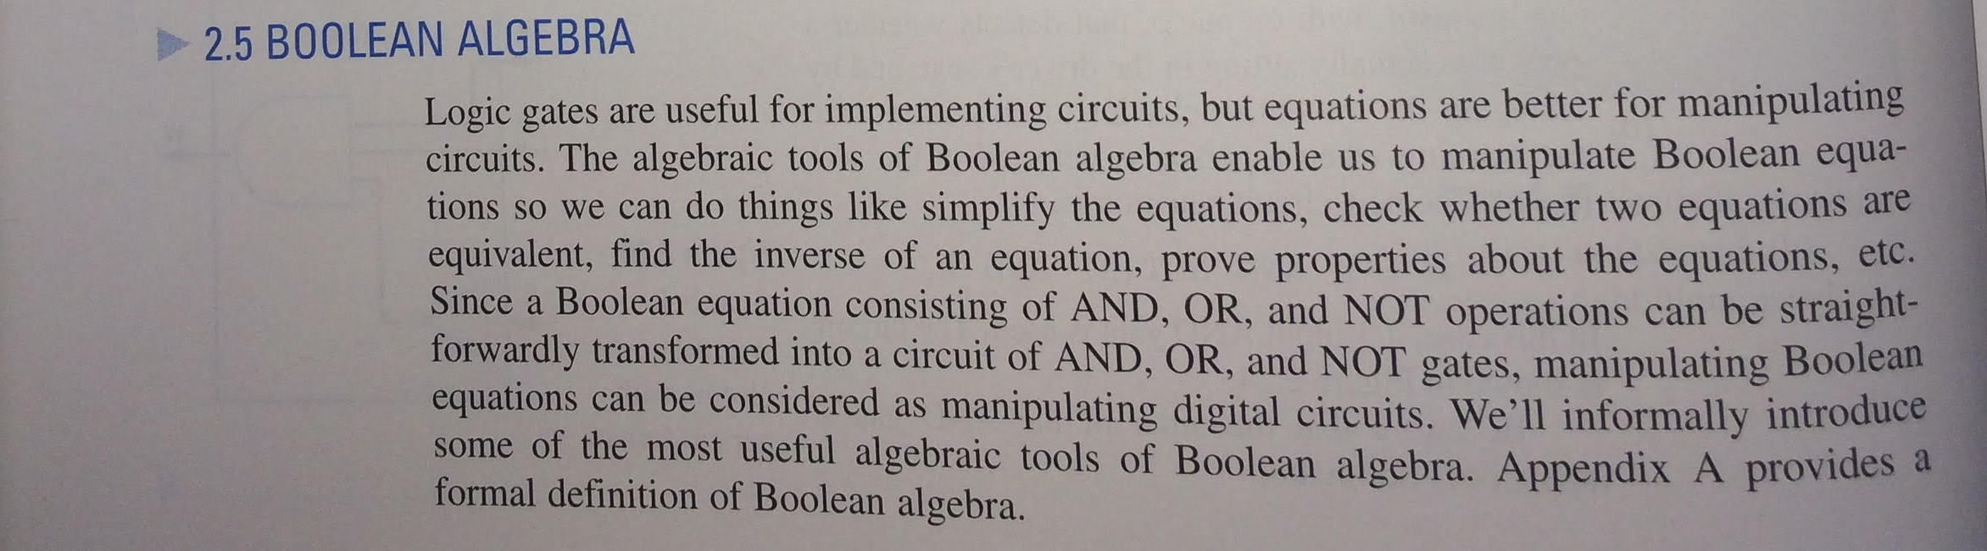
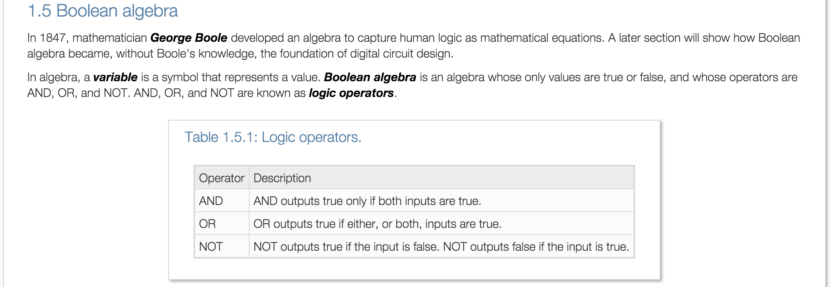
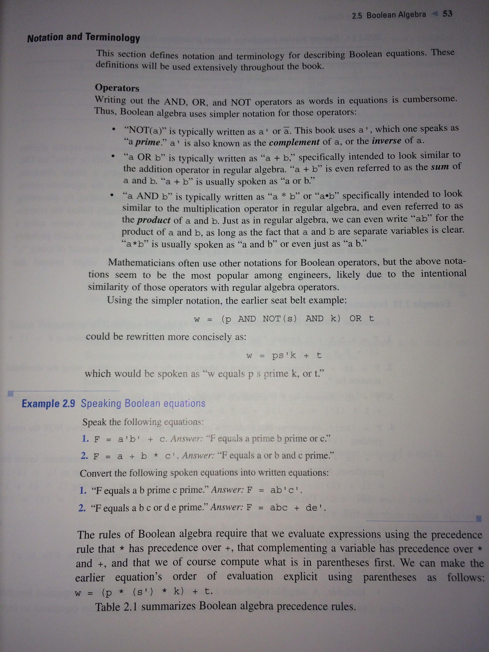
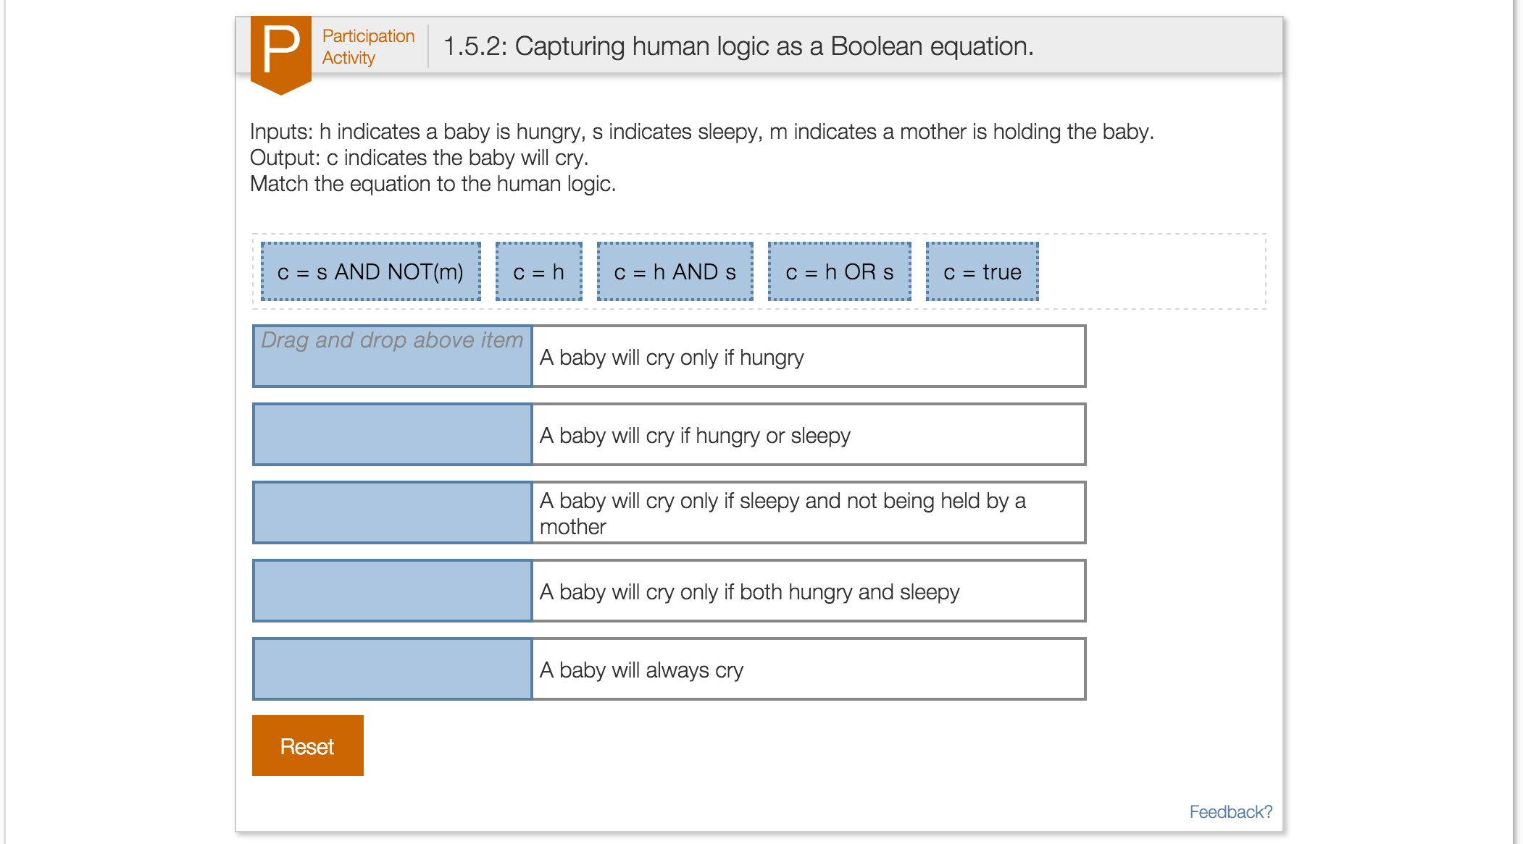
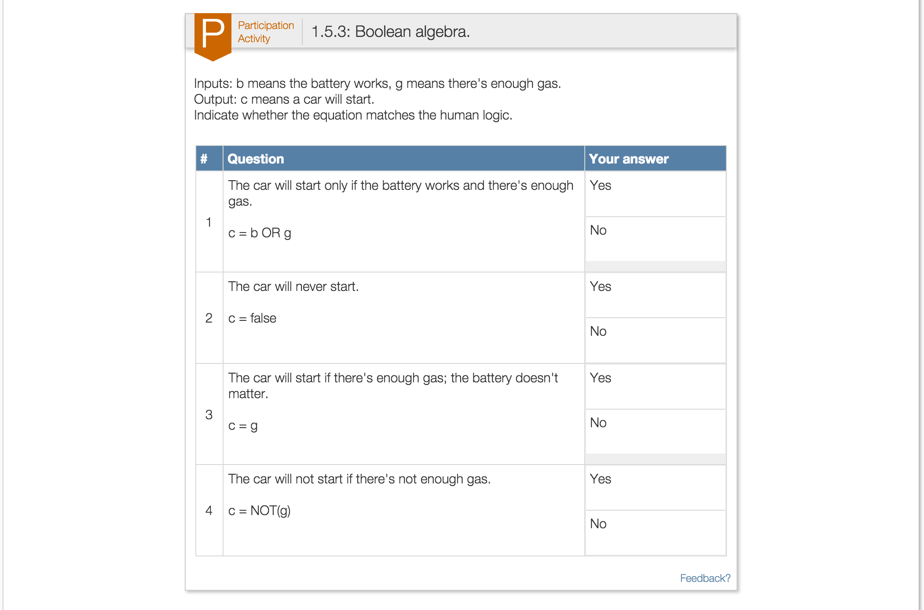
Concise text, learning questions
Copyright © 2015 Frank Vahid and Alex Edgcomb, UC Riverside / Also with zyBooks.

Slide 10
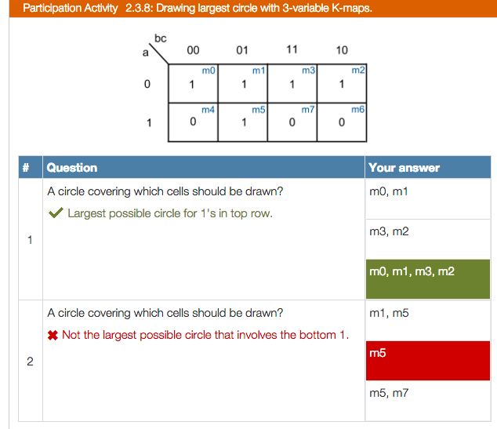
Multiple choice learning question
Right answer
earns completion.
Right and wrong answers get explanations.
Copyright © 2015 Frank Vahid and Alex Edgcomb, UC Riverside / Also with zyBooks.

Slide 11
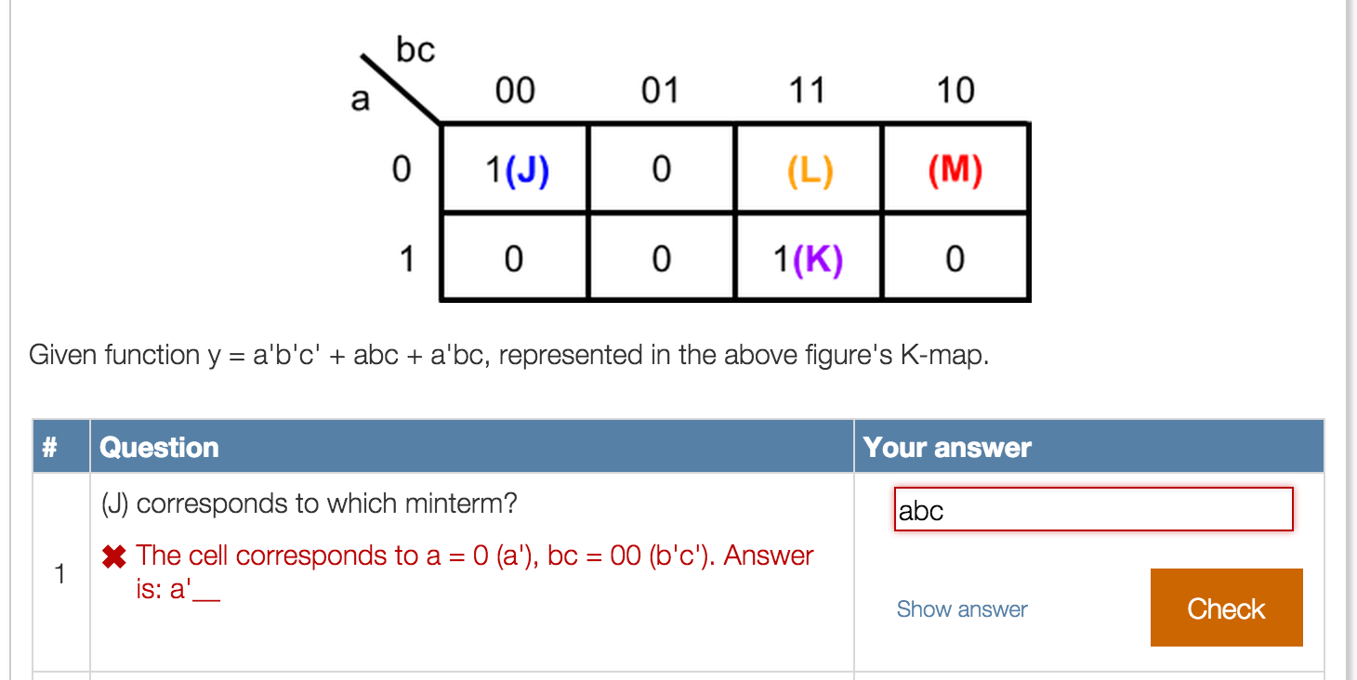
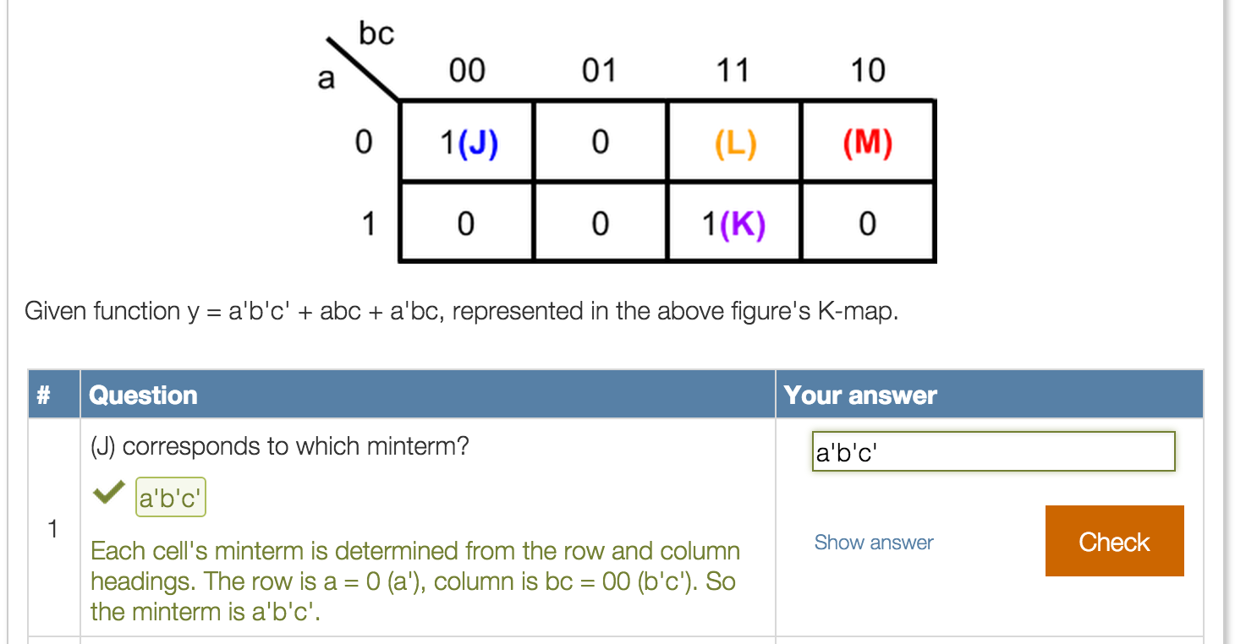
Short-answer learning question
Wrong answer gets hint
Right answer gets explanation
and earns completion
Copyright © 2015 Frank Vahid and Alex Edgcomb, UC Riverside / Also with zyBooks.

Slide 12
Instructors often wonder…
Will students read if awarded points?
Will students “cheat” system to get points?
How many points should be awarded?
Copyright © 2015 Frank Vahid and Alex Edgcomb, UC Riverside / Also with zyBooks.

Slide 13
Analysis
1,394 students across 7 universities
Points awarded* | Number of classes | Number of students
0 | 2 | 250
2 | 2 | 491
5 | 1 | 380
10 | 1 | 69
17 | 1 | 90
20 | 1 | 114
* Out of 100 course points
Each class:
Required interactive textbook by zyBooks [1]
Regularly assigned reading
Assigned points proportional to completion; single deadline per assignment
[1] zyBooks. www.zybooks.com. Oct. 2015.
Copyright © 2015 Frank Vahid and Alex Edgcomb, UC Riverside / Also with zyBooks.

Slide 14
Results
Assigned
w/ points
Completed
Earnestly completed
92%
79%
Completed
53%
Assigned
w/o points
Earnestly
completed
50%
Points awarded | Completion | Earnestness | Earnestly completed
0 | 53% | 92% | 50%
2 | 90% | 86% | 77%
5 | 93% | 89% | 83%
10 | 94% | 95% | 89%
17 | 88% | 72% | 64%
20 | 94% | 86% | 80%
Unusual circumstance
Copyright © 2015 Frank Vahid and Alex Edgcomb, UC Riverside / Also with zyBooks.

Slide 15
Conclusion
Will students read? Yes. How many point? 5-10
Will students cheat? Most will be earnest.
1,394 students across 7 universities
In reality, %’s higher if exclude drops/withdraws
Just by switching to interactive book: Improvements [2]
1,945 students across 3 universities
Points awarded | Completion | Earnestness | Earnestly completed
5 | 93% | 89% | 83%
10 | 94% | 95% | 89%
 | Exams | Projects | Class score | Class letter grade
Improvement % | 13.6% | 7.4% | 14.3% | 12.6%
We are grateful for support of this research by the NSF and Google.
[2] A. Edgcomb, F. Vahid, R. Lysecky, A. Knoesen, R. Amirtharajah, and M.L. Dorf. Student Performance Improvement using Interactive Textbooks: A Three-University Cross-Semester Analysis, Proceedings of ASEE Annual Conference, 2015. (Best paper award winner)
Copyright © 2015 Frank Vahid and Alex Edgcomb, UC Riverside / Also with zyBooks.

