Slide 1
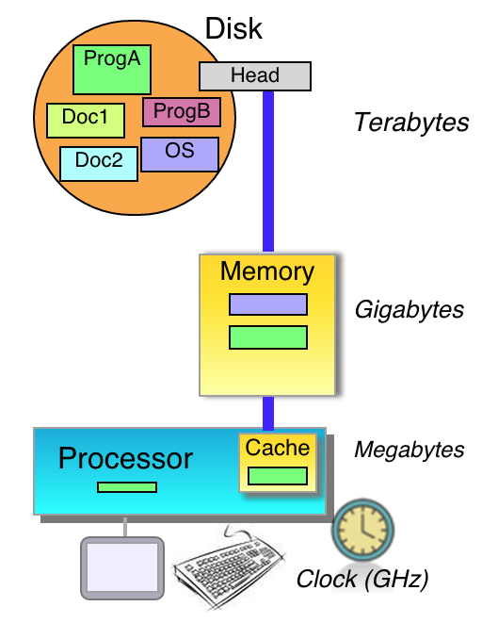
Does Student Crowdsourcing of Practice Questions and Animations Lead to Good Quality Materials?
Alex Edgcomb, Joshua Yuen, and Frank Vahid
University of California, Riverside
Dept. of Engineering and Computer Science
Also with zybooks.com
Copyright © 2015 Alex Edgcomb, UC Riverside.
1 of 13
Notes:
Hello. I’m Alex Edgcomb, a research specialist at UC Riverside, and researcher and content developer at zyBooks.

Slide 2
Crowdsourcing interactive material
Web: Enables
- But static
+ Interactive more powerful
Wikipedia.org
Copyright © 2015 Alex Edgcomb, UC Riverside.
2 of 13
Notes:
Web-based publishing enables crowd sourced contributions, such as Wikipedia,
However almost all crowd sourced items utilize static content: text and possible figures, or video lectures.
We believe interactive items, like animations and, learning questions are extremely powerful learning mechanisms enabled by the web, and they need to be utilized.

Slide 3
Memory architecture: Text
A disk can store many programs. Memory can store fewer programs than a disk. Cache (located on the processor) can store even fewer. A disk connects to memory, and memory connects to the cache on a processor.
For example, if the user runs a program ProgA, then ProgA is copied from the disk to memory, from memory to cache, then ProgA is executed. If the user then runs ProgB, then ProgB is copied from the disk to memory, from memory to cache, then executed. If the user then runs ProgA again, then ProgA is copied from memory to cache, then executed.
Not ideal
Copyright © 2015 Alex Edgcomb, UC Riverside.
3 of 13
Notes:
Let’s take the example of explaining memory architecture. Text is not ideal, as memory architecture is inherently visual.

Slide 4
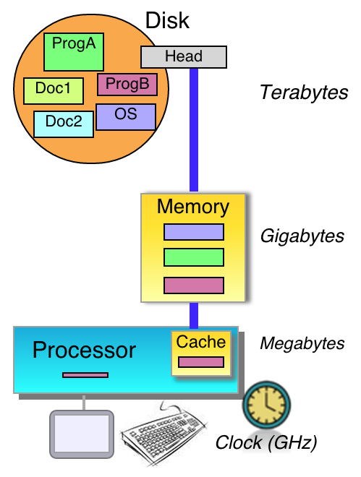
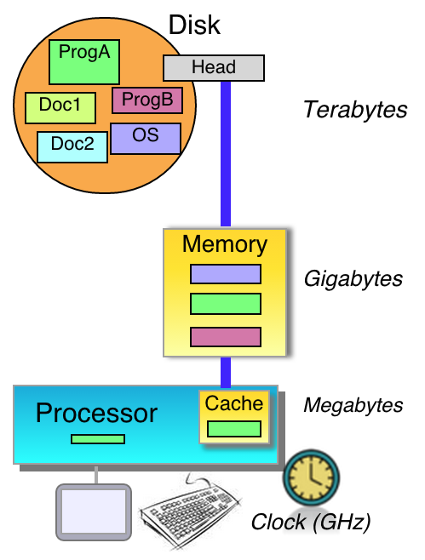
Memory architecture: Figure
(b)
Better, but not ideal
(a)
(c)
User runs ProgA. ProgA is copied from Disk to Memory to Cache, then executed.
User runs ProgB. ProgB is copied from Disk to Memory to Cache, then executed.
User runs ProgA again. ProgA is copied from Memory to Cache, then executed.
Copyright © 2015 Alex Edgcomb, UC Riverside.
4 of 13
Notes:
A multiple step figure with captions is better, but does not capture the dynamics.

Slide 5
Memory architecture: Animation
Copyright © 2015 Alex Edgcomb, UC Riverside.
5 of 13
Notes:
Animations may be the missing link in education. An animation is a series of moving objects that show a dynamic concept. Until recently, there hasn’t been an easy way to make animations. Powerpoint slides exist, but are off on their own. Professional animation tools exist but few people have access. However, an animation can convey a lot of information quickly. Professor Vahid, a co-author on this work, likes to say that if an image is worth 1000 words; an animation is worth 5000.

Slide 6
Crowdsource animations?
Can students:
Create? Rate?
Study
587 CS0 students, 3 groups:
Creators
Raters
Raters of top-19 + professional
Copyright © 2015 Alex Edgcomb, UC Riverside.
6 of 13
Notes:
So, we asked can we crowdsource animations? Specifically, can students create good-quality animations? And can students reliably rate animations, so good-quality animations percolate upward?
We conducted a study with 587 CS0 students, split into 3 groups. The first group created animations, a second group rated a random subset of those animations, and a third group rated the top 19 student-made animations and 1 professional made animation.

Slide 7
Some create good animations
Copyright © 2015 Alex Edgcomb, UC Riverside.
7 of 13
Notes:
Some students created good-quality animations. The CS0 students were asked to explain the concept of swap.

Slide 8
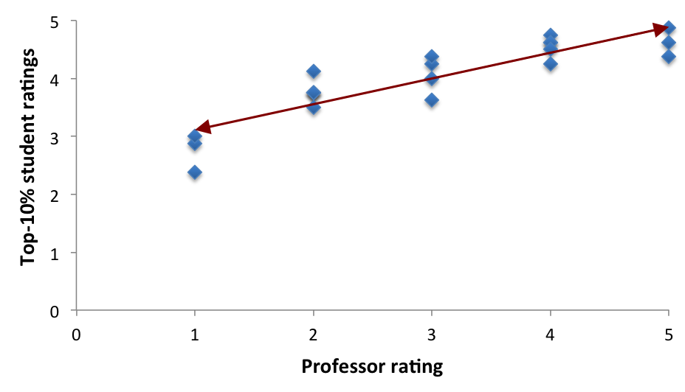
Some students can reliably rate animations
r-value = 0.74
p-value = 0.002
Student ratings
Professor rating
Copyright © 2015 Alex Edgcomb, UC Riverside.
8 of 13
Notes:
Some students can reliably rate animations. Each data point is an animation. The x-axis is the professor’s ratings. The y-axis is the average student’s ratings. The two are strongly correlated with an r-value of 0.74.

Slide 9
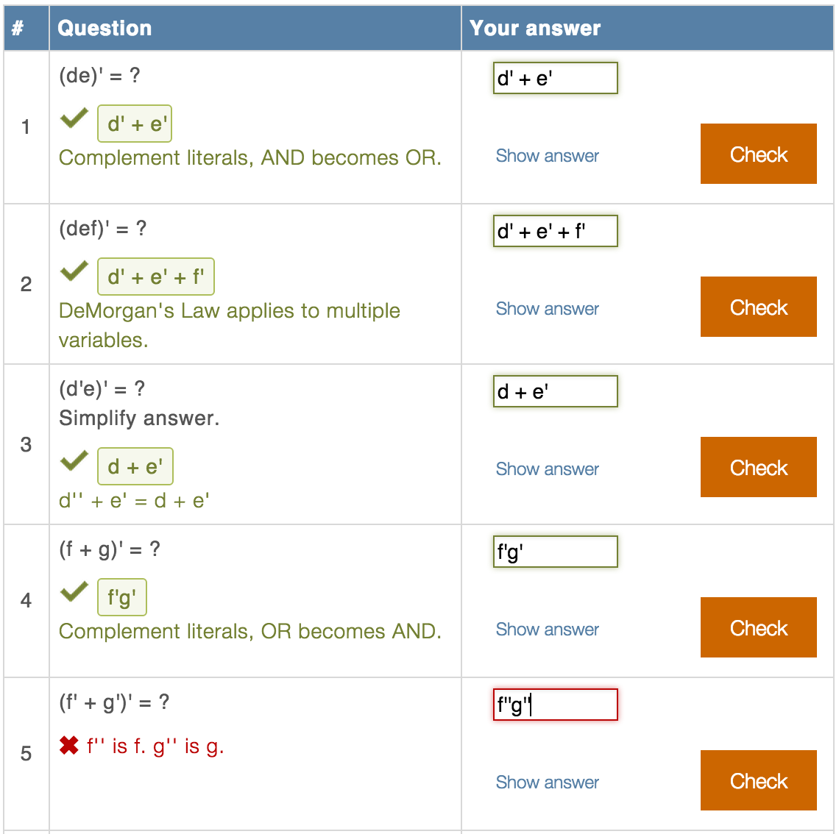
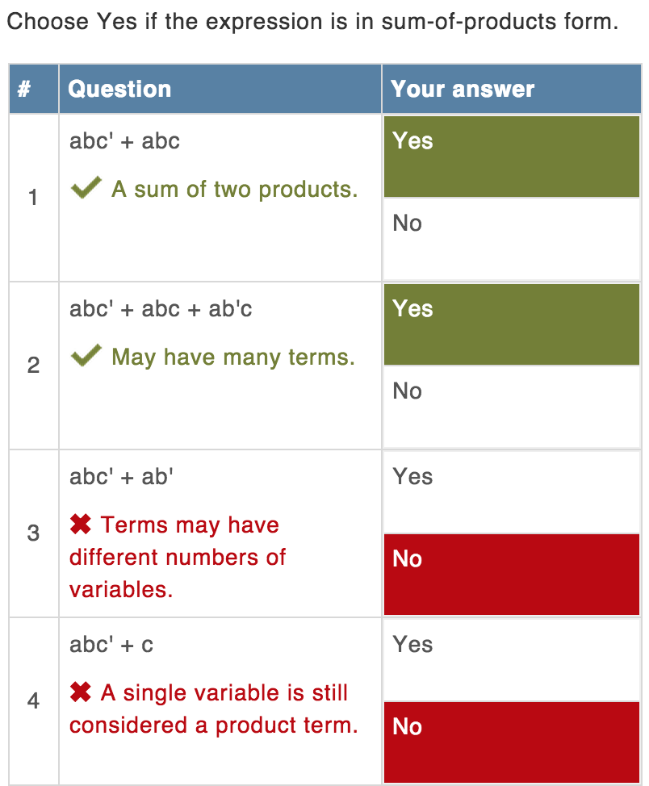
Learning questions
Copyright © 2015 Alex Edgcomb, UC Riverside.
9 of 13
Notes:
Learning questions replace text, providing a more engaging learning experience and safe place to practice. Learning questions are not quizzes or homework. There are many types of learning questions. One is a short answer type. A student enters a solution. If correct, then an explanation is shown. Otherwise, a hint is given. True / false is another type. A student selects an answer and is given an explanation.

Slide 10
Crowdsource learning questions?
Can students:
Create? Rate?
Study
25 upper-div students in embedded systems course. Each:
Created 6 questions
Rated 7 professor & 7 student questions
Copyright © 2015 Alex Edgcomb, UC Riverside.
10 of 13
Notes:
We ran a similar experiment for learning questions with 25 upper-division students in embedded systems. Each student created 6 questions and rated 7 professor-made questions and 7 student-made questions.

Slide 11
Students did not create good questions
Prof-rated 1 out of 5
Conceptually confused
Usage of “must” leads to wrong meaning
Answers not mutually exclusive
Prof-rated 1 out of 5.
Conceptually confused
Wording not precise
Explanation wrong
Copyright © 2015 Alex Edgcomb, UC Riverside.
11 of 13
Notes:
The students did not create good-quality questions. Here are two examples, both of which were rated by a professor as 1 out of 5. Both questions are conceptually confused. The first question’s usage of “must” leads to a wrong meaning. Also, the first question’s answer are not mutually exclusive. The second question also has issues with wording being imprecise and the explanation is wrong.

Slide 12
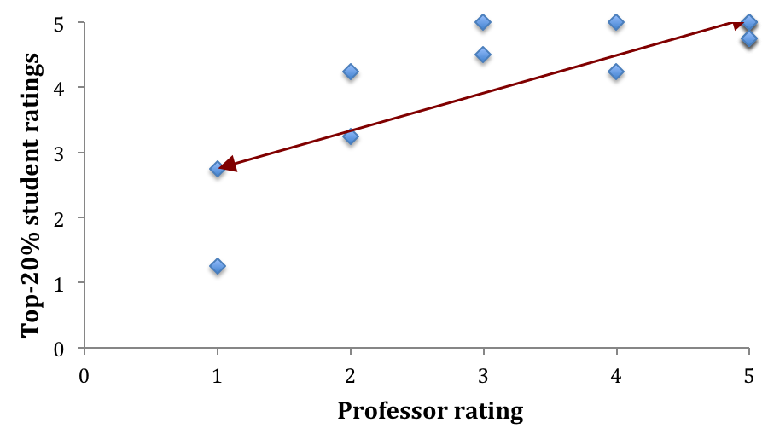
Some students can reliably rate learning questions
r-value = 0.46
p-value = 0.20
Student ratings
Professor rating
Copyright © 2015 Alex Edgcomb, UC Riverside.
12 of 13
Notes:
Some students can reliably rate learning questions. The professor and student ratings had a medium correlation of 0.46.

Slide 13
Conclusion
Web: New publishing
Enables crowdsourcing
Real power – Interactivity
Students could
Reliably rate animations / questions
Create good animations
Not create good questions
Crowdsourcing interactive content promising
Future: Instructors
Gratefully acknowledge NSF: SBIR 1315094 / 1430537
Copyright © 2015 Alex Edgcomb, UC Riverside.
13 of 13
Notes:
The web is a new publishing platform that enables crowdsourcing. We believe the real power is the interactivity. Students could reliably rate animations and questions, as well as, create good animations. But students did not create good-quality questions. Crowdsourcing of interactive content is promising. Future work includes investigating crowdsourced instructor-created questions.
We gratefully acknowledge the NSF for their support. Thank you.

