Slide 1
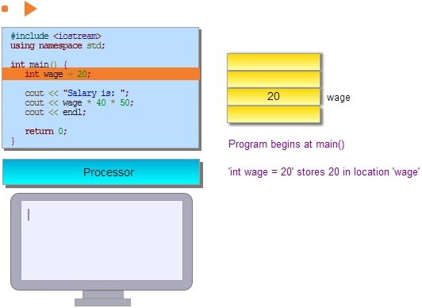
Student Performance Improvement using Interactive Textbooks: A Three-University Cross-Semester Analysis
Alex Edgcomb*, Frank Vahid*, Roman Lysecky°,
Andre Knoesen†, Rajeevan Amirtharajah†, and Mary Lou Dorf‡
*Dept. of CS&E, Univ. of California, Riverside. Also with zyBooks.com
°Dept. of ECE, Univ. of Arizona. Also with zyBooks.com
†Dept. of ECE, Univ. of California, Davis
‡Dept. of EECS, Univ. of Michigan
Copyright © 2015 Alex Edgcomb, UC Riverside.
1 of 10
Notes:
Hello. I’m Alex Edgcomb, a research specialist at UC Riverside, and researcher and content developer at zyBooks.

Slide 2
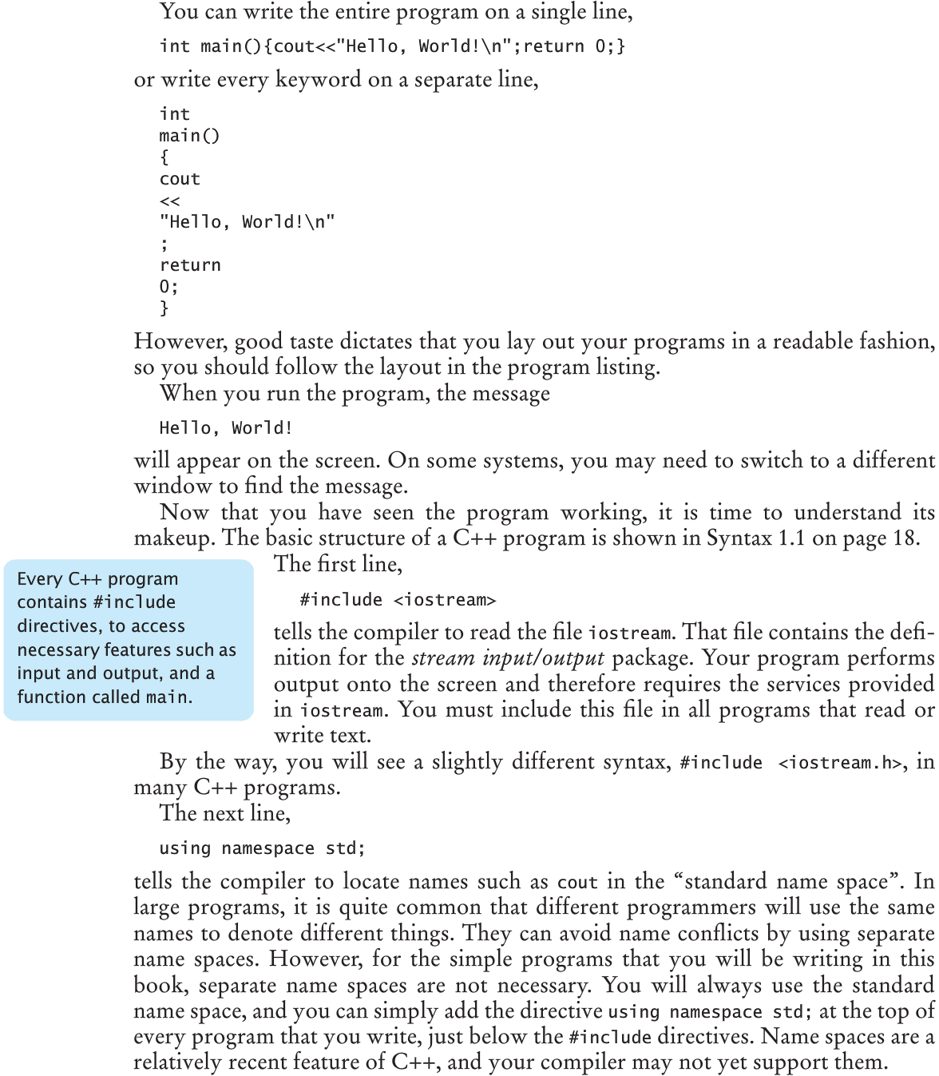
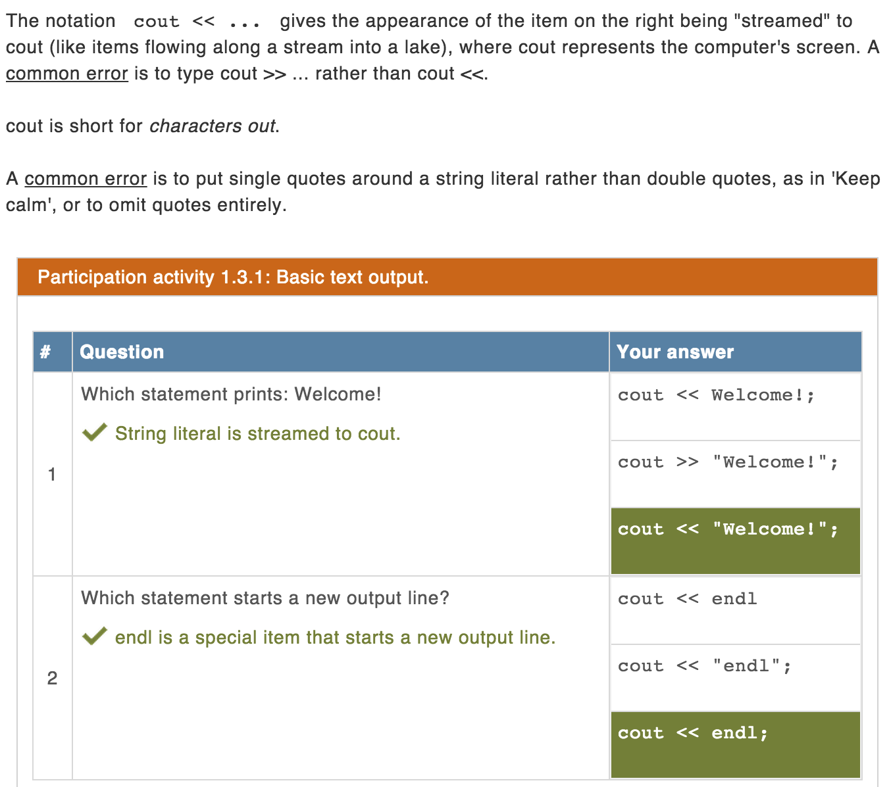
Is student performance better with an interactive textbook?
Static
Interactive
Copyright © 2015 Alex Edgcomb, UC Riverside.
2 of 10
Notes:
This work asks: Is student performance better with an interactive textbook?
A traditional static textbook uses text and figures. An interactive textbook uses less text, instead using animations, learning questions, and tools.
An interactive textbook is NOT text highlighting, end of section true/false questions, nor videos.

Slide 3
Interactive textbook demo
Copyright © 2015 Alex Edgcomb, UC Riverside.
3 of 10
Notes:
[0:00] Here’s an example of a section from an interactive textbook. The content includes learning questions, animations, and tools.
[0:10] An animation is a series of moving objects.
[0:22] Learning questions replace text, providing a more engaging learning experience and safe place to practice.
[0:37] Interactive tools enable students to tinker and play, such as this state machine tool.
[0:51] Also, tools enable auto-generated and auto-graded challenges, which may be used for homework.

Slide 4
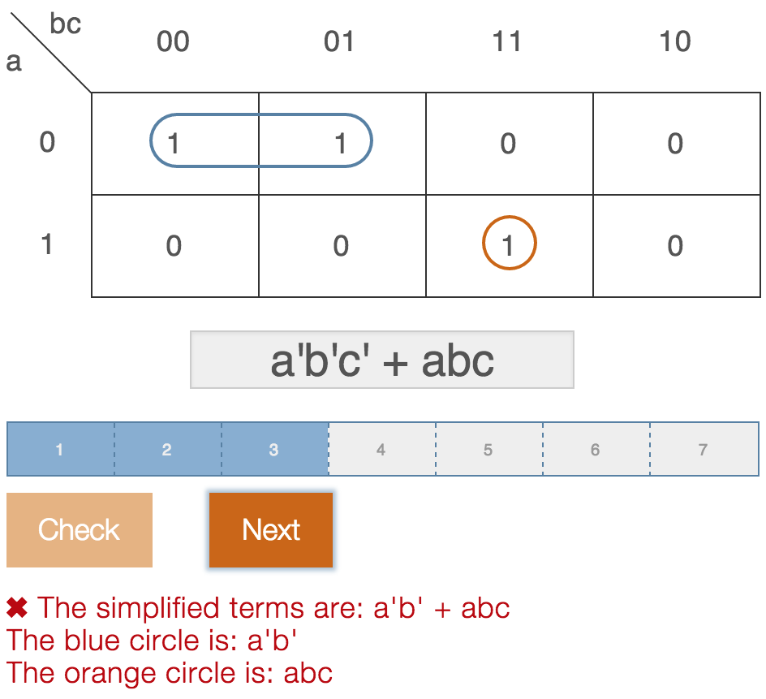
Interactive textbook demo
Copyright © 2015 Alex Edgcomb, UC Riverside.
4 of 10
Notes:
Learning questions replace text, providing a more engaging learning experience and safe place to practice.
Animations explain key concepts, visually and dynamically.
Interactive tools enable students to tinker and play. Also, tools enable auto-generated and auto-graded challenges, which may be used for homework.

Slide 5
Student performance better?
Only change was to interactive textbook. Same:
Experienced instructor
Semester (Fall 2012 vs Fall 2013)
Course work
1,945 students
Course | University | Students before | Students after
CS2 with C language | U of Arizona | 124 | 133
Problem solving with MATLAB | UC Davis | 211 | 245
CS1 with C++ language | U of Michigan | 434 | 567
CS1 with C language | U of Arizona | 140 | 166
Copyright © 2015 Alex Edgcomb, UC Riverside.
5 of 10
Notes:
We conducted an analysis with courses that only changed from using a static textbook to an interactive textbook. The courses had the same experienced instructor, were the same semester of the year (such as Fall 2012 and Fall 2013), and had the same course work. 1,945 students were included in the analysis across 4 courses: CS2 with C at the University of Arizona, problem solving with MATLAB at UC Davis, CS1 with C++ at the University of Michigan, and CS1 with C at the University of Arizona.

Slide 6
Course grades improved
CS2 with C language
Problem solving with Matlab
A
A
A
A
B
B
B
C
C
D
D
B
F
C
F
CS1 with C++ language
CS1 with C language
A
A
A
A
B
B
B
C
B
C
C
Copyright © 2015 Alex Edgcomb, UC Riverside.
6 of 10
Notes:
Course grades improved. Here’s CS2 with C. The graph shows the percentage of students with each letter grade. The x-axis shows before and after the switch to an interactive textbook. The y-axis is the percentage of students. From before to after, there were fewer Ds and Fs.
Here’s problem solving with MATLAB. Again, there were fewer Ds and Fs, and more As and Bs. Same for CS1 with C++, and CS1 with C.

Slide 7
Outcomes improved: Combined statistical analysis
 | Exams | Projects | Class score | Class letter grade
Static Z-score average | -0.192 | -0.103 | -0.228 | -0.177
Interactive Z-score average | 0.157 | 0.084 | 0.140 | 0.144
Improvement % | 13.6% | 7.4% | 14.3% | 12.6%
p-value | < 0.001 | < 0.001 | < 0.001 | < 0.001
Higher is better, except p-value
Note: Only change was to interactive textbook.
Copyright © 2015 Alex Edgcomb, UC Riverside.
7 of 10
Notes:
We conducted a combined statistical analysis, including 4 course assessments: exams, projects, class score, and class letter grade.
For each student’s assessment score, that score was Z-scored across both semester’s of that course. The Z-scoring helped account for grading scales differences between courses. Then, the Z-scores were concatenated for classes using static content, and separately concatenated for classes using interactive content.
The improvement percentage is the improvement from switching from a static textbook to an interactive textbook. Exams improved by 13.6%, projects by 7.4%, class scores by 14.3%, and class letter grade by 12.6%.
We applied a Bonferroni correction to account for the multiple significance tests, resulting in a critical p-value of 0.01. So, each improvement is interpreted as statistically significant.
The statistical techniques used during analysis are detailed in the paper. I’m glad to talk about the analysis offline.

Slide 8
Students did the reading: Instructor comments
“I assigned readings due every two weeks. I noticed a difference. The students would ask more involved questions… lecture reviewed the basics, but went more in depth -- covering the exceptions and unusual cases.”
“…students read before class. The questions students asked in lecture seemed to be less about syntax and more about design and high-level concepts.”
Copyright © 2015 Alex Edgcomb, UC Riverside.
8 of 10
Notes:
Instructors noticed students were doing the reading. One instructor said…

Slide 9
Additional data
ASEE 2014: UCR, C++, Fall 2013, 128 students
16% more improvement
Static vs Interactive textbook
66% vs 98% acquire
Interactive:
5% - 10% pnts all that’s needed
Students: 2.5 hrs / week
Study: 550 students, 4 colleges
89% earnestly attempted
10
64% more
8
6.4
6
5.5
Improvement score
7.4
4
4.5
2
Static
Initially lowest quartile
Interactive
86%
More time
voluntarily spent
[1] Edgcomb, A. and F. Vahid. Effectiveness of Online Textbooks vs. Interactive
Web-Native Content, Proceedings of ASEE Annual Conference, 2014.
[2] Senack, E. Fixing the Broken Textbook Market. U.S. Public Interest Research
Group, Student PIRG, January 2014.
Copyright © 2015 Alex Edgcomb, UC Riverside.
9 of 10
Notes:
Last year at ASEE 2014 we presented a randomized-controlled study, in which each student was randomly assigned either a static or interactive textbook for a lesson. We measured student improvement with a quiz before and a quiz after the lesson.
The y-axis is the improvement score, which is the after-lesson quiz score minus the before-lesson quiz score. In blue, is the static textbook, and green is the interactive textbook.
Across the entire class, students assigned the interactive textbook improved by 16% more than students assigned the static textbook. For the initially lowest quartile, the students assigned the interactive textbook improved by 64% more than students assigned the static textbook. Notice that the initially lowest quartile students assigned the interactive textbook nearly caught up to the rest of the class.
Additionally, this work found that students assigned the interactive textbook voluntarily spent 86% more time with the lesson than students assigned the static textbook.
In surveys we’ve conducted, we’ve found that two-thirds of students acquire the required static textbook and nearly all students acquire the required interactive textbook.
Also, awarding 5% - 10% of course points for reading resulted in over 90% reading completion, with students spending 2.5 hours per week in the textbook. In a recent analysis, we found that 89% of students earnestly attempt these readings.

Slide 10
Conclusion
Just by switching to an interactive textbook, students did better
1,945 students: UA, UCD, UMich
Even more improvement possible with hybrid / flipped lecture [3][4]
 | Exams | Projects | Class score | Class letter grade
Improvement % | 13.6% | 7.4% | 14.3% | 12.6%
Gratefully acknowledge NSF: SBIR 1315094 / 1430537
[3] Porter, L., C. Bailey-Lee, and B. Simon. Halving Fail Rates using Peer Instruction: A Study of Four Computer Science Courses.
Proceeding of the 44th ACM technical symposium on Computer science education. ACM, 2013.
[4] Simon, B., J. Parris, and J. Spacco. How we teach impacts student learning: peer instruction vs. lecture in CS0.
Proceeding of the 44th ACM technical symposium on Computer science education. ACM, 2013.
Copyright © 2015 Alex Edgcomb, UC Riverside.
10 of 10
Notes:
Just by switching to an interactive textbook, students did better. Even more improvement may be possible with a hybrid or flipped lecture.
We gratefully acknowledge the NSF for their support. Thank you.

