Slide 1
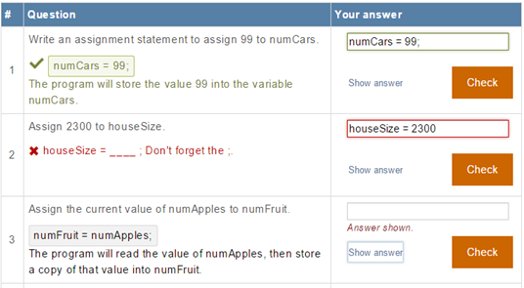
Will Students Earnestly Attempt Learning Questions if Answers are Viewable?
Joshua Yuen, Alex Edgcomb, and Frank Vahid
University of California, Riverside
Dept. of Engineering and Computer Science
Also with zybooks.com
Notes:
Hi. I’m Alex Edgcomb. I’m a research specialist at UC Riverside and a senior software engineer at zyBooks.

Slide 2
Interactive learning materials
Notes:
[0:00] Here’s an example of a section from an interactive textbook. The content includes learning questions, animations, and tools.
[0:10] An animation is a series of moving objects.
[0:21] (Pause) Learning questions replace text, providing a more engaging learning experience and safe place to practice. Multiple choice is one type of learning question. For each option, students are given an explanation for why that particular answer is correct or incorrect. Also, distractor options are deliberately included to help catch the student’s common misconceptions early.
(Play) Short answer is another type of learning question.

Slide 3
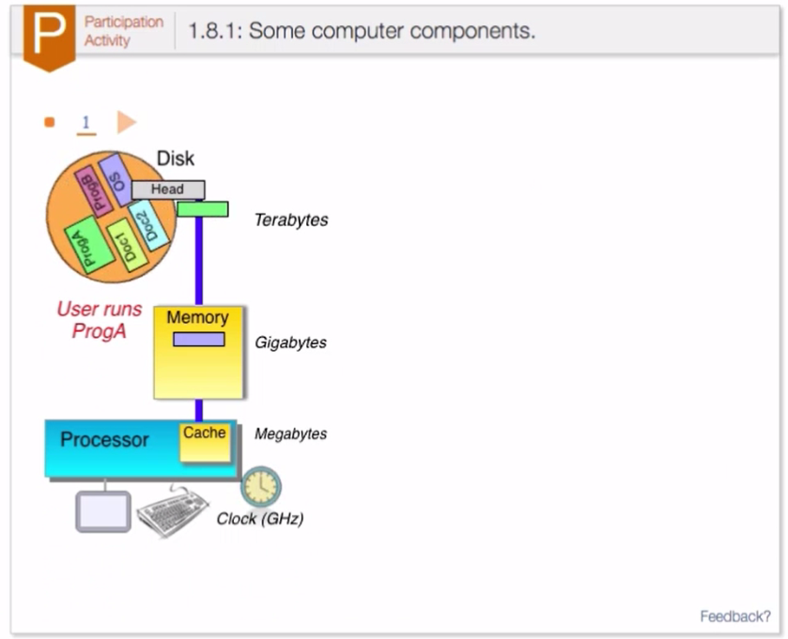
Interactive material

Slide 4
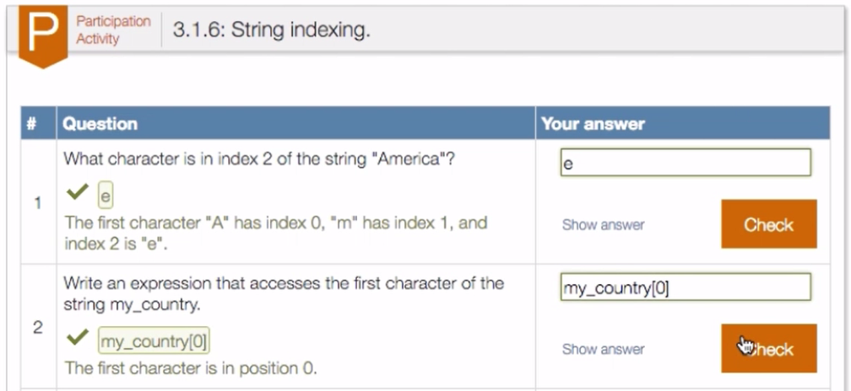
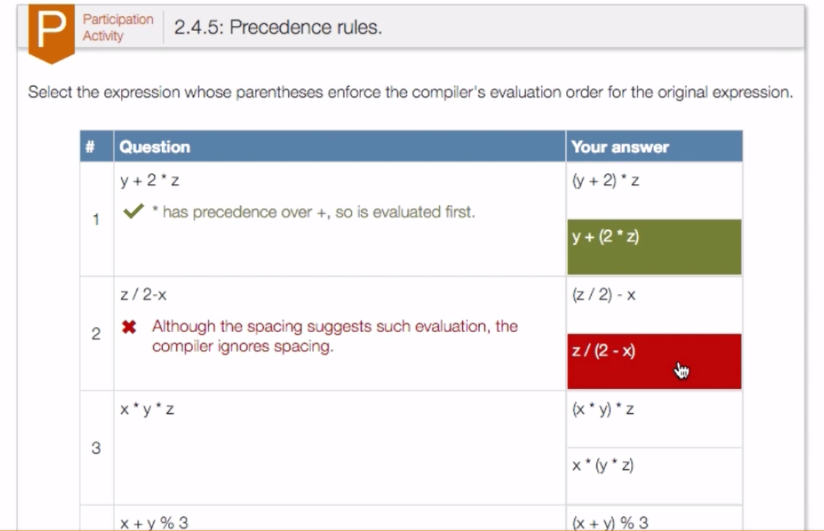
Interactive material

Slide 5
Learning questions
Notes:
A student enters an answer. If correct, an explanation is shown, as on question 1. If incorrect as in question 2, a hint is given that gets the student in the right direction. Learning questions replace text; they’re formative, not summative. So, if a student is stuck, there’s a release valve: the student can show the answer.

Slide 6
Instructors asked: Won’t students cheat the system to get their points?
Earnest
Not earnest
Notes:
Instructors asked: Won’t students cheat the system to get their points? This work investigates that question.
Earnest students attempt to answer the question with a right or wrong answer.
Not earnest students show the answer without even attempting to answer the question.

Slide 7
Study: Students earnestly attempt?
553 students across 3 colleges, 4 classes
Data collected after semester completion
Classes required students to use Programming in C++ zyBook
Classes offered during Fall 2014
Participants were not aware of the conditions of the study
College type | Number of students
Public research university | 379
Public teaching university | 117
Public community college | 57
Total | 553
Five earnestness % categories:
Highly earnest: 80%-100%
Moderately earnest: 60%-80%
Moderately unearnest: 40%-60%
Highly unearnest: 20%-40%
Cheating the system: 0% -20%
Notes:
We conducted a study to determine whether students earnestly attempt learning question.
The study included 553 students, across 3 colleges and 4 courses.
We collected data after the semester’s completion.
The class required students to use the Programming in C++ zyBook, and the class was offered during Fall 2014.
Participants were not aware of the conditions of the study.
Earnestness is defined as the number of questions attempted divided by the total number of questions.
We define 5 categories of earnestness. Highly earnest at 80 to 100% earnestness, and so on.

Slide 8
Students earnestly completed
Notes:
Students earnestly completed the learning questions. On the x-axis is the level of earnestness. On the y-axis is the percentage of students.
More than 85% of students were earnest. Only 2% were blatantly cheating the system.

Slide 9
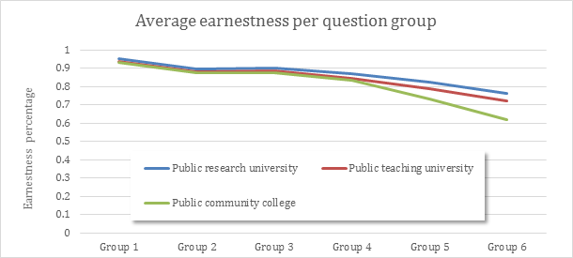
Students earnestness through semester; remains high but decreases
Grouped questions
on order of appearance
Notes:
We looked at student earnestness through the semester, which remained high but decreased. We grouped the learning questions into 6 ordered groups, which can be thought of as chapters, like chapter 1, chapter 2, and so on.
On the x-axis are the groups. On the y-axis is the earnestness percentage.

Slide 10
Slight decrease factors: Student tiredness and topic difficulty
77% student tiredness
23% topic difficulty
Details in paper.
Notes:
We considered two factors for the slight decrease: student tiredness and topic difficulty.
The intuition being that students get more tired through the semester and that the topics increase in difficulty through the semester, both of which may contribute to a decreased earnestness.
We averaged the earnestness for the first-half of the semester and the second-half, then looked at the difference.
77% was due to student tiredness and 23% was due to topic difficulty. Details are in the paper.

Slide 11
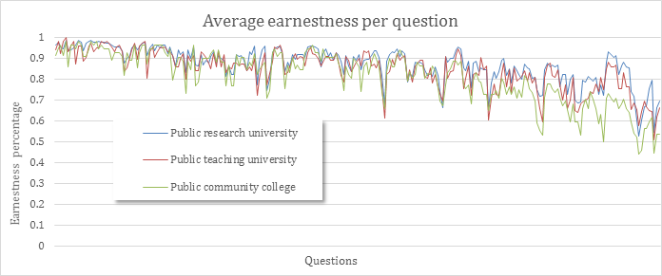
For authors: Earnestness indicates question quality
Notes:
From an authoring perspective, we found earnestness indicates question quality. On the x-axis is each learning question. On the y-axis is the earnestness percentage for that question. We see there are salient questions that create a trough. Let’s take a closer look at the trough questions.

Slide 12
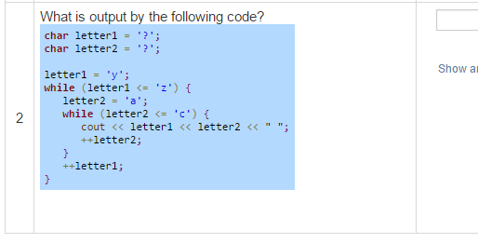
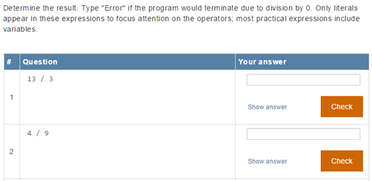
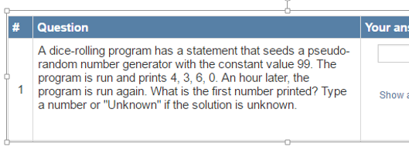
Student earnestness identified potential issues
Very
detailed
?
Learning moment:
Tricky on purpose
Notes:
We found one type of trough question was due to students being unsure how to answer the question.
Another, due to the question being very detailed.
However, a third, is tricky on purpose to create a learning moment.
Student earnestness enables empirical and automatic identification of potential issues.

Slide 13
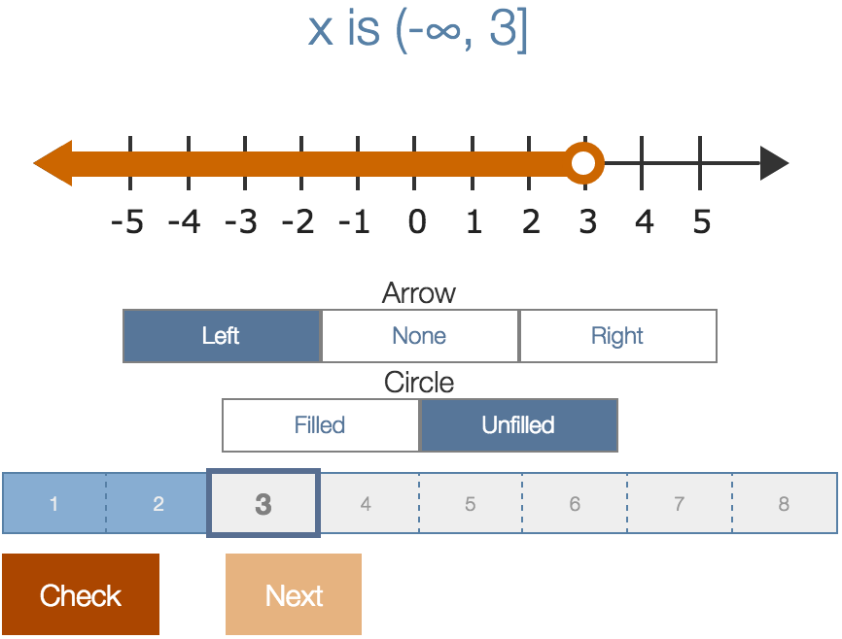
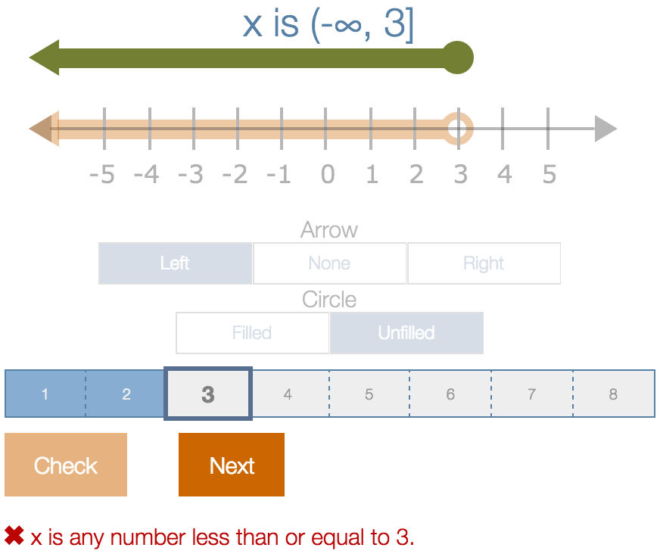
Recent data: Progression activity
54 students
12 progression activities

Slide 14
Conclusion
85% earnest, 2% cheat the system
Build content that student’s value: fair, high-quality
Earnestness provides authoring insight
Future work to analyze:
Other interactive activities
Student demographic
Gratefully acknowledge NSF: SBIR 1315094 / 1430537 and a Google faculty research award
Notes:
85% of students were earnest.
Only 2% blatantly cheated the system.
Spend effort to build content that student’s value. Fair and high-quality.
Earnestness provides insight on question quality.
Future work includes measuring earnestness of different interactive activities, measuring the impact of course difficulty on earnestness, whether student demographic affect earnestness, and whether question randomization affects earnestness.
Thank you.

