Slide 1
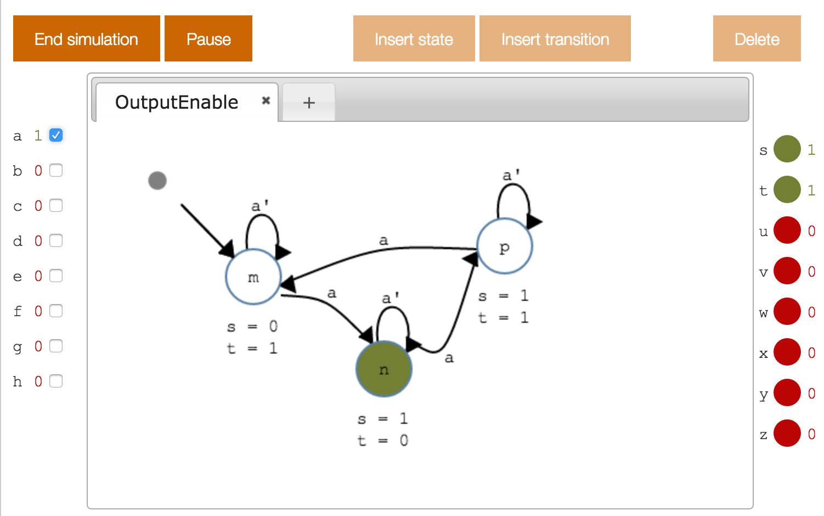
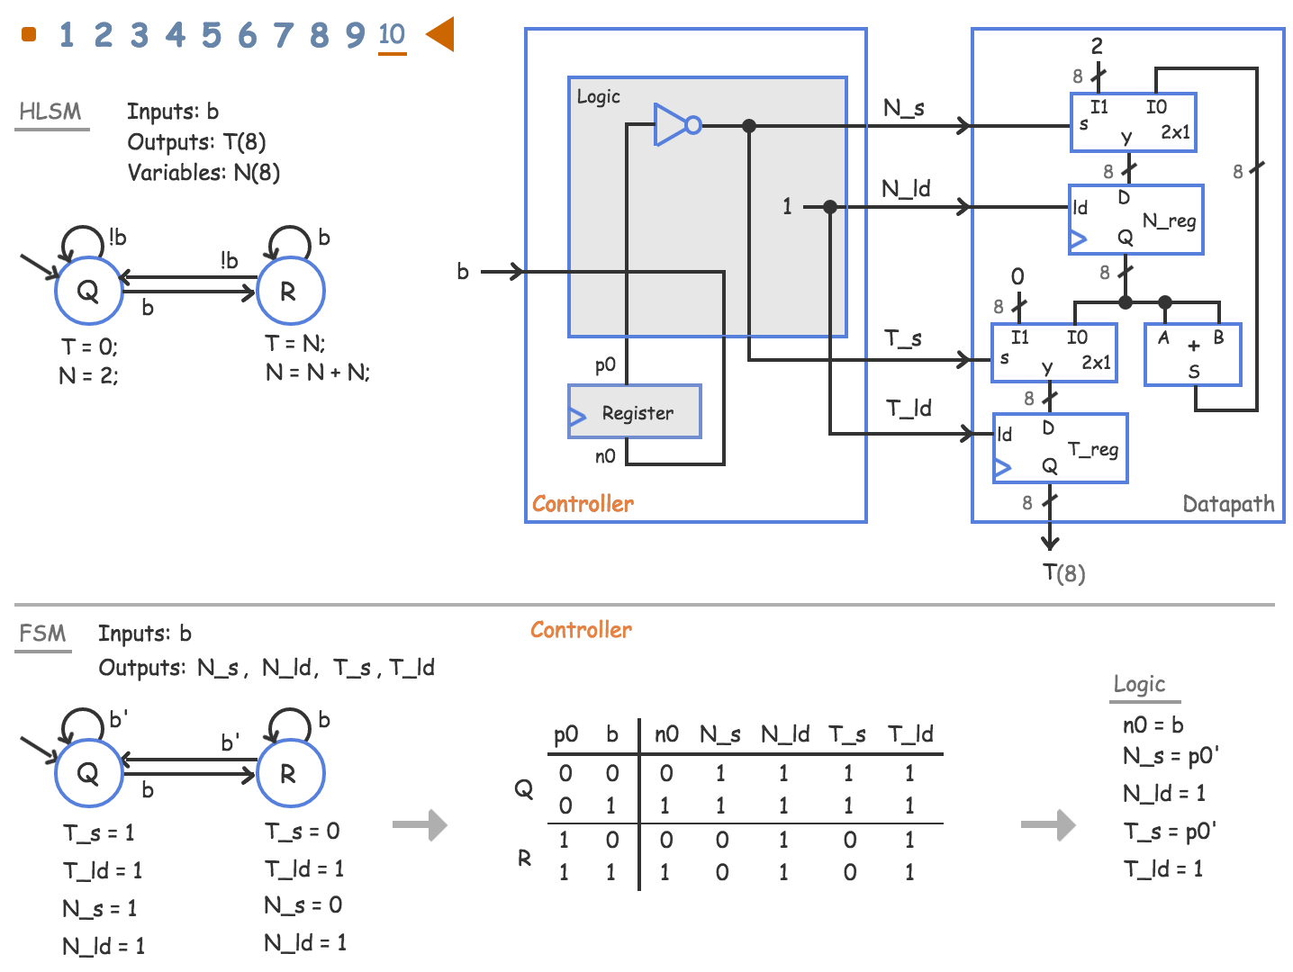
New Web-Based Interactive Learning Material for Digital Design
Frank Vahid^{1,2}, Alex Edgcomb^{1,2}, Susan Lysecky², Roman Lysecky^{2,3}
¹ Dept. of Computer Science and Eng., University of California, Riverside
² zyBooks, Los Gatos, California (zyBooks.com)
³Dept. of Electrical and Computer Eng., University of Arizona
Copyright © 2016 Frank Vahid and Alex Edgcomb, UC Riverside.
1 of 13

Slide 2
Digital Design is balance of theory / practice
Theory
Textbook + lecture
Practice
Limited, delayed, loose integ.
Reading / Homework
Loose integration
Lecture
Focus since 2000
Lab
Copyright © 2016 Frank Vahid and Alex Edgcomb, UC Riverside.
2 of 13

Slide 3
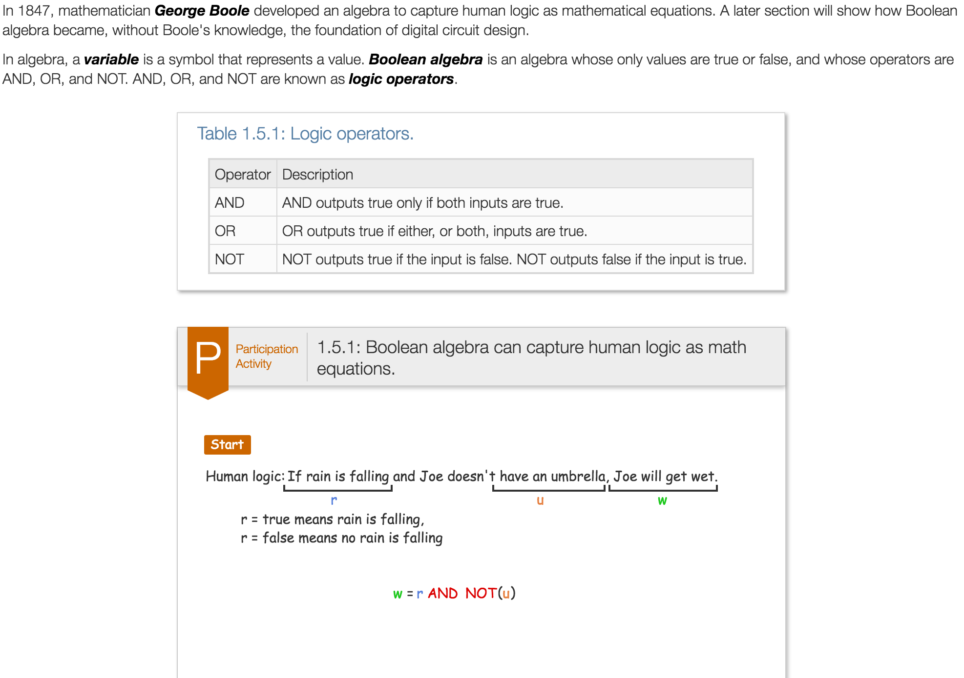
Balancing theory / practice: Boolean algebra
Copyright © 2016 Frank Vahid and Alex Edgcomb, UC Riverside.
3 of 13

Slide 4
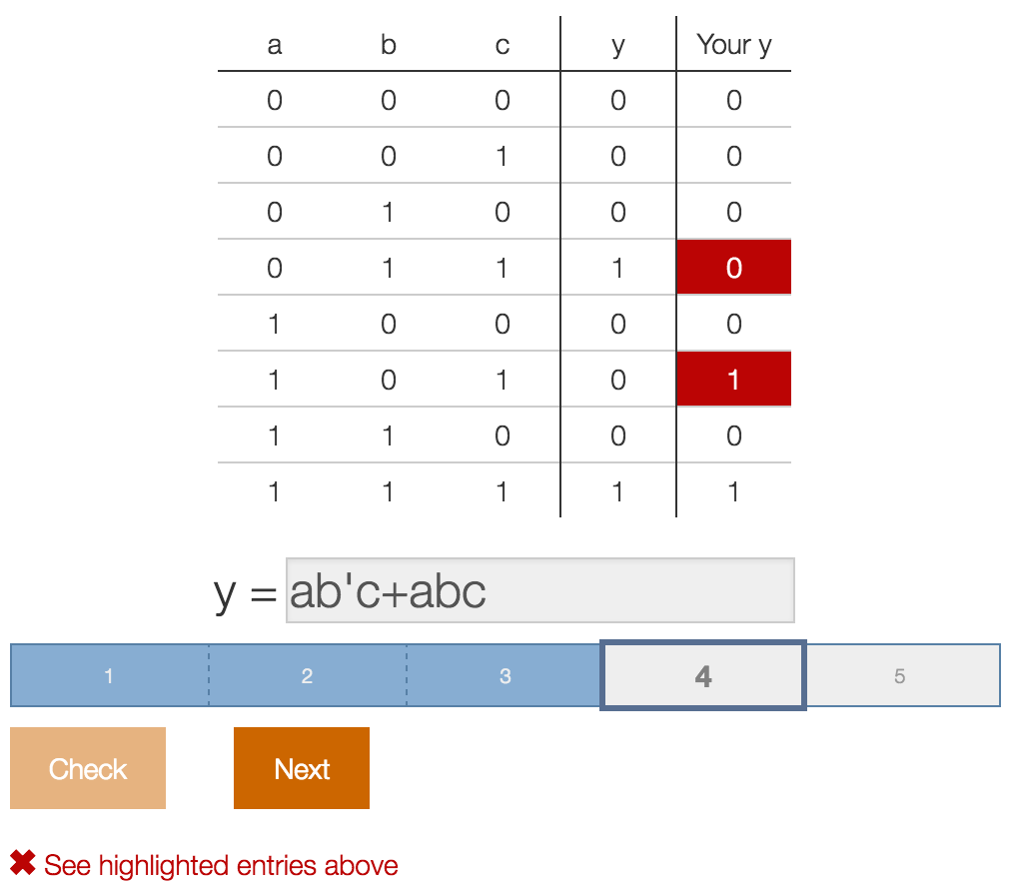
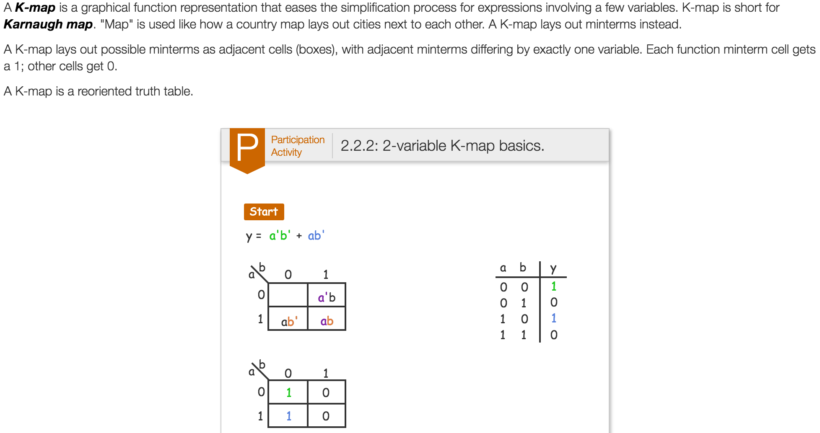
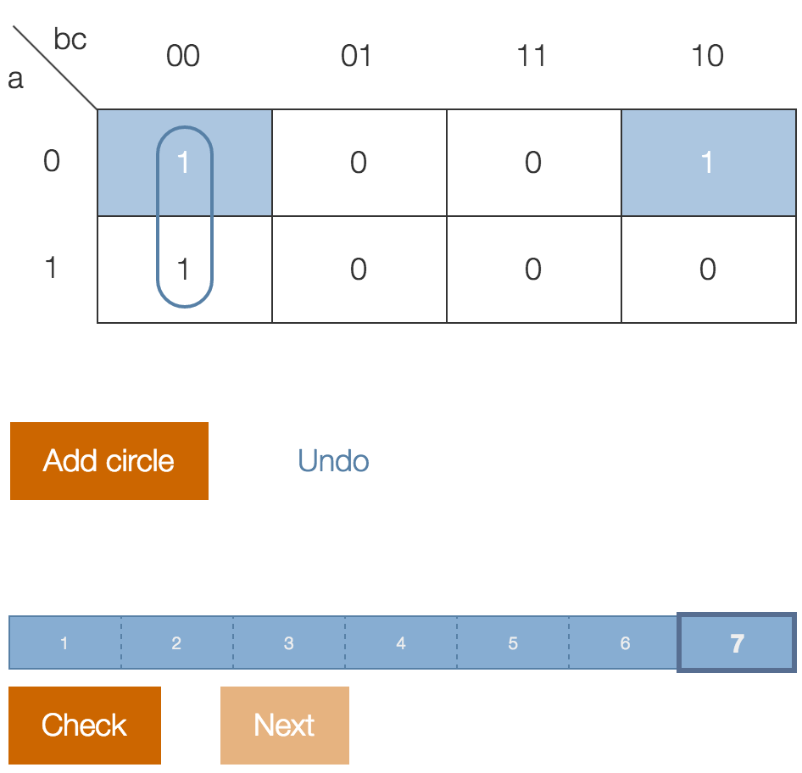
Balancing theory / practice: Combinational logic design
Copyright © 2016 Frank Vahid and Alex Edgcomb, UC Riverside.
4 of 13

Slide 5
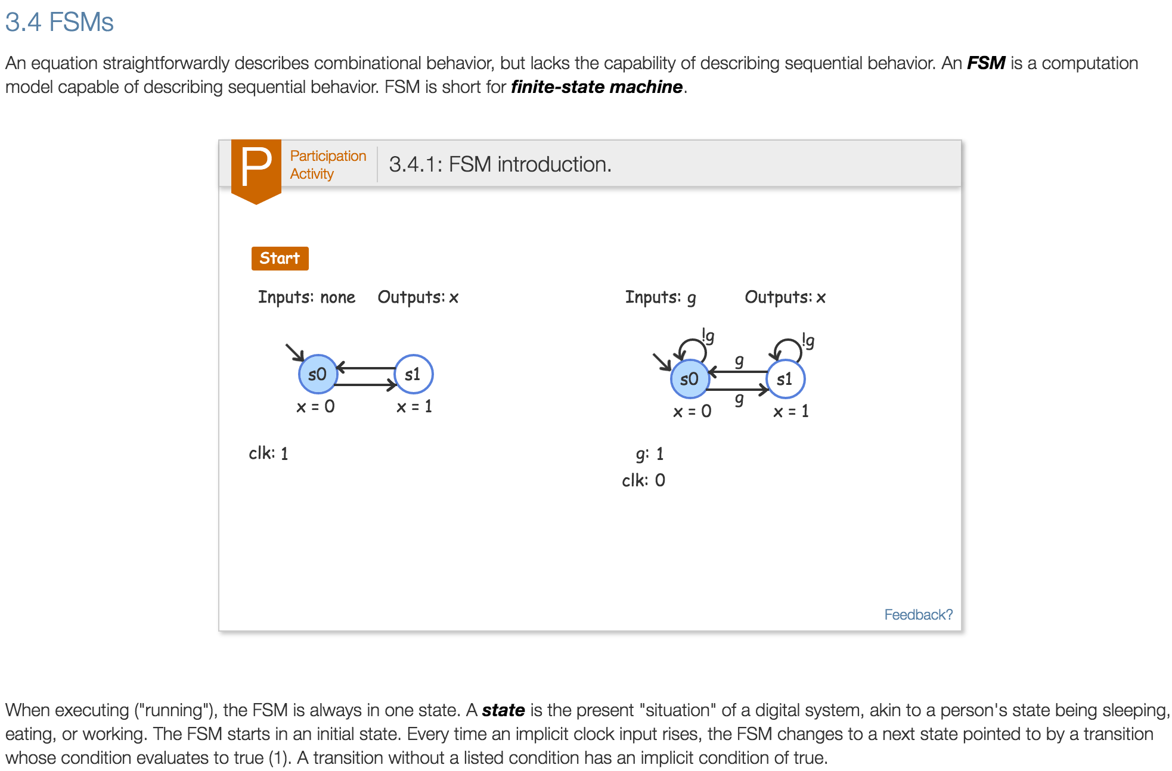
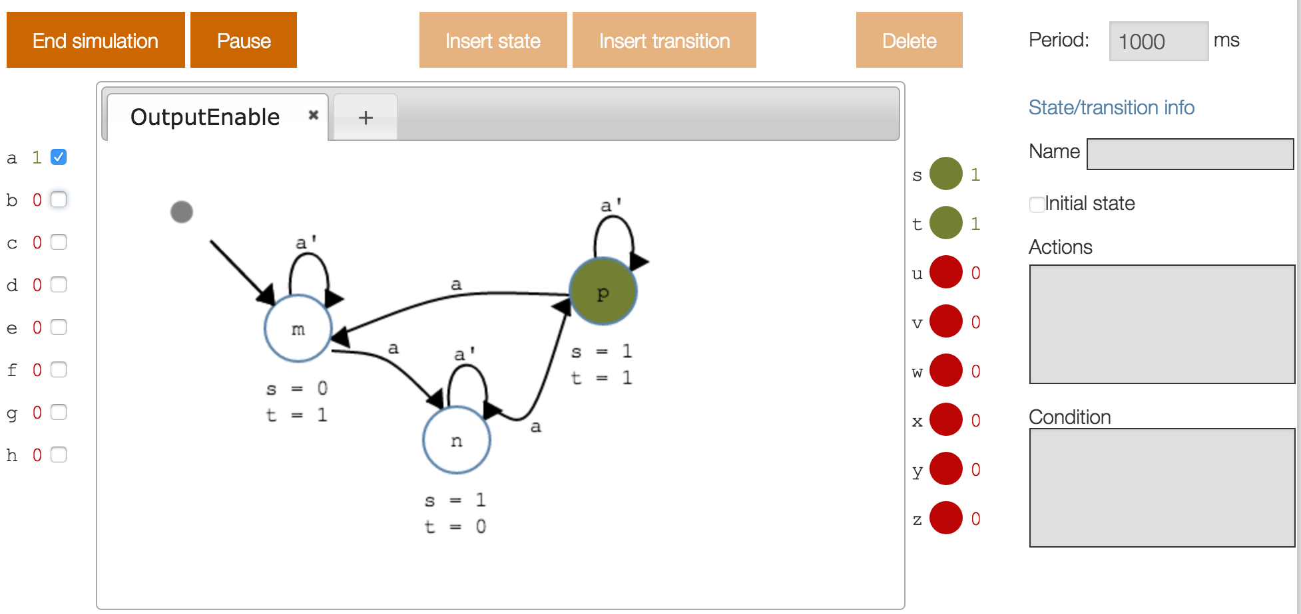
Balancing theory / practice: FSMs
Copyright © 2016 Frank Vahid and Alex Edgcomb, UC Riverside.
5 of 13

Slide 6
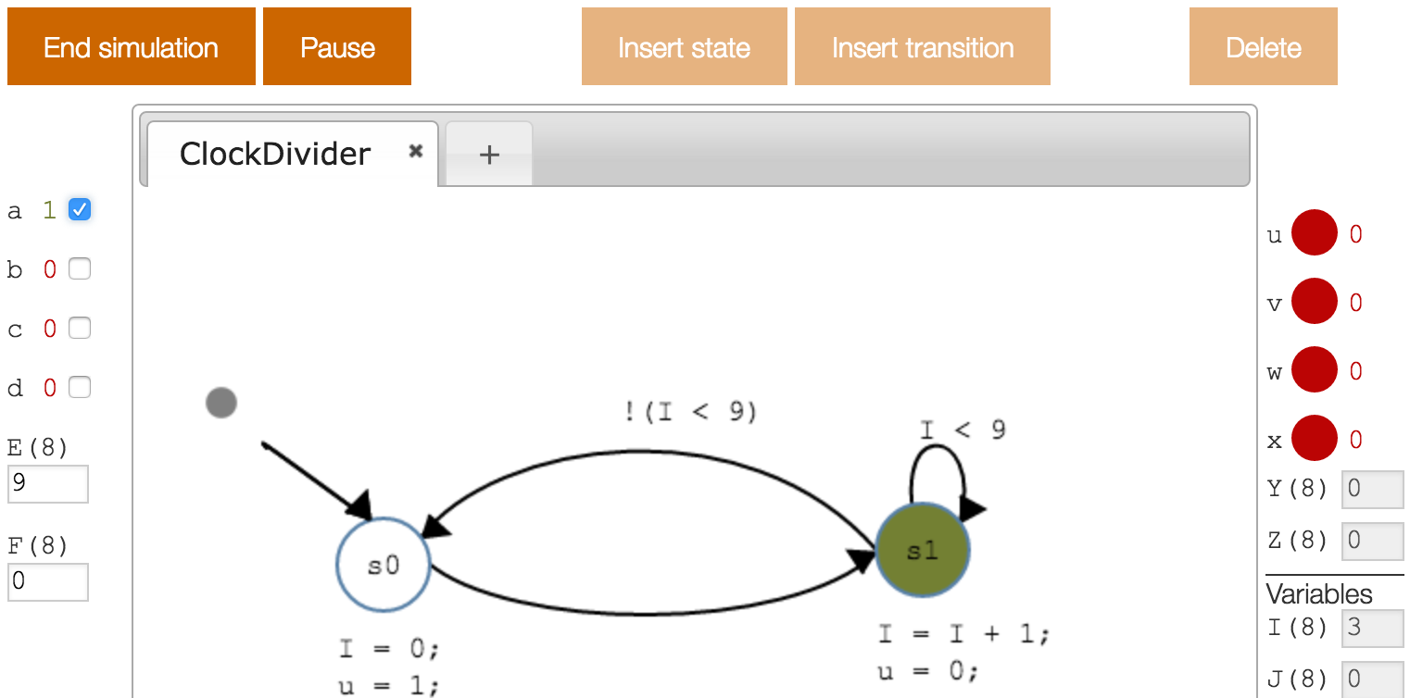
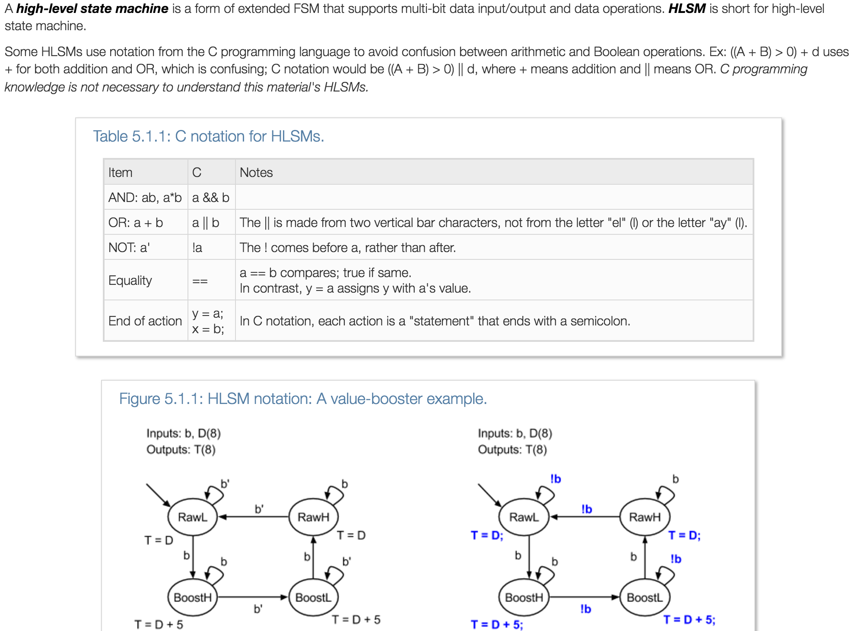
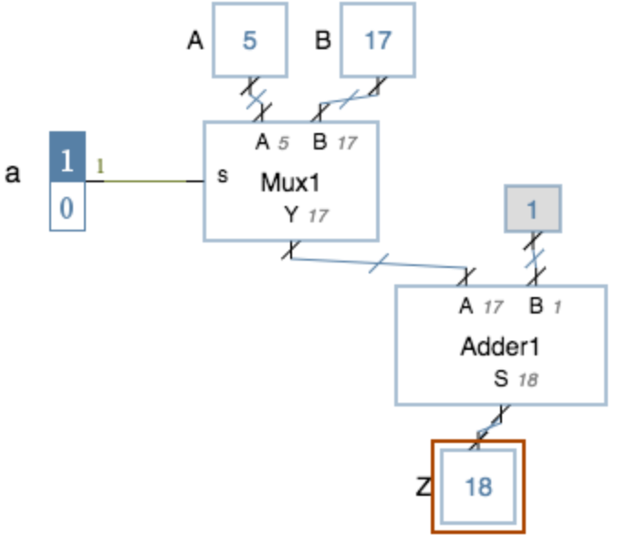
Balancing theory / practice: RTL
Copyright © 2016 Frank Vahid and Alex Edgcomb, UC Riverside.
6 of 13

Slide 7
Web can integrate theory / practice
Reading plus
Tools
Interactive questions
Animations
Auto-generated/graded homework
Reading / Homework
Lecture
Lab
Copyright © 2016 Frank Vahid and Alex Edgcomb, UC Riverside.
7 of 13

Slide 8
Content demo
Copyright © 2016 Frank Vahid and Alex Edgcomb, UC Riverside.
8 of 13

Slide 9
Also: RTL in first course
Intro
Bool alg
Comb logic design
Comb logic optim
HDL
Seq logic design
Seq logic optim
HDL
Datapath comp
Datapath design
HDL
(??RTL??)
Intro
Bool alg
Comb logic design / optim
Seq logic design / optim
Datapath components
RTL design
HDL
Copyright © 2016 Frank Vahid and Alex Edgcomb, UC Riverside.
9 of 13

Slide 10
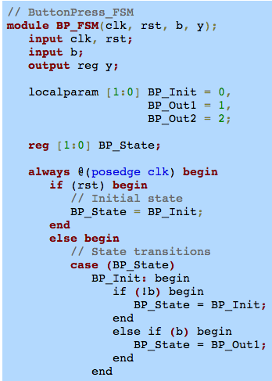
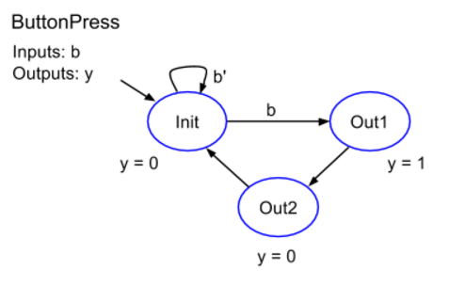
And: Later/less HDL focus, more on models
Intro
Bool alg
Comb logic design / optim
Seq logic design / optim
Datapath components
RTL design
HDL
Use HDL templates
A 12-year-old can convert model to HDL
Copyright © 2016 Frank Vahid and Alex Edgcomb, UC Riverside.
10 of 13

Slide 11
Table of contents
1. Combinational Logic
1.1 Voltage and current
1.2 Switches
1.3 CMOS transistors
1.4 Transistors and gates
1.5 Boolean algebra
1.6 Boolean algebra and digital design
1.7 Digital circuit simulator
1.8 Timing diagrams
1.9 Equations to/from circuits
1.10 Basic properties of Boolean algebra
1.11 Sum-of-products form for circuits
1.12 Binary and counting
1.13 Sum-of-minterms form
1.14 Truth tables
1.15 Why study digital design
1.16 Basic circuit drawing conventions
1.17 Number systems
2. Combinational Logic II
2.1 Two-level combinational logic minimization
2.2 K-maps: Introduction
2.3 More K-maps
2.4 Prime implicants
2.5 More Boolean algebra: DeMorgan's Law
2.6 XOR and XNOR gates
2.7 Universal gates
2.8 Muxes
2.9 Decoders
3. Sequential Logic
3.1 SR latches
3.2 Flip-flops
3.3 Basic registers
3.4 FSMs
3.5 FSM simulator
3.6 Capturing behavior with FSMs
3.7 FSMs to circuits
3.8 Circuits to FSMs
3.9 Reducing states
3.10 State encodings
3.11 Mealy FSMs
3.12 FSM issues
3.13 Controller clock frequency
4. Datapath Components
4.1 Adders
4.2 Signed numbers in binary
4.3 Subtractors
4.4 Comparators
4.5 N-bit muxes
4.6 Load registers
5. RTL Design
5.1 HLSMs: Introduction
5.2 HLSMs with variables
5.3 HLSMs with a loop
5.4 HLSM simulator
5.5 Capturing behavior with HLSMs
5.6 Datapaths for HLSMs
5.7 HLSMs to circuits: RTL design
5.8 RTL timing
5.9 Assigning and reading variables
6. Datapath Components II
6.1 Tradeoffs
6.2 Carry-lookahead adders
6.3 Multipliers (array-style)
6.4 Register files
6.5 Multi-function registers
6.6 ALUs
7. Verilog HDL
7.1 Introduction to HDLs
7.2 Combinational logic
7.3 Identifiers
7.4 Testbench
7.5 Sequential logic
7.6 RTL design
8. VHDL
8.1 Introduction to HDLs
8.2 Combinational logic
8.3 Identifiers
8.4 Testbench
8.5 Sequential logic
8.6 RTL design
Copyright © 2016 Frank Vahid and Alex Edgcomb, UC Riverside.
11 of 13

Slide 12
Subscription-based web material – zyBooks.com (unashamedly)
Copyright © 2016 Frank Vahid and Alex Edgcomb, UC Riverside.
12 of 13

Slide 13
Conclusion
New DD learning material
Tightly integrated theory / practice
RTL / HDL
Used in ~40 universities, growing
Research: ASEE’14 and ASEE’15 papers showed student outcome improvements with this kind of material
Anecdotal: “You freed me” “The students are doing much better” ”I wish I had this in my other classes” …
Gratefully acknowledge NSF: SBIR 1315094 / 1430537, past NSF/SRC/Intel/Freescale support, and a Google faculty research award
Copyright © 2016 Frank Vahid and Alex Edgcomb, UC Riverside.
13 of 13

