Slide 1

DTW-D: Time Series Semi-Supervised Learning from a Single Example
Yanping Chen

Slide 2
Outline
Introduction
The proposed method
  The key idea
  When the idea works
Experiment
Notes:
We demonstrate our ideas on diverse real word problems.

Slide 3
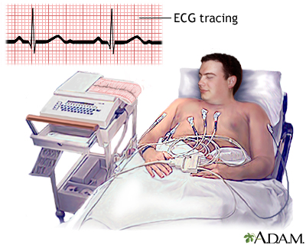
Introduction
Most research assumes there are large amounts of labeled training data.
In reality, labeled data is often very difficult /costly to obtain
Whereas, the acquisition of unlabeled data is trivial
Example: Sleep study test
A study produce 40,000 heartbeats;
but it requires cardiologists to label the individual heartbeats;
Notes:
Time series classification has been an important problem, with applications in virtually every scientific domain. In the past few decades, there are many research work that focus on this topic.

Slide 4
Introduction
Obvious solution: Semi-supervised Learning (SSL)
However, direct applications of off-the-shelf SSL algorithms do not typically work well for time series
Notes:
SSL makes use of both labeled and unlabeled data for training, typically with a small amount of labeled data, but a large amount of unlabeled data.
In the literature, there are a plethoral of SSL algorithms.

Slide 5
Our Contribution
  explain why semi-supervised learning algorithms typically
  fail for time series problems
  2. introduce a simple but very effective fix

Slide 6
Outline
Introduction
The proposed method
  The key idea
  When the idea works
Experiment

Slide 7
SSL: self-training
Self-training algorithm:
1. Train the classifier based on labeled data
2. Use the classifier to classify the unlabeled data
3. the most conﬁdent unlabeled points, are added to the training set.
4. The classiﬁer is re-trained, and repeat until stop criteria is met
classifier
classify
retrain
train
P:Labeled
U:unlabeled
Evaluation:
The classifier is evaluated on some holdout dataset
Notes:
In the literature, there are many SSL algorithms. Among them, the self-training is the most simple and commonly used method.
In self-training, the classifier is first trained using the small amount of labeled data. It is then used to classify the unlabeled data. The object which is
Most confidently classified as positive is then selected and moved to the labeled dataset. With the labeled dataset changed, the classifier is retrained using the new labeled dataset. The process continues until a stop criteria is met. When it stops, the classifier is evaluated on some holdout dataset.
As you can imagine, the accuracy of the classifier highly depends on the correct selection of the training data.

Slide 8
Two conclusions from the community
Most suitable classifier: the nearest neighbor classifier(NN)
Distance measure: DTW is exceptionally difficult to beat
In time series SSL, we use NN classifier and DTW distance.
For simplicity, we consider one-class classification, positive class and negative class.
[1] Hui Ding, Goce Trajcevski, Peter Scheuermann, Xiaoyue Wang and Eamonn Keogh (2008) Querying and Mining of Time Series Data: Experimental Comparison of Representations and Distance Measures, VLDB 2008

Slide 9
Our Observation
Observation:
Under certain assumptions, unlabeled negative objects are closer to labeled dataset than the unlabeled positive objects.
Nevertheless, unlabeled positive objects tend to benefit more from using DTW than unlabeled negative objects.
The amount of benefit from DTW over ED is a feature to be exploited.
I will explain this in the next four slides
labeled
unlabeled
d_{pos}
d_{neg}
d_{neg} < d_{pos}

Slide 10
Our Observation
Positive class
Example:
P: Labeled Dataset
1
0
P₁
Negative class
U: unlabeled dataset
1
U₁
0
U₂
Notes:
Positive class: objects defined by having three periods of sine wave and noise (blue and red)
Negative class: a constant line with same mean as positive class, corrupted by noise (green)
P: the set of labeled objects (P₁)
U: the set of unlabeled objects (U₁ and U₂)

Slide 11
Our Observation
P: Labeled Dataset
U: Unlabeled Dataset
1
1
U₁
0
P₁
0
U₂
U
Ask any SSL algorithm to choose one object from U to add to P using the Euclidean distance.
Not surprising, as is well-known, ED is brittle to warping[1].
U₂
U₁
P₁
P₁
ED(P₁, U₁) = 6.2 ED(P₁, U₂) = 11
ED(P₁, U₁) < ED(P₁, U₂) , SSL would pick the wrong one.
[1[ Keogh, E. (2002). Exact indexing of dynamic time warping. In 28th International Conference on Very Large Data Bases. Hong Kong. pp 406-417.

Slide 12
Our Observation
1
1
U₁
0
P₁
P
0
U₂
U
Why DTW fails?
Besides warping, there are other difference between P₁ and U_{2 .}
E.g., the first and last peak have different heights. DTW can not mitigate this.
What about replacing ED with DTW distance?
U₁
U₂
P₁
P₁
DTW(P₁, U₁) = 5.8 DTW(P₁, U₂) = 6.1
DTW helps significantly, but still picks the wrong one.

Slide 13
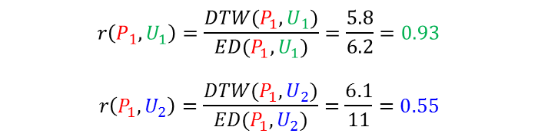
Our Observation
1
0
P₁
P
1
U₁
0
U₂
U
$$r\left(P_{1},U_{1}\right)=\frac{DTW(P_{1},U_{1})}{ED(P_{1},U_{1})}=\frac{5.8}{6.2}=0.93$$
$$r\left(P_{1},U_{2}\right)=\frac{DTW(P_{1},U_{2})}{ED(P_{1},U_{2})}=\frac{6.1}{11}=0.55$$
ED:
U₂
U₁
P₁
P₁
ED(P₁, U₁) = 6.2 ED(P₁, U₂) = 11
Under the DTW-Delta ratio(r):
DTW:
U₂
U₁
P₁
P₁
DTW(P₁, U₁) = 5.8 DTW(P₁, U₂) = 6.1

Slide 14
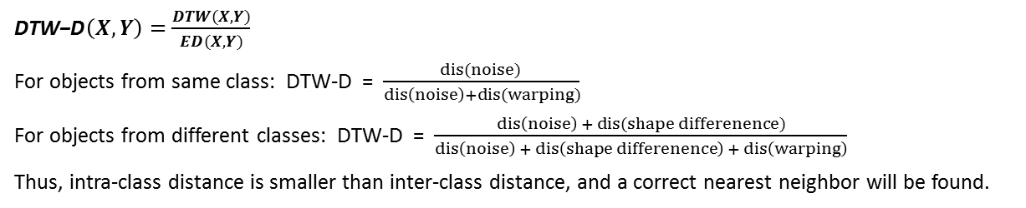
Why DTW-D works?
Objects from same class:
Objects from different classes:
distance from:
warping
noise
shape difference
warping
noise
ED =
warping
+
noise
ED =
shape difference
+
warping
+
noise
DTW =
noise
DTW =
shape difference
+
noise
$\text{DTW}\text{−}\text{D}\left(X,Y\right)=\frac{DTW(X,Y)}{ED(X,Y)}$
For objects from same class: DTW-D = $\frac{dis(noise) }{dis\left(noise\right)+dis(warping)}$
For objects from different classes: DTW-D = $\frac{dis\left(noise\right) + dis(shape differenence)}{dis\left(noise\right) + dis\left(shape differenence\right) + dis\left(warping\right)}$
Thus, intra-class distance is smaller than inter-class distance, and a correct nearest neighbor will be found.

Slide 15
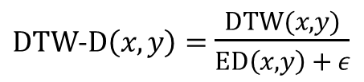
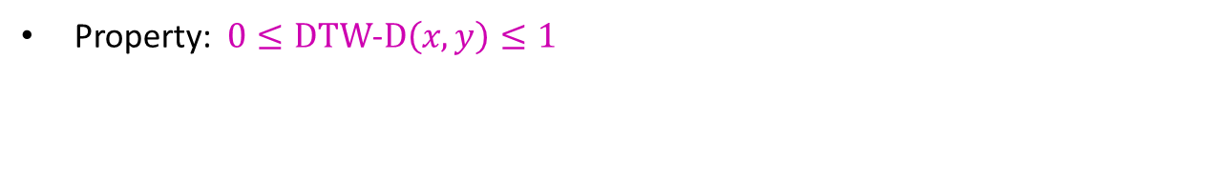
DTW-D distance
DTW-D: the amount of benefit from using DTW over ED.
$DTW$-$D\left(x,y\right)=$ $\frac{DTW(x,y)}{ED\left(x,y\right) + ε}$
Property: $0≤DTW\text{−}D\left(x,y\right)≤1$

Slide 16
Outline
Introduction
The proposed method
  The key idea
  When the idea works
Experiment

Slide 17
When does DTW-D help?
Two assumptions
Platonic ideal
  Assumption 1: The positive class contains warped versions of some platonic ideal, possibly with other types of noise/distortions.
Warped version
  Assumption 2: The negative class is diverse, and occasionally produces objects close to a member of the positive class, even under DTW.
Our claim: if the two assumptions are true for a given problem, DTW-D will be better than either ED or DTW.

Slide 18
When are our assumptions true?
    Observation1: Assumption 1 is mitigated by large amounts of labeled data
U: 1 positive object, 200 negative objects(random walks).
P: Vary the number of objects in P from 1-10, and compute the probability that the selected unlabeled object is a true positive.
Result: When |P| is small, DTW-D is much better than DTW and ED. This advantage is getting less as |P| gets larger.

Slide 19
When are our assumptions true?
    Observation2: Assumption 2 is compounded by a large negative dataset
Positive class
Negative class
P: 1 positive object
U: We vary the size of the negative dataset from 100 -1000. 1 positive object.
Result: When the negative dataset is large, DTW-D is much better than DTW and ED.

Slide 20
When are our assumptions true?
    Observation3: Assumption 2 is compounded by low complexity negative data
5 non-zero DFT coefficients; 20 non-zero DFT coefficients;
P: 1 positive object
U: We vary the complexity of negative data, and 1 positive object.
Result: When the negative data are of low complexity, DTW-D is better than DTW and ED.
[1] Gustavo Batista, Xiaoyue Wang and Eamonn J. Keogh (2011) A Complexity-Invariant Distance Measure for Time Series. SDM 2011

Slide 21
Summary of assumptions
    Check the given problem for:
      Positive class
        Warping
        Small amounts of labeled data
      Negative class
        Large dataset, and/or…
        Contains low complexity data

Slide 22
DTW-D and Classification
DTW-D helps SSL, because:
small amounts of labeled data
negative class is typically diverse and contains low-complexity data
DTW-D is not expected to help the classic classification problem:
large set of labeled training data
no class much higher diversity and/or with much lower complexity data than
other class

Slide 23
Outline
Introduction
The proposed method
  The key idea
  When the idea works
Experiment

Slide 24
Experiments
  Initial P:
    Single training example
    Multiple runs, each time with a different training example
    Report average accuracy
  Evaluation
    Classifier is evaluated for each size of |P|
select
U
P
test
holdout

Slide 25

Experiments
  Insect Wingbeat Sound Detection
Two positive examples
Unstructured audio stream
Two negative examples
Positive : Culex quinquefasciatus♀ (1,000)
Negative : unstructured audio stream (4,000)
200
1000
2000
1
DTW-D
0.8
DTW
0.6
Accuracy of classifier
0.4
0.2
ED
0
0
100
200
300
400
Number of labeled objects in P

Slide 26
  Comparison to rival methods
Both rivals start with 51 labeled examples
Our DTW-D starts with a single labeled example
1
0.95
0.9
Ratana’s method[1]
Accuracy of classifier
0.85
Wei’s method[2]
0.8
Grey curve: The algorithm stops adding objects to the labeled set
0.75
0.7
0
50
100
150
200
250
300
350
400
Number of objects added to P
[1] W. Li, E. Keogh, Semi-supervised time series classification, ACM SIGKDD: 2006
[2] C. A. Ratanamahatana., D. Wanichsan, Stopping Criterion Selection for Efficient Semi-supervised Time Series Classification. SNPD 2012. 149: 1-14, 2008.

Slide 27



Experiments
  Historical Manuscript Mining
Positive class: Fugger shield(64)
Negative class: Other image patches(1,200)
Red
Green
Blue
1
DTW-D
0.9
DTW
0.8
Accuracy of classifier
0.7
ED
0.6
0.5
0
2
4
6
8
10
12
14
16
Number of labeled objects in P

Slide 28
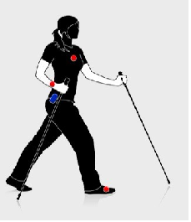
Experiments
  Activity Recognition
0.6
DTW-D
0.5
DTW
0.4
Accuracy of classifier
0.3
ED
0.2
0.1
0
10
20
30
40
50
60
70
80
90
100
Number of labeled objects in P
Dataset: Pamap dataset[1] (9 subjects performing 18 activities)
Positive class: vacuum cleaning
Negative class: Other activities
[1] PAMAP, Physical Activity Monitoring for Aging People, www.pamap.org/demo.html , retrieved 2012-05-12.

Slide 29
Conclusions
We have introduced a simple idea that dramatically improves the quality of SSL in time series domains
Advantages:
  Parameter free
  Allow use of existing SSL algorithm. Only a single line of code needs to be changed.
Future work:
  revisiting the stopping criteria issue
  consider other avenues where DTW-D may be useful

Slide 30
Questions?
Thank you!
Contact
Author: Yanping Chen
Email: ychen053@ucr.edu

Slide 31
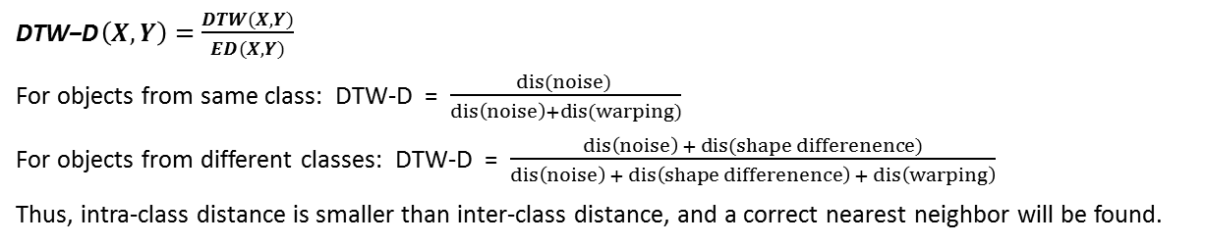
Why DTW-D works?
Objects from same class:
Objects from different classes:
distance from:
warping
noise
shape difference
warping
noise
ED =
warping
+
noise
ED =
shape difference
+
warping
+
noise
DTW =
noise
DTW =
shape difference
+
noise
$\text{DTW}\text{−}\text{D}\left(X,Y\right)=\frac{DTW(X,Y)}{ED(X,Y)}$
For objects from same class: DTW-D = $\frac{dis(noise) }{dis\left(noise\right)+dis(warping)}$
For objects from different classes: DTW-D = $\frac{dis\left(noise\right) + dis(shape differenence)}{dis\left(noise\right) + dis\left(shape differenence\right) + dis\left(warping\right)}$
Thus, intra-class distance is smaller than inter-class distance, and a correct nearest neighbor will be found.

Slide 32
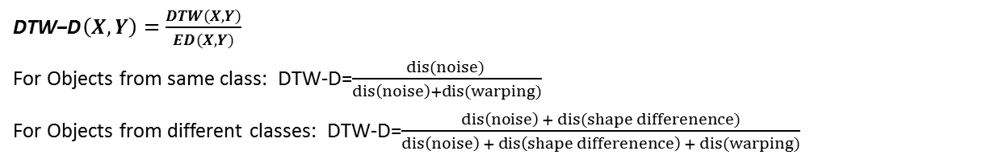
Why DTW-D works?
Objects from same class:
Objects from different classes:
distance includes:
warping
noise
shape difference
warping
noise
ED =
warping
+
noise
ED =
shape difference
+
warping
+
noise
DTW =
noise
DTW =
shape difference
+
noise
$\text{DTW}\text{−}\text{D}\left(X,Y\right)=\frac{DTW(X,Y)}{ED(X,Y)}$
For Objects from same class: DTW-D=$\frac{dis(noise) }{dis\left(noise\right)+dis(warping)}$
For Objects from different classes: DTW-D=$\frac{dis\left(noise\right) + dis(shape differenence)}{dis\left(noise\right) + dis\left(shape differenence\right) + dis(warping)}$

Slide 33
DTW-D and Classification
DTW-D helps SSL, because:
small amounts of labeled data
negative class is typically diverse and contains low-complexity data
Even an occasional false positive is lethal for any SSL algorithm
DTW-D is not expected to help the classic classification problem:
large set of labeled training data
no class with much lower complexity data, and/or much higher diversity than
other class
a few misclassifications do NOT hurt classification accuracy much

Slide 34
Are the assumptions commonly true in real word?
  Assumption1: There are warping in the positive class
    Most real world signals are not perfectly aligned in time.
    Walking patterns:
    Walk slowly or quickly
    Accelerations or decelerations in one observation
  We don’t expect two observations to be perfectly aligned. The variations in time and speed results in the warping in data.
Assumption2: The negative class is diverse
  Walking patterns: limited way to ‘walk’, but unlimited way to be ‘not walking’
  Audio: limited way to sound like a mosquito wingbeat, but unlimited ways to be not like a mosquito wingbeat.
Notes:
Speech analysis:
some people speaks faster, some slower
even a same person may have different accelerations in two pronunciations

Slide 35
Why DTW-D works?
Intra-class comparison:
  Same model, so objects are all the same without noise
  In reality, they are corrupted by warping + noise.
  ED = dis(warping) + dis(noise); DTW = dis(noise);
  Dis(warping) occupies a big portion, DTW<< ED.
Inter-class comparison:
  ED = dis(model difference) + dis(warping) + dis(noise);
  DTW = dis(model difference) + dis(noise);
  2. DTW < ED, but not <<. So do not change much.

Slide 36
Why is DTW-D better?
1
DTW-D
1
DTW-D
Accuracy
DTW
0.6
0.5
0.2
0
ED
0
100
200
300
400
0
100
200
300
400
Number of labeled objects in P
top) Helps training: Use DTW-D/DTW(DTW-D/ED) for selecting training objects, but use the same distance metric DTW(ED) for testing.
1
DTW-D
1
DTW-D
Accuracy
0.6
DTW
0.5
0.2
ED
0
0
100
200
300
400
0
100
200
300
400
Number of labeled objects in P
bottom) Helps testing: use the same distance metric DTW(ED) for selecting training objects, but use different distance metrics DTW-D/DTW (DTW-D/ED) for testing.

Slide 37
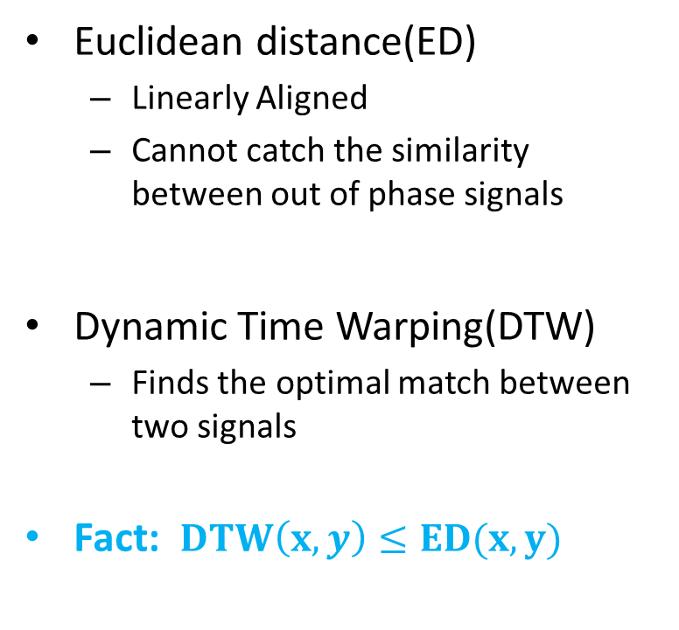
ED and DTW
Euclidean distance(ED)
  Linearly Aligned
  Cannot catch the similarity between out of phase signals
Dynamic Time Warping(DTW)
  Finds the optimal match between two signals
  Fact: $DTW\left(x,y\right)≤ED(x,y)$
Notes:
Because our whole idea is based on ED and DTW, so I’ll spend a little time talking about these two.

Slide 39
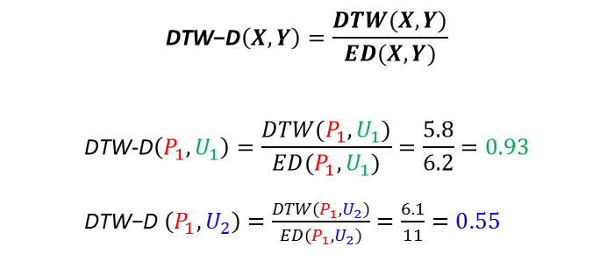
Our Observation
ED
U₂
U₁
1
P₁
P₁
$$\text{DTW}\text{−}\text{D}\left(X,Y\right)=\frac{DTW(X,Y)}{ED(X,Y)}$$
$$\text{DTW}\text{−}\text{D}\left(P_{1},U_{1}\right)=\frac{DTW(P_{1},U_{1})}{ED(P_{1},U_{1})}=\frac{5.8}{6.2}=0.93$$
$\text{DTW}\text{−}\text{D}$ $\left(P_{1},U_{2}\right)=\frac{DTW(P_{1},U_{2})}{ED(P_{1},U_{2})}=\frac{6.1}{11}=0.55$
ED(P₁, U₁) = 6.2 ED(P₁, U₂) = 11
Under the DTW-Delta ratio:
0
P₁
P
1
U₁
DTW
0
U₂
U
U₁
U₂
P₁
P₁
DTW(P₁, U₁) = 5.8 DTW(P₁, U₂) = 6.1

