Slide 1
Fast Shapelets: All Figures in Higher Resolution

Slide 2
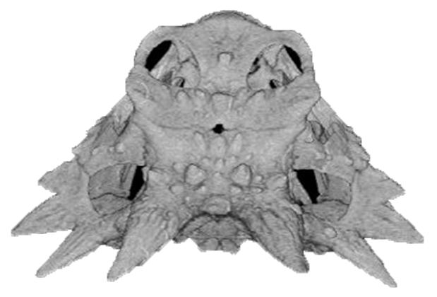
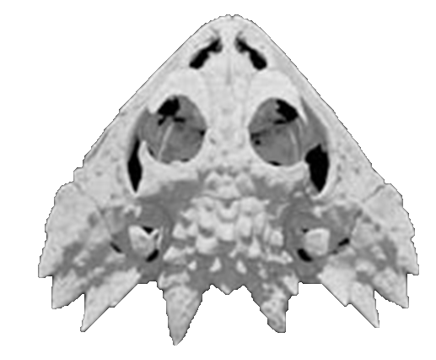
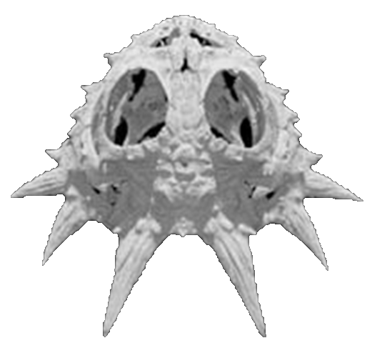
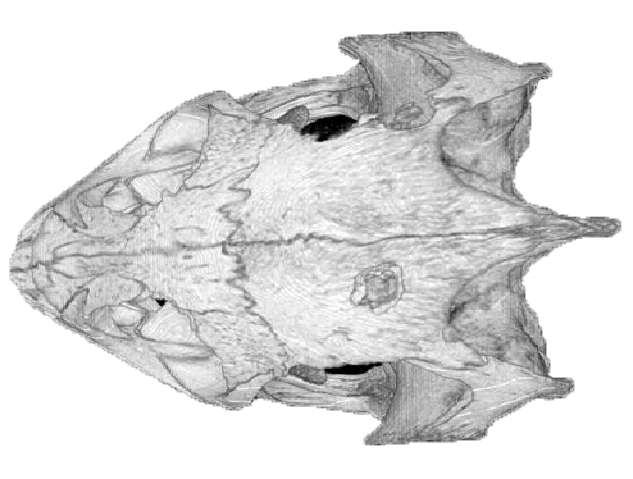
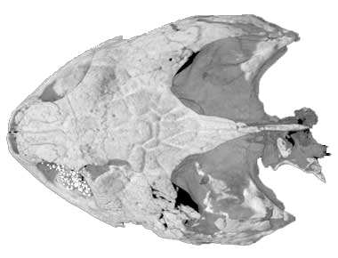
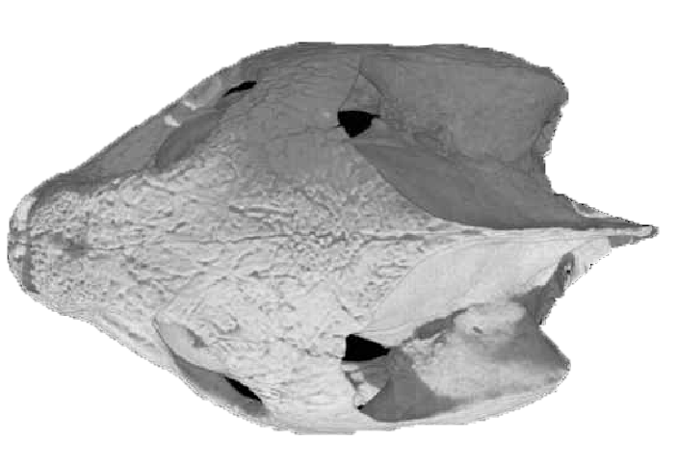
0
200
400
600
800
1000
1200
1400
Figure 1: left) Skulls of horned lizards and turtles. right) the time series representing the images. The 2D shapes are converted to time series using the technique in [14]

Slide 3
0
200
400
600
800
1000
1200
1400
Figure: Time series of two skulls of horned lizards

Slide 4
Figure 2: left) The shapelet that best distinguishes between skulls of horned lizards and turtles, shown as the purple/bold subsequence. right) The shapelet projected back to the original 2D shape space

Slide 5
split
0
Orderline
∞
candidate
Figure 3: The orderline shows the distance between the candidate subsequence and all time series as positions on the x-axis. The three objects on the left hand side of the line correspond to horned lizards and the three objects on the right correspond to turtles

Slide 6
a
a
0.67
b
c
0
c
-0.67
d
a
a
0.67
c
0
b
d
-067
c
another example of a SAX word
Figure 4: top.left) The SAX word adbacc created from a subsequence of the time series corresponding to P. coronatum. bottom) sliding window technique

Slide 7
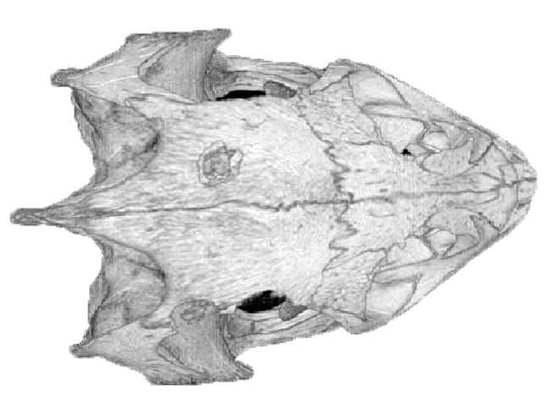
SAX Words
1st Random Mask
2nd Random Mask
Obj 1
Obj 2
Obj 3
Figure 5: left) SAX words of each object. right) SAX words after masking two symbols. Note that masking positions are randomly picked

Slide 8
A)
ID
Signatures
Object List
Obj 1
Obj 2
Obj 3
Obj 1
1
2
1
3
Obj 2
2
2
Obj 3
3
B)
ID
Signatures
Object List
Obj 1
Obj 2
Obj 3
Obj 1
1
2
Obj 2
2
3
2
Obj 3
3
Figure 6: The first (A) and second (B) iterations of the counting process. left) Hashing process to match all same signatures. Signatures created by removing marked symbols from SAX words. right) Collision tables showing the number of matched objects by each words

Slide 9
A)
B)
C)
D)
Class1
Class2
Close to Ref
Far from Ref
Distinguishing Power
Obj 1
Obj 2
Obj 3
Obj 4
Class1
Class2
Class1
Class2
Figure 7: A) The collision table of all words after five iterations. Note that counts show the number of occurrences that an object shares a same signature with the reference word. B) Grouping counting scores from objects in the same class. C) Complement of (B) to show that how many times objects in each class that do not share the same signature with the reference word. D) The distinguishing power of each SAX word

Slide 10
Classification Accuracy Comparison
1
In this area,
SOTA is
better
Current state-of the-art
In this area,
our algorithm
is better
17 wins
15 loses
0
0
Our algorithm
1
Figure 8: Classification accuracy of our algorithm and the state-of-the-art on 32 datasets from the UCR archive

Slide 11
sec
Execution Time Comparison
3
10
2
10
1
10
Our algorithm
1X
0
10
10X
1000X
10000X
100X
-1
sec
10
0
1
2
3
4
5
10
10
10
10
10
10
Current state-of-the-art
Figure 9: Running time comparison between our algorithm and the state-of-the-art on 32 datasets from UCR time series archives

Slide 12
Scalability on Number of Time Series
Scalability on Time Series Length
x10⁴
x10³
(average from 30 runs)
3
8
state-of-the-art
state-of-the-art
2
6
seccond
seccond
4
1
2
our algorithm
our algorithm
0
0
50
100
200
300
400
500
600
700
800
50
100
200
300
400
500
600
700
800
number of time series
length of time series
Figure 10: Scalability of our algorithm and the current state-of-the-art on StarlightCurves dataset. left) Number of time series in the dataset is varying. right) The length of time series is varying

Slide 13
1.5
FN
TP
Actual Ratio
1
TN
FP
0.5
0.5
1
1.5
Expected Ratio
Figure 11: Accuracy ratio between FastShapelet algorithm and Euclidean-distance-based one nearest neighbor on all 45 datasets from UCR archives

Slide 14
(average from 30 runs)
400
Vary R
400
Vary K
Time (sec)
300
300
200
200
100
100
0
0
1
10
20
30
40
50
1
10
20
30
40
50
100
100
Accuracy (%)
80
80
60
60
40
40
20
Vary R
20
Vary K
0
0
1
10
20
30
40
50
1
10
20
30
40
50
Figure 12: bottom) The accuracy of the algorithm is not sensitive for both parameters r and k. top) The running time of the algorithm is approximately linear by either parameter. Note that when we vary r (k), we fix k (r) to ten, thus we are changing only one parameter at a time

Slide 15
Eclipsed Binaries
0
1024
RR Lyrae
Variables
Cepheids
0
1024
0
1024
Figure 13: Examples of starlight curves in three classes: Eclipsed Binaries, Cepheis, and RR Lyrae Variables

Slide 16
2
Shapelet I
I
1
0
-1
dist thres = 15.58
-2
object from RR
EB
II
0
200
400
600
800
1024
2
Shapelet II
Cep
RR
1
0
-1
dist thres = 5.79
-2
object from Cep
0
200
400
600
800
1024
Figure 14: left) Decision tree of StarlightCurve dataset created by our algorithm. right) Two shapelets shown as the red/bold part in time series

Slide 17
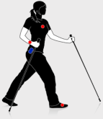
Outdoor Activities from PAMAP Dataset
Slow Walk
Normal Walk
Nordic Walk
Run
Cycle
Soccer
3
Rope
Jump
0
-3
0
200
400
600
800
1000
1100
Figure 15: Examples of all outdoor activities from PAMAP dataset. Note that the time series of each activity are generally different lengths

Slide 18
Original long time series when recorded
Time series of class1 and class 2
Shapelet shown in red/bold
4
4
0
0
-4
-4
-8
-8
dish threshold = 2.446
0
20
40
60
80
100
120
136
0
20
40
60
80
100
120
136
Figure 16: top) ECG time series when first recorded. left) Time series from two classes are very similar even hard to distinguish by eyes. right) the shaplet discovered by our algorithm shown in red/bold

